Slide 1
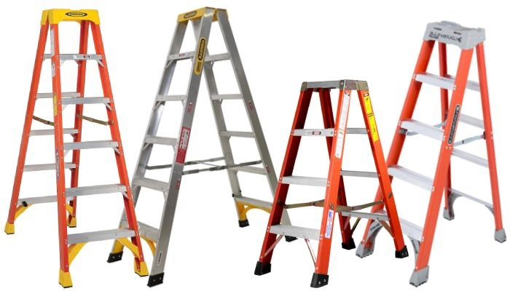
Ladder Safety
7/31/2024

Slide 2
Disclaimer
The contents of this document are intended only for the informational use of the addressee. The information contained herein is not intended as, nor does it constitute, specific legal or technical advice to the reader. Any information or recommendations contained herein are provided to the addressee for usage at their own discretion. Neither Signal Mutual Indemnity Association Ltd., its Members, Managers, or Signal Management Services, LLC and/or their employees accept liability whether in tort, negligence, contract, or otherwise, to anyone for any lack of technical skill, completeness of recommendations, or analysis of issues associated with the discussion of topics set forth herein. No responsibility is assumed for the discovery or elimination of unsafe conditions. Compliance with any recommendations herein should not assume your compliance with any federal, state, or local law or regulation. Additionally, the information contained herein does not constitute and shall not be construed to reflect the adoption of any coverage position by Signal Mutual Indemnity Association Ltd., its Members, Managers, or Signal Management Services, LLC and/or their employees.

Slide 3
Introduction
Most of our workdays are spent with our feet firmly on the ground. At ground level, our tools and work surfaces are within easy reach.
But there are times when we need access to areas beyond our reach.
Sometimes a truck with a "Lift Bucket” will be brought in to raise us to the desired height.
For long-term projects, scaffolding may be erected.
For most of us, though, working off the ground, means bringing in a ladder

Slide 4
Benefits of Ladders
When used correctly, ladders make our jobs easier and make us more efficient.
They allow us to work comfortably on surfaces that are ordinarily out of our reach.
It's hard to imagine what we'd do without them.

Slide 5
Common Ladder Hazards
Improper set-up.
Portable ladders not 3 feet above the landing surface.
Not securing the ladder correctly.
Standing on the top two steps of a stepladder.
Overreaching when working from a ladder.

Slide 6
Ladder Safety
We've got to be careful though, because of the danger of falling, and other hazards.
Using ladders incorrectly can lead to accidents that cause serious injuries.

Slide 7
Use Ladders Properly
Like your other tools, ladders should be used properly.
Before you climb, read the manufacturer's instructions for special safeguards.
There are many different kinds of ladders, but they all have things in common.
A good ladder will get you safely to the right height, providing you select the correct one for the job.

Slide 8
Choosing the Right Ladder
Before stepping onto a ladder, think about these things:
Duty rating of the ladder—what capacity can it hold?
Height of the ladder—too short or too tall?
Condition of the ladder and instructions unique to the ladder selected.

Slide 9
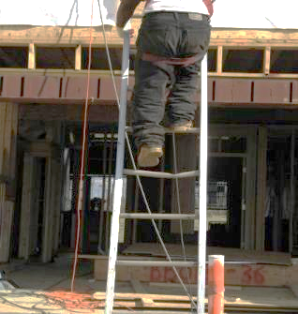
Ladder Inspections
Ladders must be inspected before each use.
Broken or weak ladders or ladders that are not stable must be marked or tagged as defective and taken out of service.
Look for cracks and weak points.
Competent person must periodically inspect ladders.

Slide 10
Ladder Inspections

Slide 11
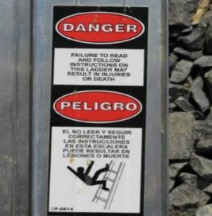
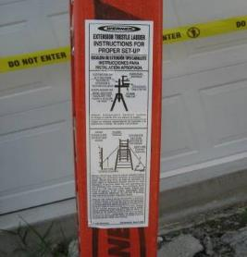
Review the Safety Labels

Slide 12
Ladder Weight Capacities
Different types of ladders are built with different weight capacities in mind.
Ladders shall not be loaded beyond the maximum intended load for which they were built nor beyond their manufacturer's rated capacity.
Read the manufacturer's instructions to ensure the type of ladder you're using will support the weight you'll be putting on it.
This includes yourself and any tools/equipment

Slide 14
Stepladders
Only use in the fully open position on firm, level ground.
Do not use a Stepladder that is folded or in a leaning position.
Never sit/stand on the top two rungs.
Consider work height when selecting a Stepladder.

Slide 15
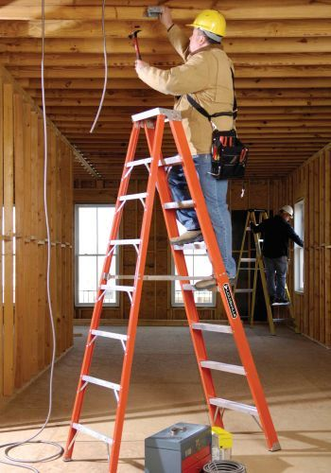
Stepladders
Stepladders are designed for use in an opened-and-locked position.

Slide 16
Stepladders
Do NOT use a stepladder that is folded or in a leaning position.

Slide 17
Proper Height of Stepladders
Maximum Height You Need to Reach | Stepladder Height
7 | 3
8 | 4
9 | 5
10 | 6
12 | 8
14 | 10
15 | 11
16 | 12
18 | 14
20 | 16
Choose a stepladder no more than 4 feet shorter than the height you want to reach.

Slide 18
Extension Ladders
Consider the placement and pitch of the ladder.
Secure and stabilize the ladder.

Slide 19
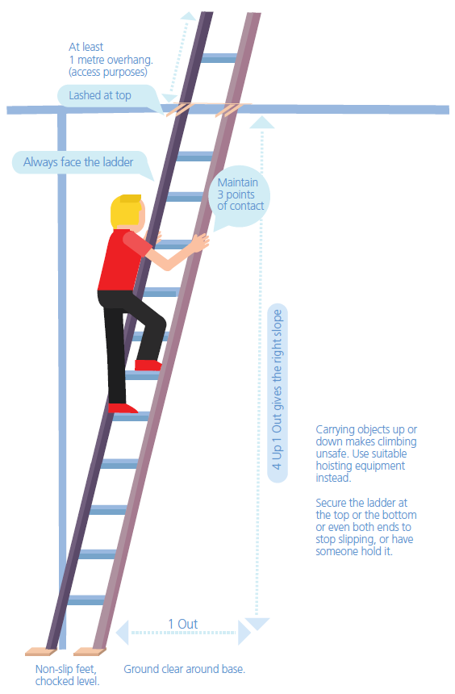
Extension Ladders
Extension ladders should be used at a 4 to 1 pitch (1.2 to .3 m).
For every 4 ft. (1.2 m) in height, the bottom of the ladder should be 1 ft. (.3 m) away from the structure.
Ex.: 20 ft. (height) ÷ 4 ft. = 5 ft. pitch

Slide 20
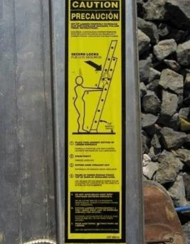
Extension Ladders

Slide 21
Extension Ladders
When accessing another level, the ladder must extend at least 3ft. (0.9m) above the landing to provide a handhold for getting on and off the ladder.
Extension ladders should not be separated to create 2 ladders.

Slide 22
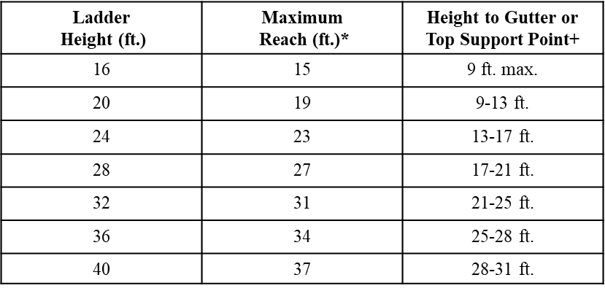
Proper Height for Extension Ladders
Choose the right ladder for the height you need to work.
*Assume a 5 ft.-6 in. person with a vertical reach of 12 in.
+Support points for extension ladders reflect section overlap, ladder angle, or 3-ft. extension above the roof line

Slide 23
Secure and Stabilize Ladders
Extension ladders should be secured at the top or bottom to prevent movement.
The base of an extension ladder must be secured in place by using the safety feet on the ladder or other effective means.
For extension ladders to give you the proper support, they should be tall enough so that there is at least a three-rung overlap between the two sections of the ladder.

Slide 24
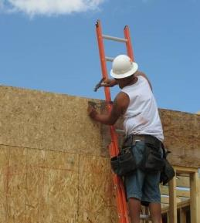
Secure and Stabilize Ladders

Slide 25
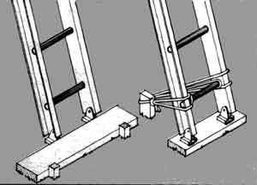
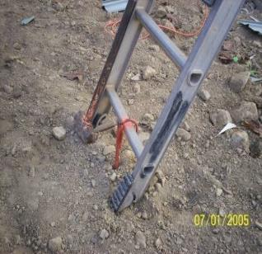
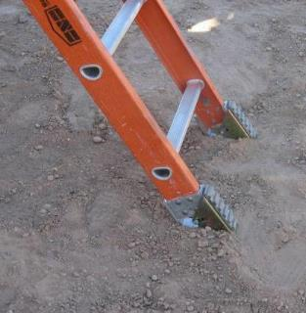
Secure and Stabilize Ladders

Slide 26
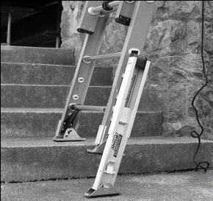
Secure and Stabilize Ladders

Slide 27
Straight Ladders
If you're using a straight ladder to reach a roof or platform, it should be tall enough so that the top three rungs of the ladder extend beyond the roof edge or support point.
This will keep the ladder stable while you're on it.

Slide 28
Permanently Fixed Ladders
Before climbing a ladder that is permanently fixed in place, make sure that all the rungs are securely attached and that there is no rust or corrosion on the safety cage or the rungs themselves.

Slide 29
Ladder Working Condition
Many accidents occur when workers fail to notice problems that have developed with their ladders.
Becoming familiar with the parts that make up the ladder will allow you to be more aware of their working condition.
The rungs, for instance, should be firm and unbroken.

Slide 30
Ladder Working Condition
To provide a stable base that prevents slipping, ladders should have sturdy, non-slip safety feet.
Make sure that the ropes, pulleys, and other moving parts on extension ladders are in good working condition.
To further secure the legs of a stepladder, make sure that the spreader is locked into position before climbing.
Stepladders should also have braces to keep the rails, or side supports, from swaying.

Slide 31
Setting Up a Ladder
When setting up the ladder, make sure to secure the legs.
Place them on a level surface and keep the area around the base of the ladder clear of debris.
The rails of the ladder should be perpendicular to the ground.
In cases where the ground is uneven, shore up the legs with boards.
If the ground is soft, placing wide boards under the feet of the ladder will keep it steady.
If you must place a ladder in front of a door, block or lock the door so no one can come through it while you're working.
Avoid setting up ladders in high-traffic areas or barricade the area around the ladder.

Slide 32
Moving a Ladder
If you're moving a ladder, carry it horizontally and keep the load at your side.
This will keep the ladder from throwing you off balance, making it easier to carry.
Remember, if you can't easily carry the ladder by yourself, don't risk an accident. Get help.

Slide 33
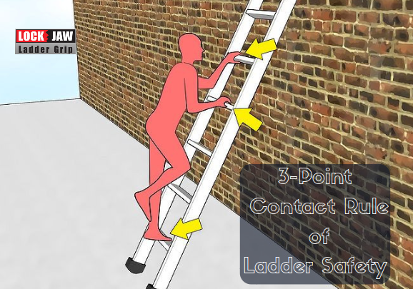
Climbing a Ladder Safely
Get a good grip on the ladder. Make sure your shoes, hands, and the rungs of the ladder are dry and free of oil or other slippery substances.
Be sure to check them before you climb.
When climbing, follow the rules of the "3-Point Climb."
Try to always keep two hands and a foot or one hand and two feet in contact with the ladder.
When possible, use the buddy system.
Someone holds the bottom of the ladder, so it won't slip.
This person will also make sure that no one bumps into the ladder while you're working.

Slide 34
Maintain a Safe Position
Face the ladder when ascending or descending.
Maintain 3 points of contact at all times.
Keep your body centered on the ladder.
Never let your belt buckle pass either side rail.

Slide 35
When Not to Climb a Ladder
Avoid using metal ladders when working near power lines, electrical wiring, or machinery.
If a metal ladder contacts an uninsulated power source, it will conduct the electricity straight to your body ... causing electric shock.
If you're working around electricity, choose a non-conducting fiberglass or wooden ladder.
Don't climb ladders in poor weather conditions. Rain and wind can make climbing dangerous.
Fear of heights.
Don't climb ladders if you're ill or under medication that makes you drowsy.
You can easily lose your balance if you're not feeling right.

Slide 36
Avoid the Top Steps of the Ladder
Standing too close to the top of a ladder can cause you to lose your balance and lead to a fall.
Do not stand on the top 4 rungs of an extension ladder or the top 2 steps of a stepladder.
If a bigger ladder is called for, then get one.

Slide 37
Additional Safe Work Practices
Always face the front of the ladder and never rush.
Keep your hands on the side rails, and don't try to slide down or jump off the ladder when you're finished.
To avoid falling accidents while working on ladders, keep your weight centered between the rails.
If you’re alone on the job, tie off the ladder securely and set up hazard signs to keep people from bumping into the ladder.

Slide 38
One Person at a Time
Never work with more than one person on a ladder.
Too much stress can weaken the ladder over time, and another person's movements can throw you off balance.
This also goes for stepladders. Don't have one person stand on the backside to help the person on the front of the ladder …
Unless the stepladder is a specially built “two-person" ladder.

Slide 39
Tools and Materials
Hoisting up tools or materials while you're climbing can be dangerous.
Wear a tool belt and pull materials up to you after you've reached the top.
Fasten containers or tool holders to your ladder to hold supplies or tools.
Falling objects are dangerous to those working below.
Watch out for people underneath you and use extreme care when handling tools and materials.

Slide 40
When Finished Working with a Ladder
Don't leave a raised ladder unattended.
Once you're finished with a ladder, make sure it is secured and stored it in a safe, dry space.

Slide 41
Falling off a Ladder
If you suffer a fall, knowing how to fall the right way can prevent serious injuries.
Tense muscles will heighten the severity of any injury, so it's important to relax your muscles when you fall.
Absorb the concussion by bending your arms and legs.
This allows them to act as shock absorbers, or springs, when you hit the ground.
Roll with the direction of the fall to further absorb the shock.

Slide 42
First Aid for Fall Victims
If someone has fallen, there may be broken bones, a concussion, or even damage to the spinal column.
Do not move the person unless they are in an area of extreme danger.
Movement will only make these injuries worse.
Call for medical help immediately.
While you wait for help to arrive, monitor the victim's breathing and work to stop any bleeding.
Be prepared; in some cases, the victim may go into shock.

Slide 43
What’s Wrong Here?

Slide 44
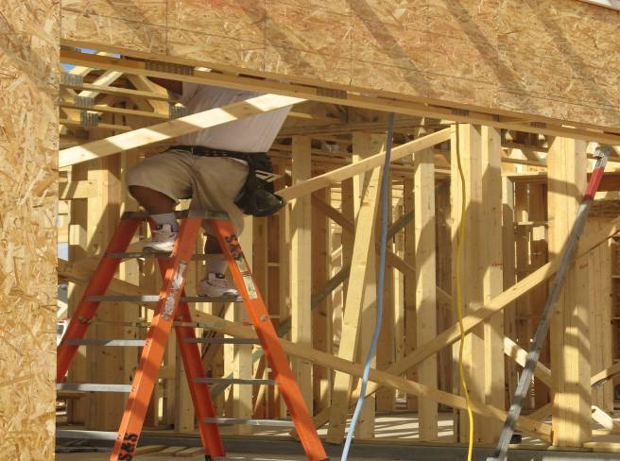
Notes:
This worker should use a taller stepladder to reach his task. He is not using the top two steps/rungs, but he is using the backside of the ladder to increase his reach. The back side of a stepladder is not permitted for use unless designed for such use.

Slide 45
Notes:
Although no one is using the ladder, the metal spreader is not in the fully opened position.

Slide 46
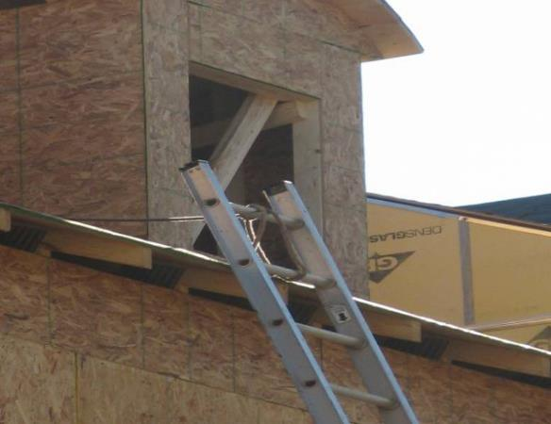
Notes:
This ladder is not positioned properly. When extension ladders are being used to access another level, they must extend at least 3 feet beyond the landing surface to provide a handhold for getting on and off the ladder.

Slide 47
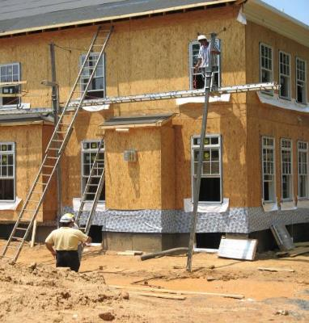
Notes:
The ladder is set up at an incorrect angle to provide access to the scaffold. The scaffolding is also set up incorrectly.

Slide 48
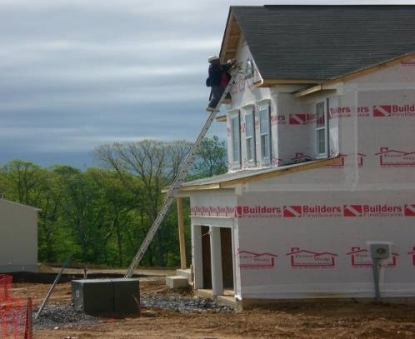

Slide 49
Review
Pick the right ladder for the job and test it before each use.
Set up your ladder accordingly.
Always stay inside the rails, and never lean out or back at an angle.
And, if an accident occurs, be prepared to act.

Slide 50
Questions?

