Slide 1
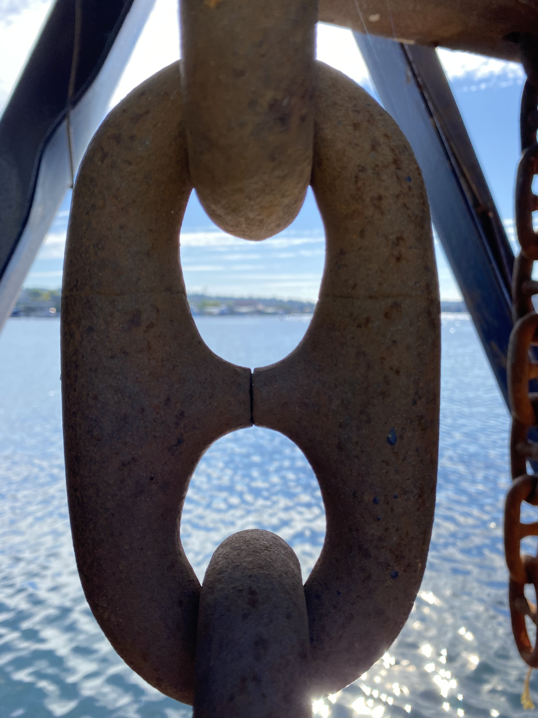

Signal Safety
Pacific NW Regional
member forum
A virtual meeting
to network and learn
Presented via MSTeams
Thursday, October 7th, 2021
9:30 - 11:30 AM Pacific

Slide 2
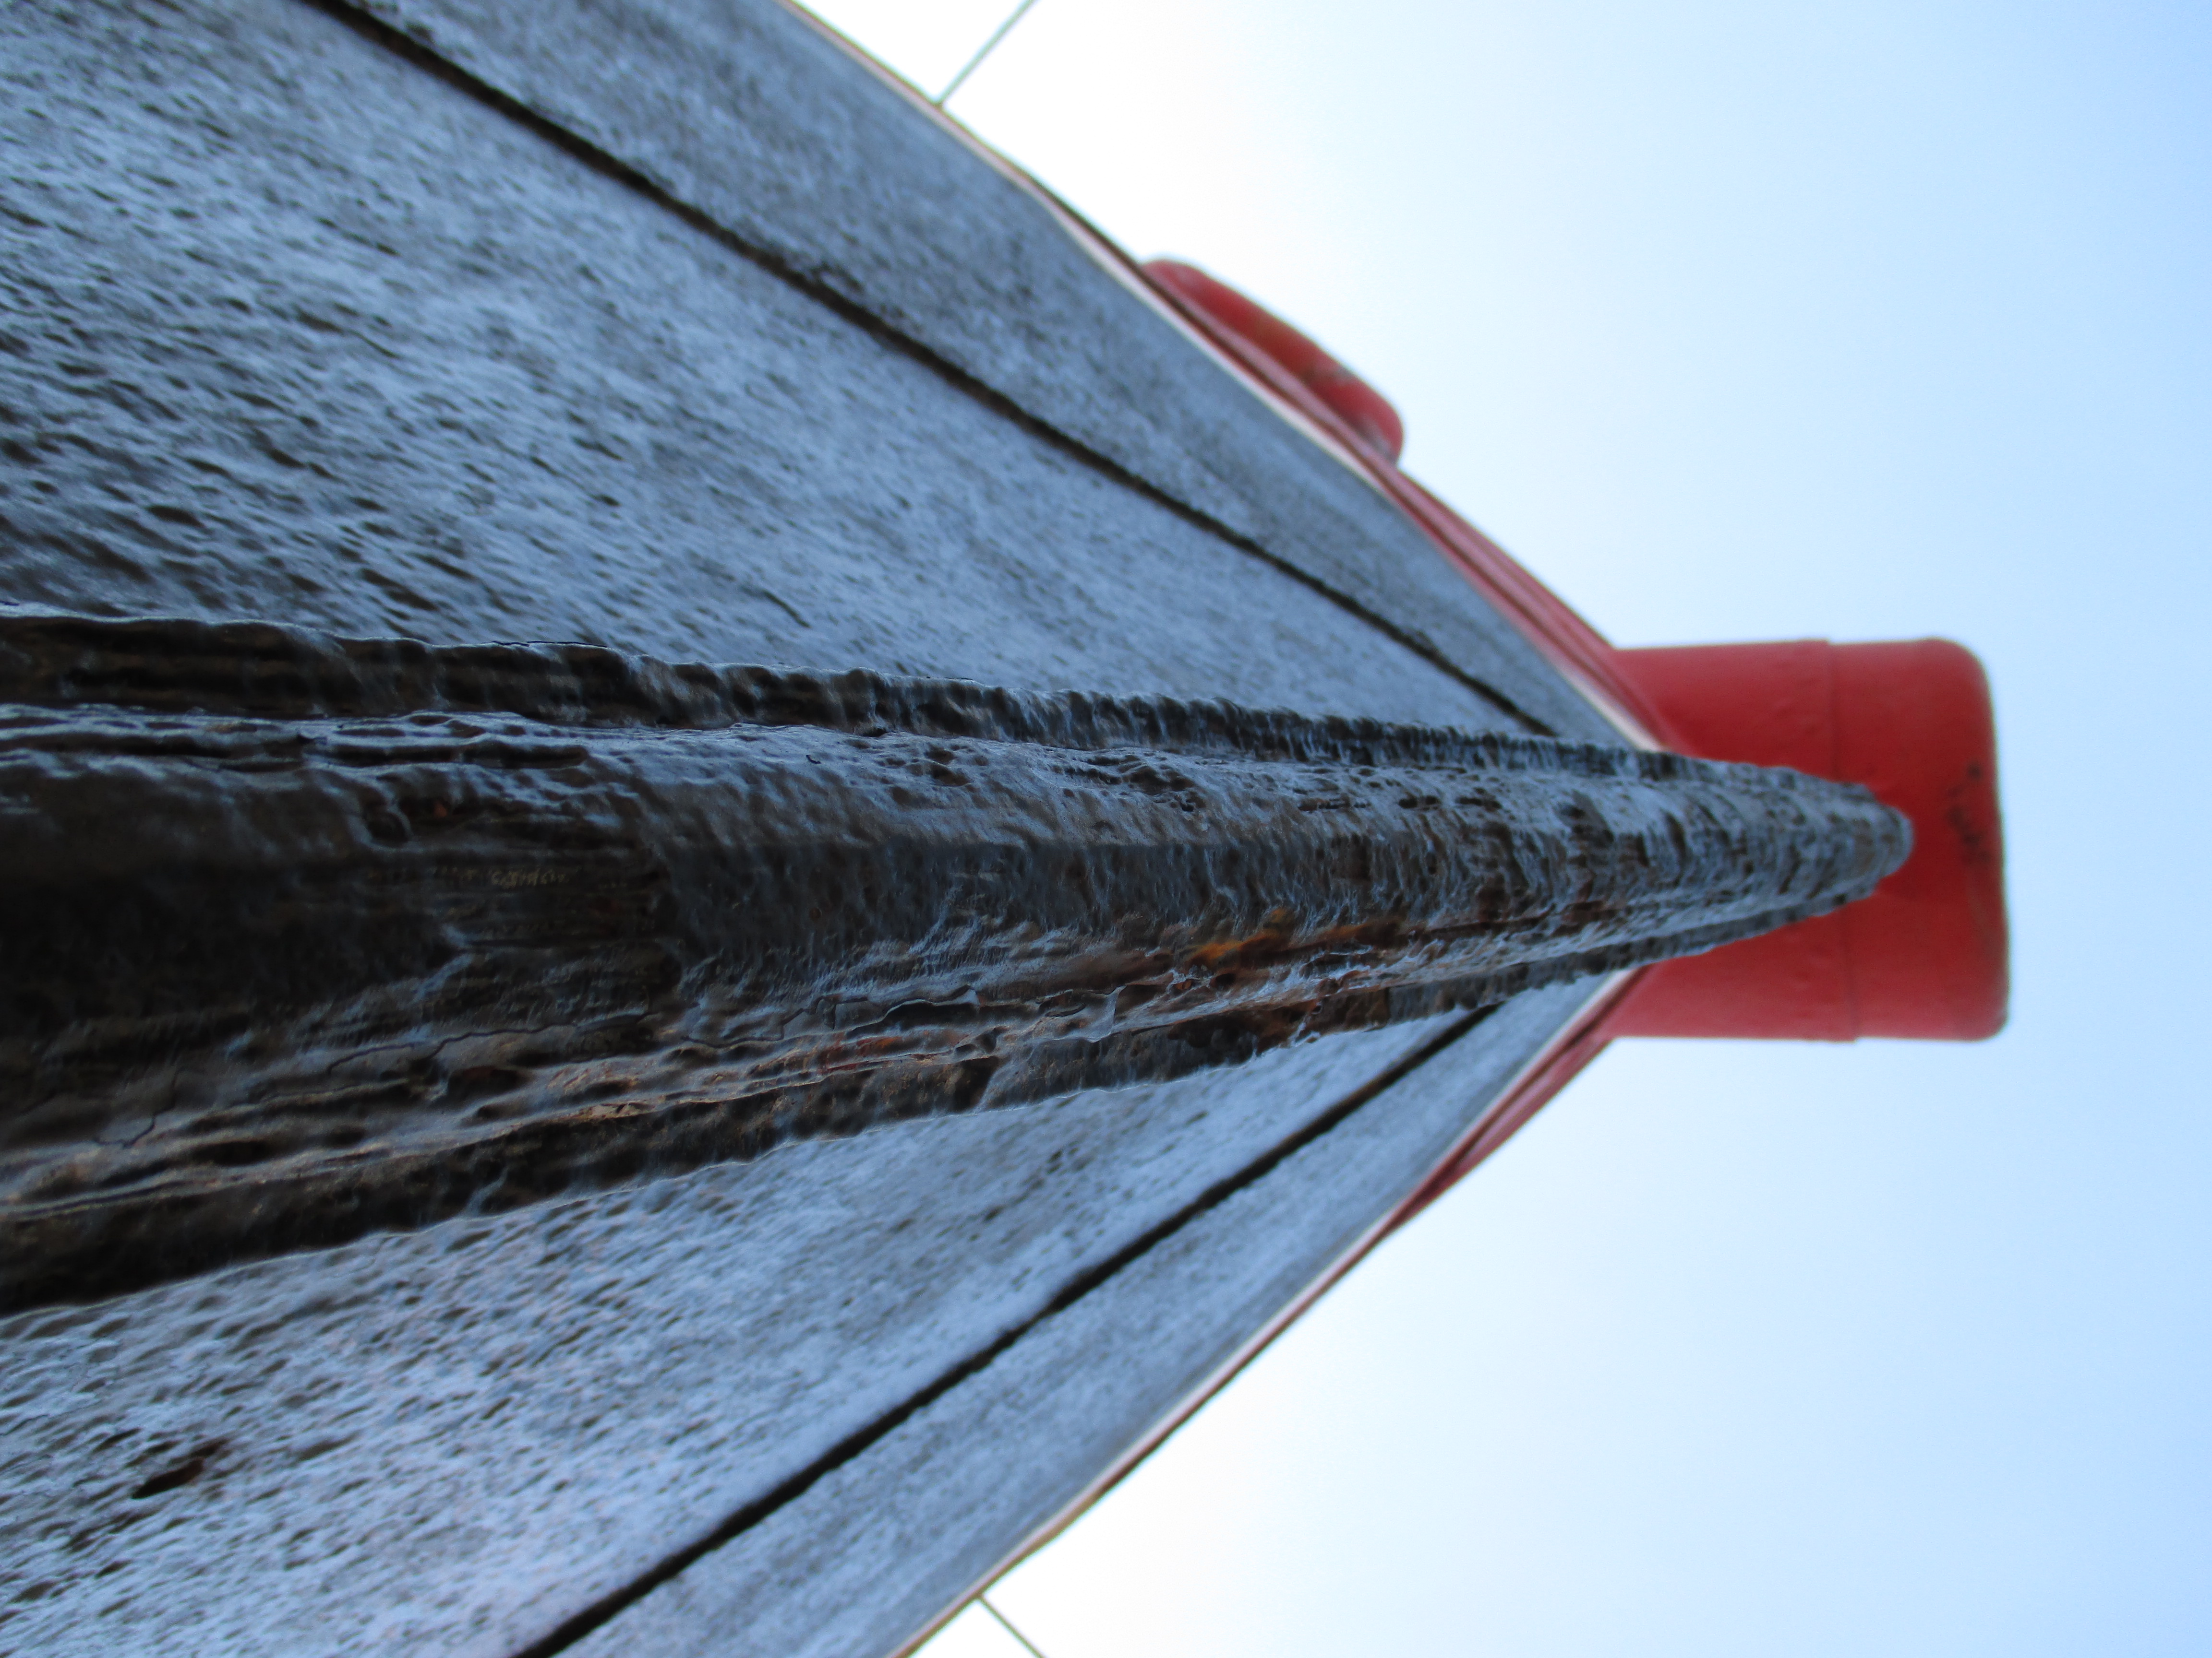

Member Forum Agenda
Welcome & Introductions:
Opening Comments Purpose and Format
  Member-to-Member Solutions
  Meeting Frequency
Signal Safety Annual General Meeting recap
Ship Access/Gangway use
Longshore safety training for one day calls
State mandated cold weather requirements
Elevator bucket Maintenance
COVID-19 Current Actions and Directions in the PNW
Signal Mutual’s Safety Committee
Topics for the Next PNW Safety Forums (December and March)

Slide 3
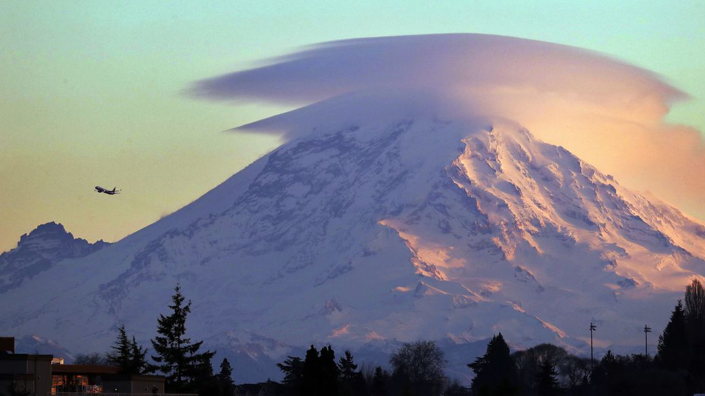

Signal Safety – Annual General Meeting
Overview
Supervisor Safety Leadership
Executive Safety Leadership
Leadership Engagement Panel
  Executives were invited to discuss engagement with the present members. Video may be forthcoming.

Slide 4
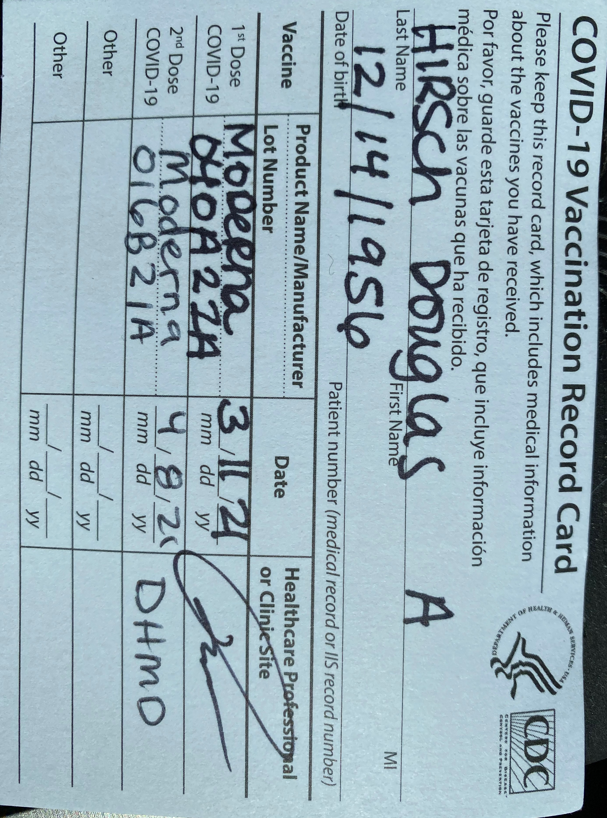
COVID-19 18 months later
Vaccinations %
Facial Coverings
Temperature Checks
Social Distancing
Current actions and directions in the PNW
Notes:
As of 6 a.m. EDT Aug. 31, a total of 174,121,529 Americans had been fully vaccinated, or 52.4 percent of the country's population, according to the CDC's data.
60.17% of the Washington Population
58.6% of the Oregon Population.
https://www.beckershospitalreview.com/public-health/states-ranked-by-percentage-of-population-vaccinated-march-15.html
Mask Mandates are back with the increase of community spread with the Delta Variant.

Slide 5
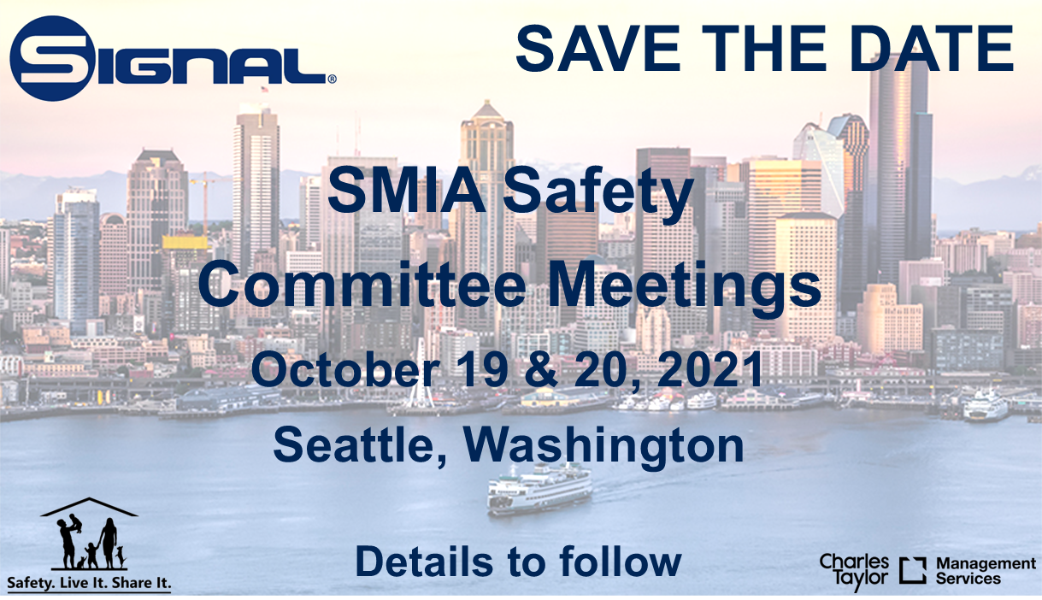
Notes:
Addition of a new sub committee for Energy and Construction.

Slide 6
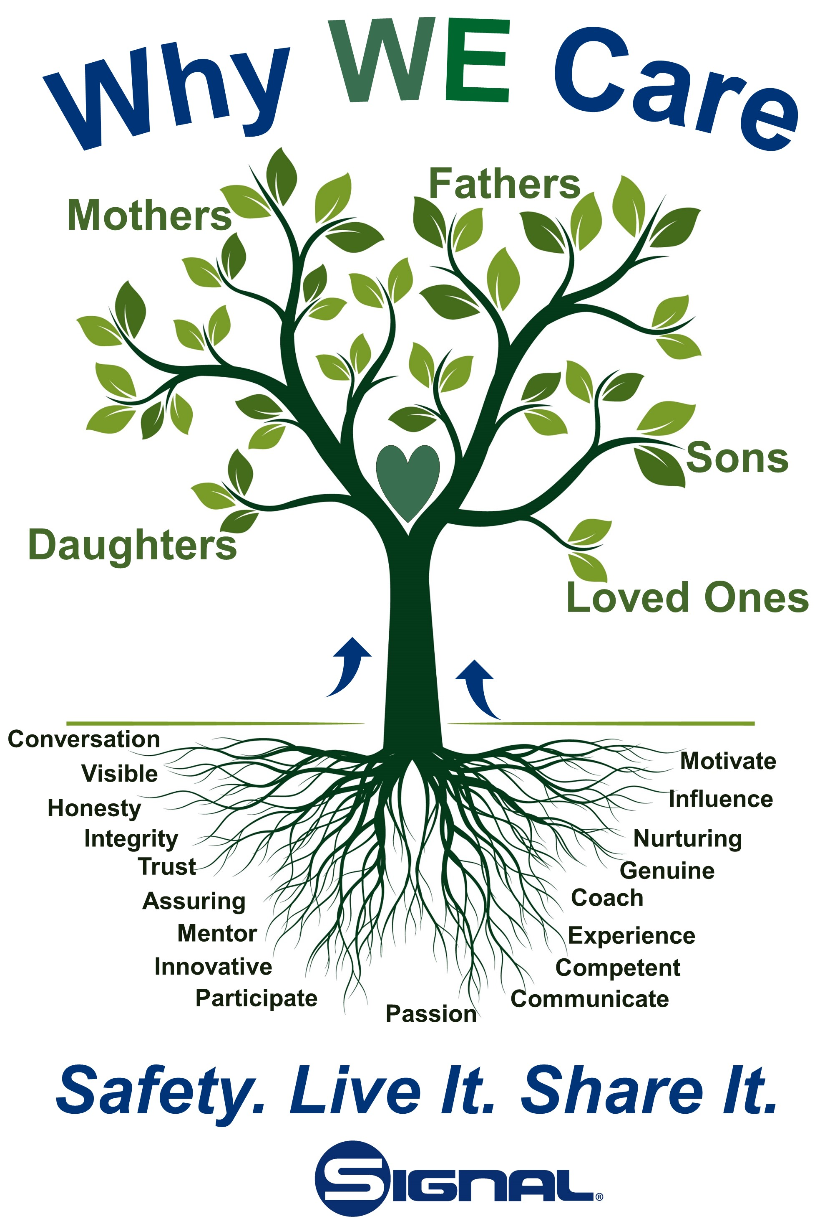
“OpenMic”
  Member-to-Member Solutions
Topics & Dates for the Next Roundtable Meeting
  December 7th
  March 7th

Slide 7




Thank You
Bob Dearing
360.662.0862
Robert.Dearing@signal-ct.com
www.signalmutual.com

