Slide 1
This is a Template for Member use and is intended to be customized by the end user with jobsite specific hazards, policies, procedures, and pictures/videos

Slide 2
Barge Access
MCODED

Slide 3
DISCLAIMER: The contents of this document are intended only for the informational use of the addressee. The information contained herein is not intended as, nor does it constitute, specific legal or technical advice to the reader. Any information or recommendations contained herein are provided to the addressee for usage at their own discretion. Neither Signal Mutual Indemnity Association Ltd., its Members, Managers, or Signal Management Services, LLC and/or their employees accept liability, whether in tort, negligence, contract, or otherwise, to anyone for any lack of technical skill, completeness of recommendations, or analysis of issues associated with the discussion of topics set forth herein. No responsibility is assumed for the discovery or elimination of unsafe conditions. Compliance with any recommendations herein should not assume your compliance with any federal, state, or local law or regulation. Additionally, the information contained herein does not constitute and shall not be construed to reflect the adoption of any coverage position by Signal Mutual Indemnity Association Ltd., its Members, Managers, or Signal Management Services, LLC and/or their employees.

Slide 4
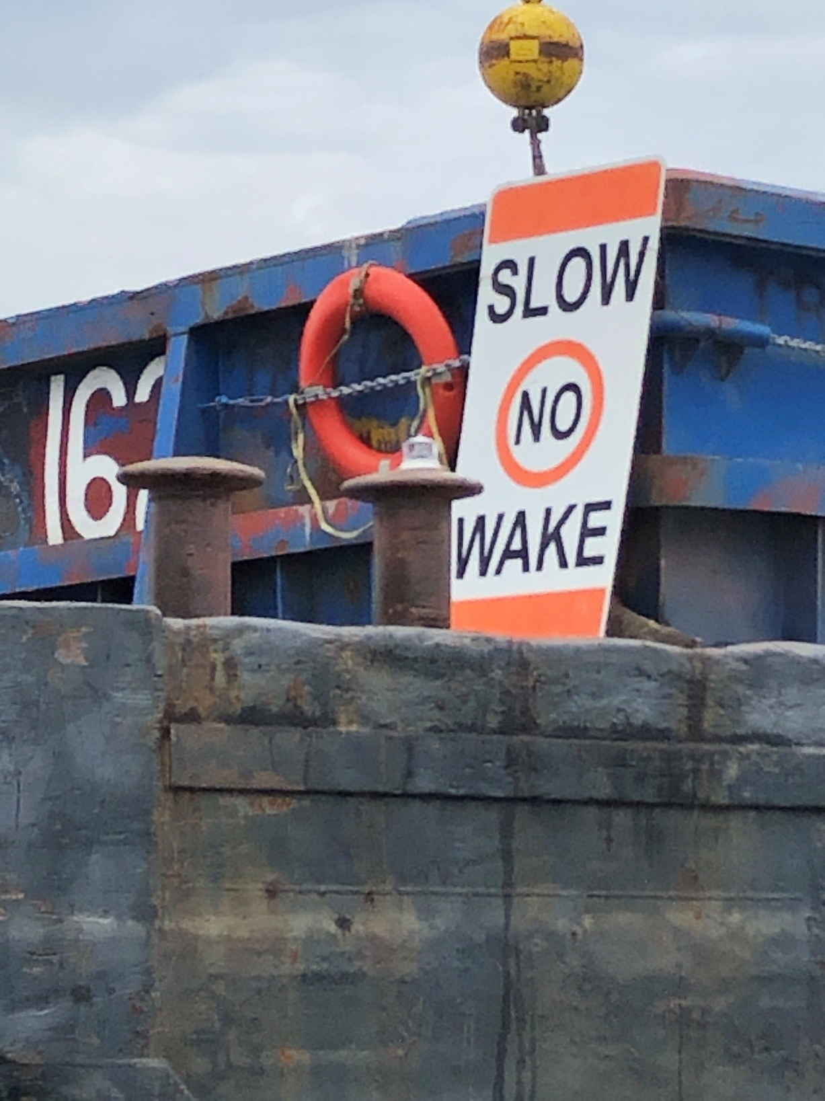
Marine Construction
Due to the specialized nature and location of our work, gangway & walkway systems are critical to the safety of our employees, subcontractors, inspectors, and visitors as well as to the efficiency of building our jobs. With barges and gangways in constant motion on the water due to changing tides, listing of barges, vessel traffic and current, the selection, installation and maintenance of gangway systems is essential when providing safe access to and from barges, and to other work areas on the water including but not limited to false work members and waterfront structures.

Slide 5
GANGWAYS

Slide 6
The employer must provide, and ensure each employee uses, a safe means of access and egress to and from walking-working surfaces. 1910.22(c)
In providing a safe place of work, one must not overlook the importance of providing and maintaining safe access to and egress from the work areas. Very often, a risk assessment or Job Hazard Analysis (JHA) is critical during the planning stage with all the details put down methodically in a work plan process – size of gangways, float stages, ladders, stairways and steps, ramps, etc.

Slide 7
Accessing a Barge can raise some unique challenges, not only because of the constant motion and the changing tides.
Barge access can become difficult due to deck configuration
Materials and Equipment on the Barge
Operational space for loading and unloading materials
Working Area

Slide 8
Transitioning from land or fixed structures to water rigs and vessels as well as float stages and others. Can cause specific hazards:
• Involve ladders, gangways and temporary platforms or falsework.
• Performing tasks near the edge of barges with obstructed areas or stored energy such as hydraulic hoses
• Others – Slip & Trip (underfoot hazards), caught between and equipment struck by incidents

Slide 9
Personnel must board vessels safely using approved boarding devices. Movement of the floating vessel can cause movement of the boarding device, thus increasing the possibility of workers falling or being injured by a moving device.
Potential Hazards
Workers being injured when boarding a barge
Workers falling off the gangways or ladders to a lower level or into the water
Structural failure of a gangway or ladder causing the worker to fall to a lower level or into the water
Movement of the gangway or ladder resulting in injuries
Workers being struck by moving material or cargo loads
Damaged gangway or ladder from tidal changes

Slide 10
OSHA 1926 Does Not Address Gangways or Barge Access.. …. When employees cannot step safely to or from the wharf and a float, barge, or river towboat, either a ramp meeting the requirements of paragraph (a) of this section or a safe walkway meeting the requirements of § 1918.22(f) shall be provided. When a ramp or walkway cannot be used, a straight ladder meeting the requirements of § 1918.24 and extending at least three feet (.91 m) above the upper landing surface and adequately secured or held against shifting or slipping shall be provided. When neither a walkway nor a straight ladder can be used, a Jacob's ladder meeting the requirements of § 1918.23 shall be provided. Exception: For barges operating on the Mississippi River System, where the employer shows that these requirements cannot reasonably be met due to local conditions, other safe means of access shall be provided. 1918.26(b)

Slide 11
Gangway secured to Pier
Divers Access Ladder

Slide 12
After the gangway has been secured, and before each use:
Check for Cleanliness on the gangway, and in the area of the gangway
Inspect the gangway for faults and damage daily prior to use
Inspect moving parts
Inspect securing devices
Signs are posted for PPE that is Required
A Fire Extinguisher is available
A Life Ring and Throw Bag are available on land and on the barge located near the gangway

Slide 13
Whenever practicable, a gangway of not less than 20 inches (.51 m) in width, of adequate strength, maintained in safe repair and safely secured shall be used. Gangways shall be of adequate strength and designed by a qualified person capable of supporting, without failure, its own weight and at least 4 times the maximum intended load applied to it. 1915.74(a)(1)

Slide 14
Gangways shall be installed in such a manner that employees are protected from being struck by cranes, excavators, aerial lifts and other mobile equipment.

Slide 15
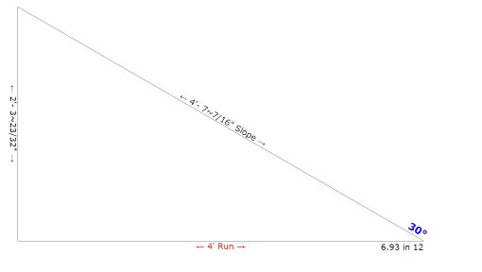
No ramp, gangway or walkway shall be inclined more than 30 degrees above the horizontal. Plan for tidal changes and barge unloading activities when selecting gangway sizes

Slide 16
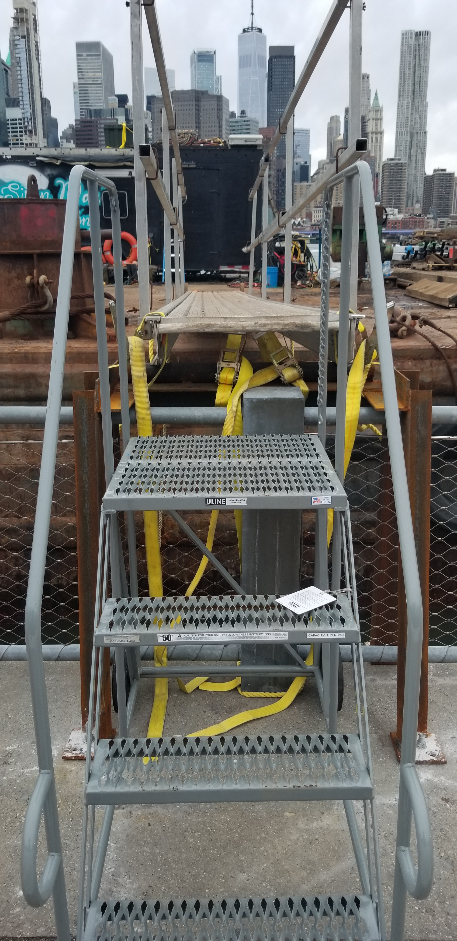
Each side of the gangway, shall have a handrail with a minimum height of 33 inches (.84 m) measured perpendicularly from rail to walking surfaces at the stanchion, with a midrail. Rails shall be of wood, pipe, chain, wire, rope or materials of equivalent strength and shall be kept taut always. Rails shall be surfaced to prevent injury to an employee from punctures or lacerations, and to prevent snagging of clothing.
Stairway over fencing on Pier to Gangway

Slide 17
Gangways should be secured to the structure they are providing access to. This typically involves securing the top end of the gangway at all times while in use. Rising and falling tides can cause gangways to shift making them unsafe. Monitor walkways frequently and make adjustments as needed to ensure a minimum of 6” bearing is maintained and/or secured from accidental displacement. Gangway rollers or similar should be installed to the non-secured end of the gangway frame to allow the gangway to move freely as the tide conditions fluctuate.
Gangway Rollers

Slide 18
Portable stanchions supporting railings shall be supported or secured to prevent accidental dislodgement. Ensure handrails and perimeter protection is installed where needed or required
Even when properly installed, never lean on guardrails
If the foot of a gangway is more than one foot away from the edge of the apron, the space between them shall be bridged by a firm walkway equipped with a handrail with a minimum height of approximately 33 inches with midrails on both sides.
Avoid, under any circumstances, “bridging the gap” between barges especially during tow

Slide 19
Housekeeping and organization are critical in eliminating access incidents
Obstructions shall not be laid on or across the gangway.
Ensure walkways, gangways, ladders, step off areas, etc. are free of obstructions
Hoses, cords, leads need to be constantly managed to minimize impact on surface conditions
The gangway shall be kept properly trimmed.

Slide 20
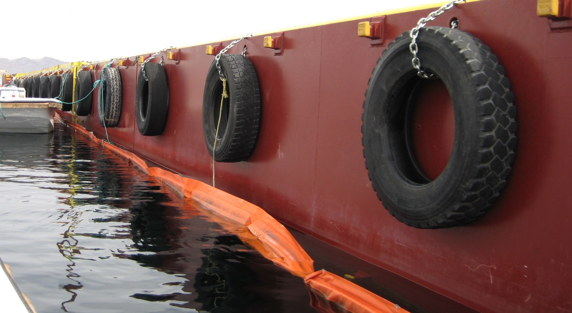
Tires are NEVER a proper form of access to barges

Slide 21
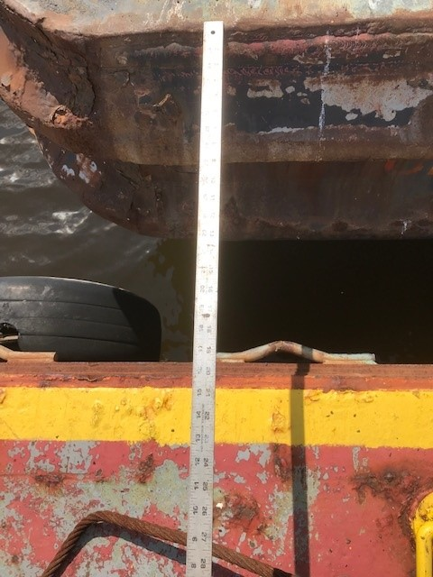
NEVER jump or stretch over the space between barges. You could fall and be crushed between two barges. Gangways are to be utilized as access from one barge to another when two or more barges are lying side by side or facing the same way. Commercially available aluminum gangways are a good solution for access between barges. Check with the manufacturer to ensure they are properly rated for their intended use. A competent person is to ensure gangways are installed properly as well as inspected, maintained, repaired and resolve issues.

Slide 22
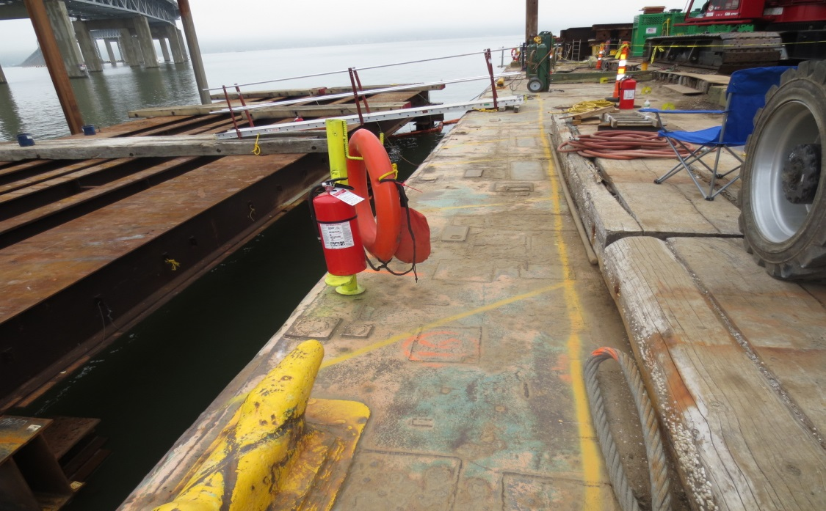
If the gap is greater than 12” a gangway must be installed

Slide 23
If change in elevation is greater than 19” a walkway, step, ramp, gangway must be installed

Slide 24
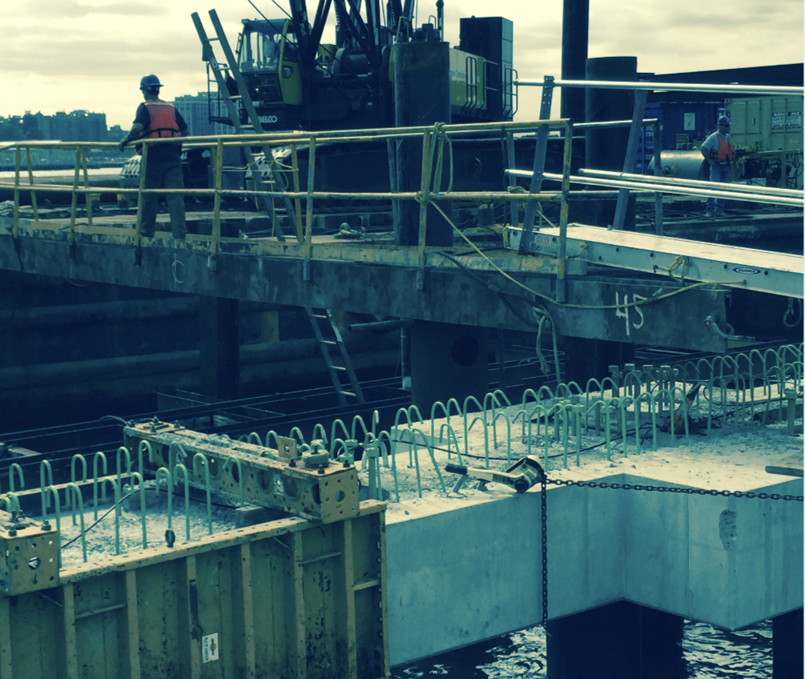
If the foot of a gangway is more than one foot away from the edge of the apron, the space between them shall be bridged by a firm walkway equipped with a hand rail with a minimum height of approximately 33 incheswith midrails on both sides.

Slide 25
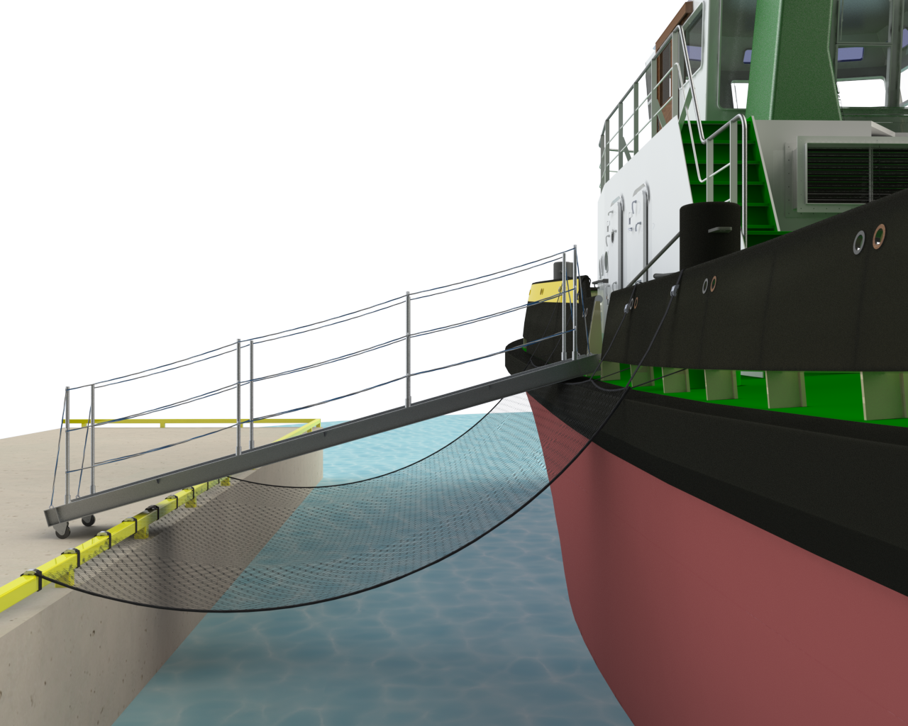
Ensure each person accessing a gangway and barge/tug has been trained on your companies MOB Procedure, Appropriate PPE including proper donning and doffing, and the required Life Saving Equipment

Slide 26
If a gangway is not practicable, a straight ladder meeting OSHA Requirements, that extends at least 36 inches above the upper landing surface and is secured against shifting or slipping shall be provided. Ladders shall extend 3’+ above the upper landing and be secured from displacement

Slide 27
Ladders are inspected before initial use in each work shift, and more frequently as necessary, to identify any visible defects that could cause employee injury Wooden ladders are not coated with any material that may obscure structural defects

Slide 28
A bulwark ladder should be utilized when the top of the gangway or portable ladder rests or is level with the bulwark. It should be securely attached to the vessel to prevent movement and must be equipped with two rigidly secured handrails/stanchions

Slide 29
Signs must be posted with PPE Requirements

Slide 30
Access to the barges must be limited to Authorized Personnel Only

Slide 31
Other Options To Ensure Safe Access
Removable Ladder Access System
NOTE: Tires are never means of proper access to barges

Slide 32
Boarding Ladders

Slide 33
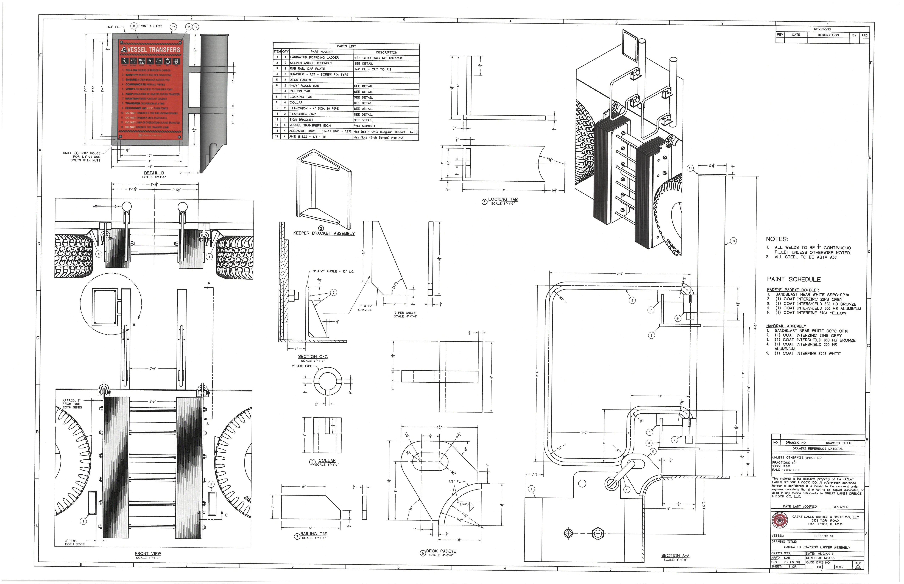

Slide 34
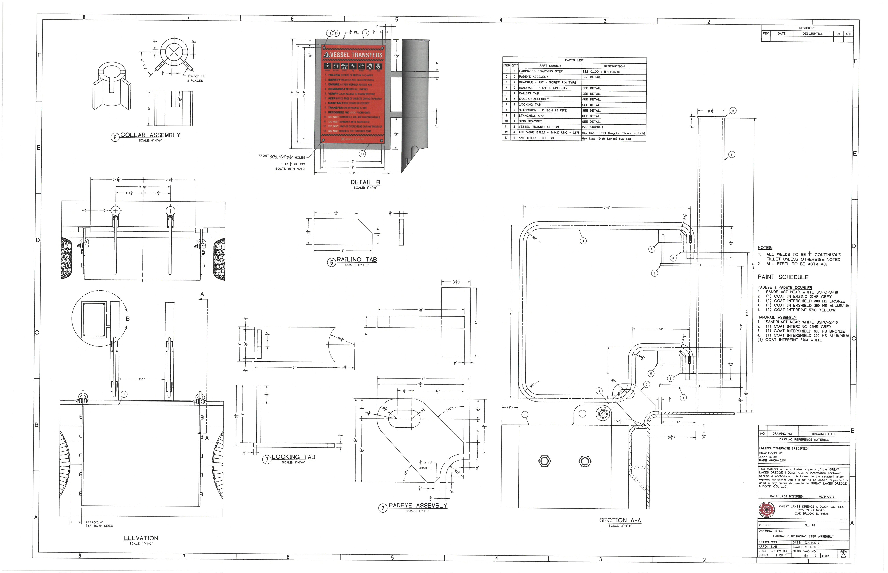

Slide 35
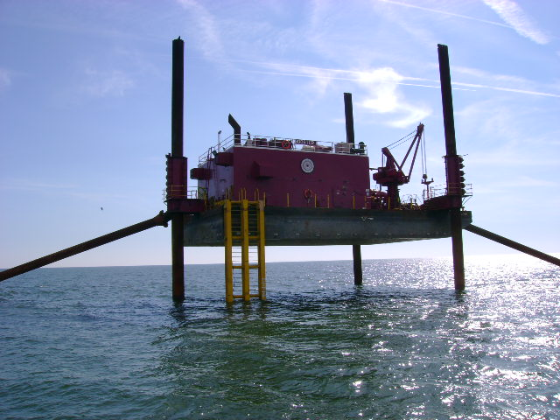
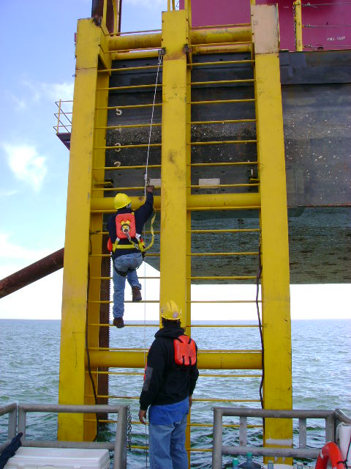
Booster Jack Ladder

Slide 36
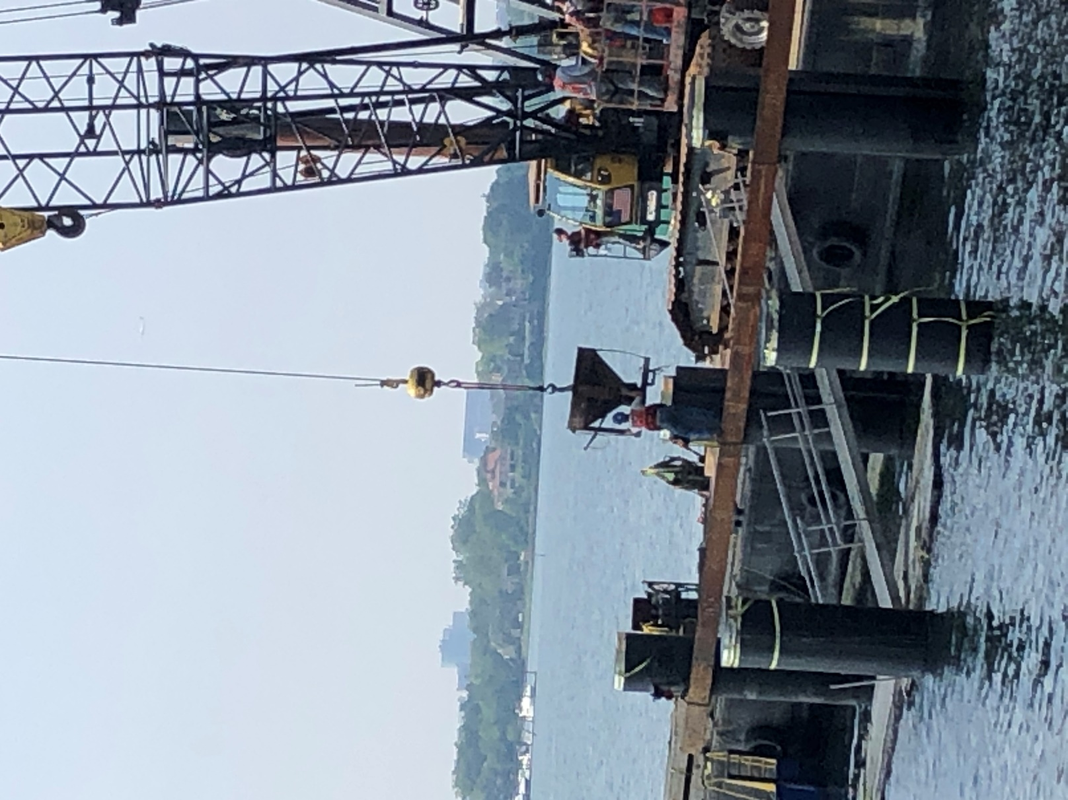
Access from water level to the barge
Gangway attached to a float stage

Slide 37
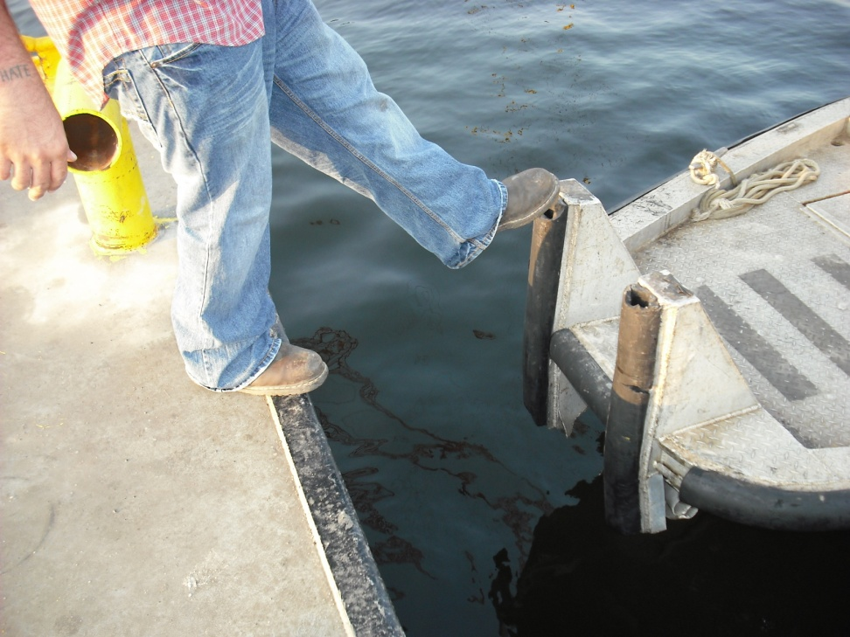
Boat Access Basics
Boats are how we sometimes get around on the job.
Before getting on any boat make sure that the deck is in line with the dock or barge.
Never board a crew boat that is not completely aligned with the dock.

Slide 38
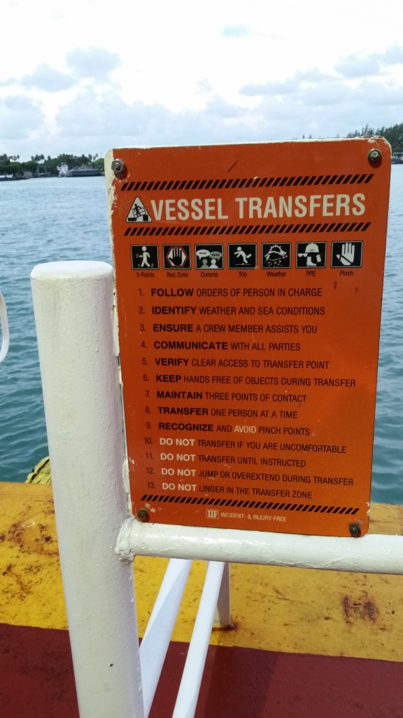

Slide 39
Before and while Embarking or Disembarking:
Put on PPE prior to boarding vessel.
Always use designated transfer location.
Do not jump from one height to another when moving from one vessel to another.
Know your path of travel and keep hands free
Keep hands clear of doorway / hatch cover frame pinch points
Take orders from and direct communication to Person In Charge of vessel
Remain seated until Captain secures vessel or gives instruction to get up or disembark.
Ensure gangway is secure and that path of travel is clear of obstructions before beginning transfer.
When going aboard:
Stay out of Line of Fire (snap back) zone when lines are under tension.
Walk around winch cables
Hand off packages, backpacks, and carry-ons before attempting a transfer.

Slide 40
When boarding a vessel or moving from a vessel onto land, be sure the boat is positioned near a handrail you can reach while doing so.
Be sure you have the OK from the Captain
Be sure the vessel is secured before loading or unloading

