Slide 1
Risk Assessment Process High Level Overview
7/26/2024

Slide 2
Disclaimer
The contents of this document are intended only for the informational use of the addressee. The information contained herein is not intended as, nor does it constitute, specific legal or technical advice to the reader. Any information or recommendations contained herein are provided to the addressee for usage at their own discretion. Neither Signal Mutual Indemnity Association Ltd., its Members, Managers, or Signal Management Services, LLC and/or their employees accept liability whether in tort, negligence, contract, or otherwise, to anyone for any lack of technical skill, completeness of recommendations, or analysis of issues associated with the discussion of topics set forth herein. No responsibility is assumed for the discovery or elimination of unsafe conditions. Compliance with any recommendations herein should not assume your compliance with any federal, state, or local law or regulation. Additionally, the information contained herein does not constitute and shall not be construed to reflect the adoption of any coverage position by Signal Mutual Indemnity Association Ltd., its Members, Managers, or Signal Management Services, LLC and/or their employees.

Slide 3
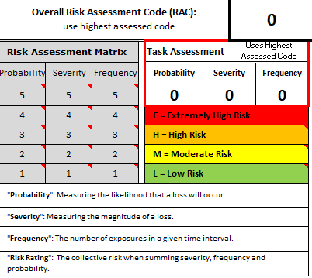
Risk Assessment – What is it?
The overall process of hazard identification, risk analysis, and selection of controls.
Identify jobs with high incident potential
Analyze and quantify risk
Select controls to eliminate or reduce risk

Slide 4
Risk Assessment – Why Do We Perform Them?
Spot hazards
Consider the potential harm
Identify people who may be at risk
Protect the people at risk
Plan the work safely
Review existing controls
Make improvements
Comply with the law

Slide 5
Risk Assessment – The Journey
March 2020 Start of COVID-19 Pandemic
April 2020 Training hosted
Quarter 3 2020 Discussed Remote Risk Assessments
Quarter 4 2020 Discussed Blended Risk Assessments
February 2021 COVID Restrictions Eased
March 2021 Determined In-Person Risk Assessments
April 2021 Planned In-Person Risk Assessment
May 2021 Conducted Risk Assessment
Now Present Findings & Outline for Future Risk Assessments
2019 Delivered In-Person Training in Partnership with Signal

Slide 6
Risk Assessment – Execution I
Risk Assessments performed in teams consisting of safety and operations staff
Safety acts as a guide and observes a live operation
Operations
Performs assessment
Identifies the hazards of the operation
Offers solutions for the hazards on the Risk Assessment
TEAMS can be utilized for team members unable to be on location
Each Risk Assessment will begin with a task educational component for those unfamiliar with the job processes, gear, equipment, or location

Slide 7
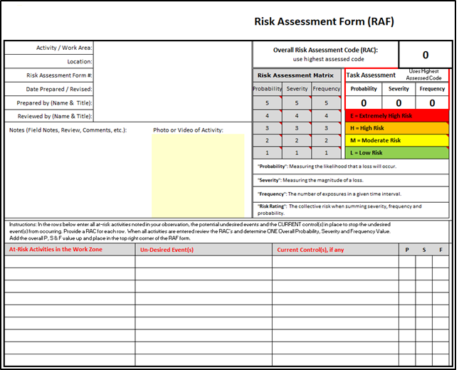
Risk Assessment – Execution II
The processes will be broken down into steps. Risk will be quantified by probability, severity, and frequency.
Work practices and controls will be reviewed to reduce risk as low as reasonably practicable (ALARP).
The team will consider preventive measures using the Hierarchy of Controls.

Slide 8
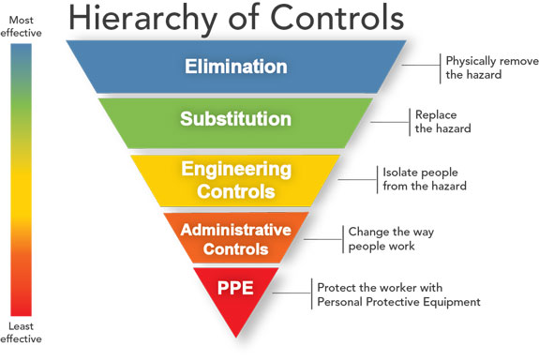
Risk Assessment – Execution III
The team will consider enhancing current controls or implementing more effective preventive measures using the Hierarchy of Controls.
Tasks will be reanalyzed, taking the additional controls into account.

Slide 9
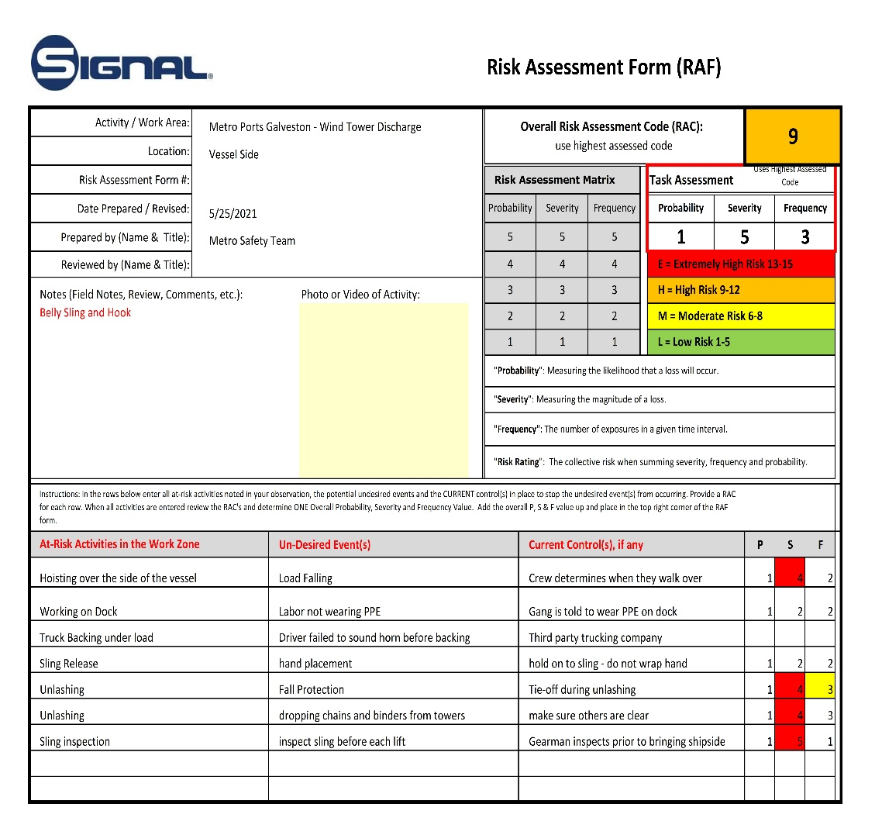
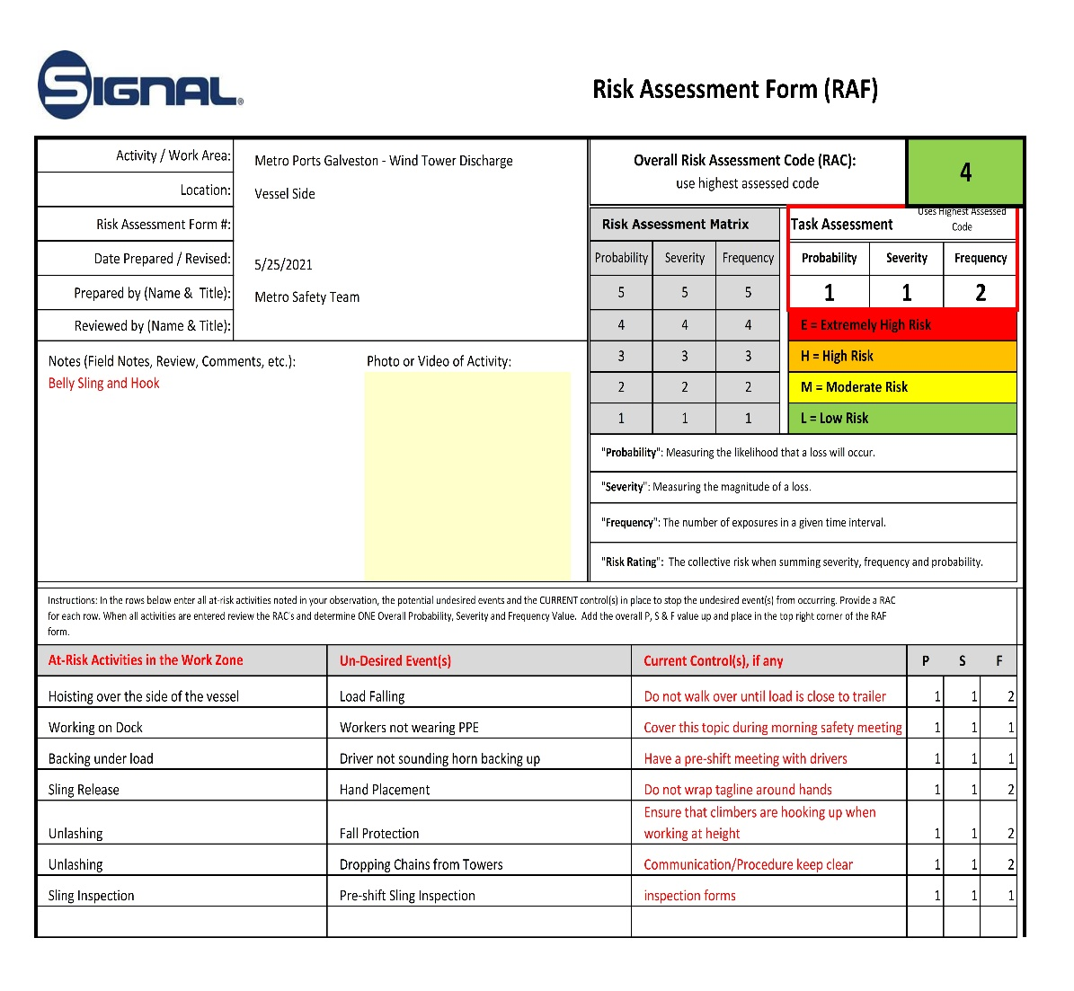
Example Risk Matrix: Hazards/Controls = JHA

Slide 10
Example Audit Form

Slide 11
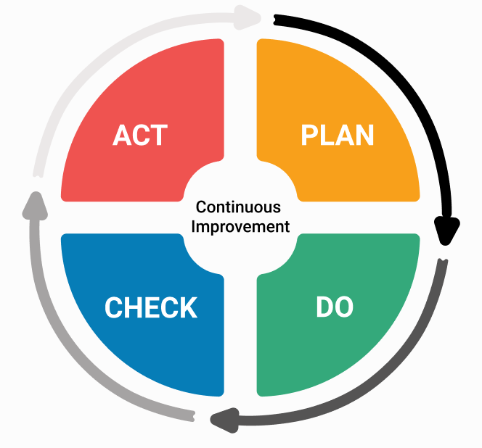
Risk Assessment – Review and Auditing
Improvements to processes will be monitored to confirm proper implementation and measure effectiveness.

Slide 12
Example Job Hazard Analysis

