Slide 1

ACTIVE SHOOTER HOW TO RESPOND

Slide 2
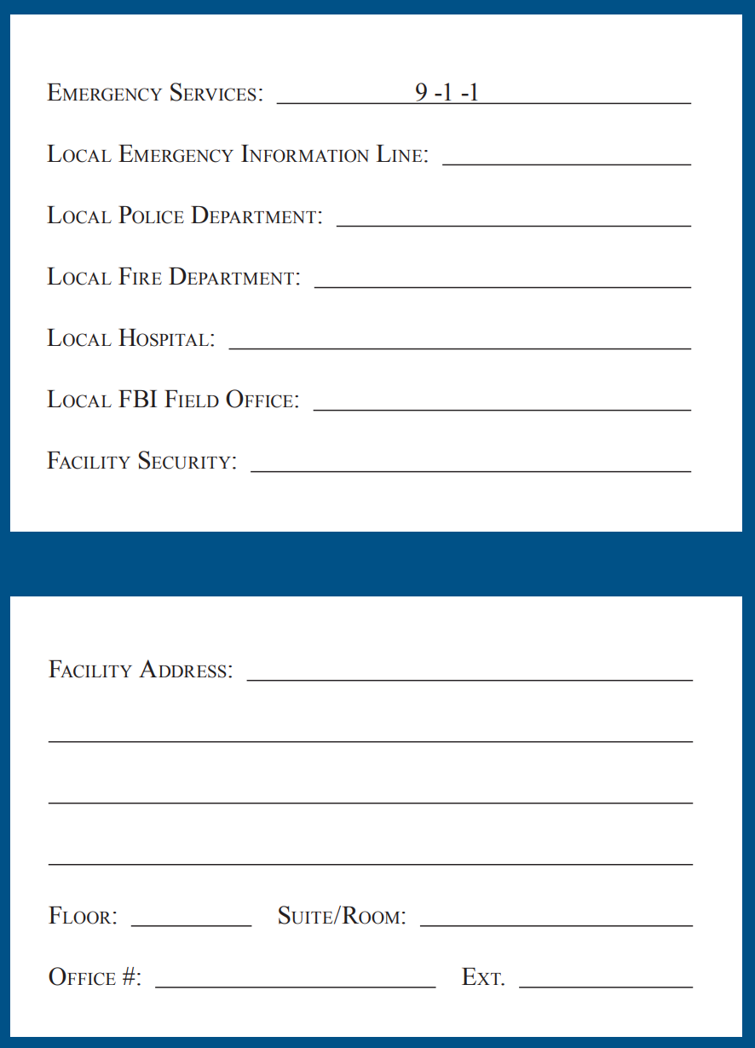
Emergency Numbers

Slide 3
PROFILE OF AN ACTIVE SHOOTER
An Active Shooter is an individual actively engaged in killing or attempting to kill people in a confined and populated area; in most cases, active shooters use firearms(s) and there is no pattern or method to their selection of victims.
Active shooter situations are unpredictable and evolve quickly. Typically, the immediate deployment of law enforcement is required to stop the shooting and mitigate harm to victims.
Because active shooter situations are often over within 10 to 15 minutes, before law enforcement arrives on the scene, individuals must be prepared both mentally and physically to deal with an active shooter situation.

Slide 4
Good practices for coping with an active shooter situation:
• Be aware of your environment and any possible dangers
• Take note of the two nearest exits in any facility you visit
• If you are in an office, stay there and secure the door
• If you are in a hallway, get into a room and secure the door
• As a last resort, attempt to take the active shooter down. When the shooter is at close range and you cannot flee, your chance of survival is much greater if you try to incapacitate him/her.
CALL 911 WHEN IT IS SAFE TO DO SO!

Slide 5
HOW TO RESPOND WHEN AN ACTIVE SHOOTER IS IN YOUR VICINITY
Quickly determine the most reasonable way to protect your own life. Remember that customers and clients are likely to follow the lead of employees and managers during an active shooter situation.
RUN If there is an accessible escape path, attempt to evacuate the premises.
Be sure to:
• Have an escape route and plan in mind
• Evacuate regardless of whether others agree to follow
• Leave your belongings behind
• Help others escape, if possible
• Prevent individuals from entering an area where the active shooter may be
• Keep your hands visible
• Follow the instructions of any police officers
• Do not attempt to move wounded people
• Call 911 when you are safe

Slide 6
HOW TO RESPOND WHEN AN ACTIVE SHOOTER IS IN YOUR VICINITY
HIDE If evacuation is not possible, find a place to hide where the active shooter is less likely to find you. Your hiding place should:
  • Be out of the active shooter’s view
  • Provide protection if shots are fired in your direction (i.e., an office with a closed and locked
  door)
  • Not trap you or restrict your options for movement To prevent an active shooter from
  entering your hiding place:
  • Lock the door
  • Blockade the door with heavy furniture

Slide 7
HOW TO RESPOND WHEN AN ACTIVE SHOOTER IS IN YOUR VICINITY
If the active shooter is nearby:
• Lock the door
• Silence your cell phone and/or pager
• Turn off any source of noise (i.e., radios, televisions)
• Hide behind large items (i.e., cabinets, desks)
• Remain quiet If evacuation and hiding out are not possible:
• Remain calm
• Dial 911, if possible, to alert police to the active shooter’s location
• If you cannot speak, leave the line open and allow the dispatcher to listen

Slide 8
HOW TO RESPOND WHEN AN ACTIVE SHOOTER IS IN YOUR VICINITY
As a last resort, FIGHT only when your life is in imminent danger, attempt to disrupt and/or incapacitate the active shooter by:
• Acting as aggressively as possible against him/her
• Throwing items and improvising weapons
• Yelling
• Committing to your actions

Slide 9
HOW TO RESPOND WHEN LAW ENFORCEMENT ARRIVES
Law enforcement’s purpose is to stop the active shooter as soon as possible. Officers will proceed directly to the area in which the last shots were heard.
• Officers usually arrive in teams of four (4)
• Officers may wear regular patrol uniforms or external bulletproof vests,
Kevlar helmets, and other tactical equipment
• Officers may be armed with rifles, shotguns, handguns
• Officers may use pepper spray or tear gas to control the situation
• Officers may shout commands, and may push individuals to the ground
for their safety

Slide 10
HOW TO RESPOND WHEN LAW ENFORCEMENT ARRIVES
• Remain calm, and follow officers’ instructions
• Put down any items in your hands (i.e., bags, jackets)
• Immediately raise hands and spread fingers
• Keep hands visible at all times
• Avoid making quick movements toward officers such as holding on to them for
safety
• Avoid pointing, screaming and/or yelling
• Do not stop to ask officers for help or direction when evacuating, just proceed
in the direction from which officers are entering the premises

Slide 11
Information to provide to law enforcement or
911 operator:
Location of the active shooter
• Number of shooters, if more than one
• Physical description of shooter/s
• Number and type of weapons held by the shooter/s
• Number of potential victims at the location
The first officers to arrive to the scene will not stop to help injured persons. Expect rescue teams comprised of additional officers and emergency medical personnel to follow the initial officers. These rescue teams will treat and remove any injured persons. They may also call upon able-bodied individuals to assist in removing the wounded from the premises.
Once you have reached a safe location or an assembly point, you will likely be held in that area by law enforcement until the situation is under control, and all witnesses have been identified and questioned. Do not leave until law enforcement authorities have instructed you to do so.

Slide 12
TRAINING YOUR STAFF FOR AN ACTIVE SHOOTER SITUATION
To best prepare your staff for an active shooter situation, create an Emergency Action Plan (EAP), and conduct training exercises. Together, the EAP and training exercises will prepare your staff to effectively respond and help minimize loss of life.

Slide 13
Components of an Emergency Action Plan (EAP)
Create the EAP with input from several stakeholders including human resources, your training department, facility owners / operators, your property manager, and local law enforcement and/or emergency responders. An effective EAP will include:
• A preferred method for reporting fires and other emergencies
• An evacuation policy and procedure
• Emergency escape procedures and route assignments (i.e., floor plans, safe areas)
• Contact info and responsibilities of individuals to be contacted under the EAP
• Information concerning local area hospitals (i.e., name, telephone number, and
distance from your location)
• An emergency notification system to alert various parties of an emergency including:
- Individuals at remote locations within the premises
- Local law enforcement
- Local area hospitals

Slide 14
Components of Training Exercises
The most effective way to train your staff to respond to an active shooter situation is to conduct mock active shooter training exercises. Local law enforcement is an excellent resource in designing training exercises.
• Recognizing the sound of gunshots
• Reacting quickly when gunshots are heard and/or when a shooting is
witnessed:
- Run
- Hide
- Fight the shooter as a last resort
• Calling 911
• Reacting when law enforcement arrives
• Adopting the survival mind set during times of crisis

Slide 15
Additional Ways to Prepare For and Prevent an Active Shooter Situation
Preparedness
- Ensure that your facility has at least two evacuation routes
- Post evacuation routes in conspicuous locations throughout your facility
- Include local law enforcement and first responders during training exercises
- Encourage law enforcement, emergency responders, SWAT teams, K-9 teams, and
bomb squads to train for an active shooter scenario at your location
Prevention
- Foster a respectful workplace
- Be aware of indications of workplace violence and take remedial actions
accordingly
For more information on creating an EAP contact the U.S. Department of Labor, Occupational Health and Safety Administration, www.osha.gov.

Slide 16
PREPARING FOR AND MANAGING AN ACTIVE SHOOTER SITUATION
Your human resources department and facility managers should engage in planning for emergency situations, including an active shooter scenario. Planning for emergency situations will help to mitigate the likelihood of an incident by establishing the mechanisms described below.

Slide 17
Human Resources’ Responsibilities
Conduct effective employee screening and background checks
• Create a system for reporting signs of potentially violent behavior
• Make counseling services available to employees
• Develop an EAP which includes policies and procedures for dealing with an
active shooter situation, as well as after action planning

Slide 18
Facility Manager Responsibilities
• Institute access controls (i.e., keys, security system pass codes)
• Distribute critical items to appropriate managers / employees, including:
- Floor plans
- Keys
- Facility personnel lists and telephone numbers
• Coordinate with the security department to ensure the physical security of the location
• Assemble crisis kits containing:
- radios
- floor plans
- staff roster, and staff emergency contact numbers
- first aid kits
- flashlights
• Place removable floor plans near entrances and exits for emergency responders
• Activate the emergency notification system when an emergency situation occurs

Slide 19
Reactions of Managers During an Active Shooter Situation
Employees and customers are likely to follow the lead of managers during emergency situations. During an emergency, managers should be familiar with their EAP, and be prepared to:
• Take immediate action
• Remain calm
• Lock and barricade doors
• Evacuate staff and customers via a preplanned evacuation route to a
safe area

Slide 20
Assisting Individuals with Special Needs and/or Disabilities
Ensure that EAPs, evacuation instructions and any other relevant information address to individuals with special needs and/or disabilities
• Your building should be handicap-accessible, in compliance with ADA
requirements

Slide 21
RECOGNIZING POTENTIAL WORKPLACE VIOLENCE
An active shooter in your workplace may be a current or former employee, or an acquaintance of a current or former employee.
Intuitive managers and coworkers may notice characteristics of potentially violent behavior in an employee.
Alert your Human Resources Department if you believe an employee or coworker exhibits potentially violent behavior.

Slide 22
Indicators of Potential Violence by an Employee
Employees typically do not just “snap,” but display indicators of potentially violent behavior over time. If these behaviors are recognized, they can often be managed and treated.
Potentially violent behaviors by an employee may include one or more of the following (this list of behaviors is not comprehensive, nor is it intended as a mechanism for diagnosing violent tendencies):
• Increased use of alcohol and/or illegal drugs
• Unexplained increase in absenteeism; vague physical complaints
• Noticeable decrease in attention to appearance and hygiene
• Depression / withdrawal
• Resistance and overreaction to changes in policy and procedures
• Repeated violations of company policies

Slide 23
Indicators of Potential Violence by an Employee
• Increased severe mood swings
• Noticeably unstable, emotional responses
• Explosive outbursts of anger or rage without provocation
• Suicidal; comments about “putting things in order”
• Behavior which is suspect of paranoia, (“everybody is against me”)
• Increasingly talks of problems at home
• Escalation of domestic problems into the workplace; talk of severe
financial problems
• Talk of previous incidents of violence
• Empathy with individuals committing violence
• Increase in unsolicited comments about firearms, other dangerous
weapons and violent crimes

Slide 24
MANAGING THE CONSEQUENCES OF AN ACTIVE SHOOTER SITUATION
After the active shooter has been incapacitated and is no longer a threat, human resources and/or management should engage in post-event assessments and activities, including:
• An accounting of all individuals at a designated assembly point to determine
who, if anyone, is missing and potentially injured.
• Determining a method for notifying families of individuals affected by the
active shooter, including notification of any casualties.
• Assessing the psychological state of individuals at the scene, and referring
them to health care specialists accordingly.
• Identifying and filling any critical personnel or operational gaps left in the
organization as a result of the active shooter.

Slide 25
LESSONS LEARNED
To facilitate effective planning for future emergencies, it’s important to analyze the recent active shooter situation and create an after-action report. The analysis and reporting contained in this report is useful for:
• Serving as documentation for response activities
• Identifying successes and failures that occurred during the event
• Providing an analysis of the effectiveness of the existing EAP
• Describing and defining a plan for making improvements to the EAP

Slide 26
References
Safety Guidelines for Armed Subjects, Active Shooter Situations, Indiana University Police Department, April 2007.
Safety Tips & Guidelines Regarding Potential “Active Shooter” Incidents Occurring on Campus, University of California Police.
Shots Fired, When Lightning Strikes (DVD), Center for Personal Protection and Safety, 2007.
Workplace Violence Desk Reference, Security Management Group International, www.SMGICorp.com
How to Plan for Workplace Emergencies and Evacuations, U.S. Department of Labor, Occupational Health and Safety Administration, OSHA 3088, 2001.

Slide 27

DISCLAIMER: The contents of this document are intended only for the informational use of the addressee. The information contained herein is not intended as, nor does it constitute, specific legal or technical advice to the reader. Any information or recommendations contained herein are provided to the addressee for usage at their own discretion. Neither Signal Mutual Indemnity Association Ltd., its Members, Managers, or Signal Management Services, LLC and/or their employees accept liability whether in tort, negligence, contract, or otherwise, to anyone for any lack of technical skill, completeness of recommendations, or analysis of issues associated with the discussion of topics set forth herein. No responsibility is assumed for the discovery or elimination of unsafe conditions. Compliance with any recommendations herein should not assume your compliance with any federal, state, or local law or regulation. Additionally, the information contained herein does not constitute and shall not be construed to reflect the adoption of any coverage position by Signal Mutual Indemnity Association Ltd., its Members, Managers, or Signal Management Services, LLC and/or their employees.

