Slide 1
Establishing a Risk Assessment Protocol
7/26/2024

Slide 2
Disclaimer
The contents of this document are intended only for the informational use of the addressee. The information contained herein is not intended as, nor does it constitute, specific legal or technical advice to the reader. Any information or recommendations contained herein are provided to the addressee for usage at their own discretion. Neither Signal Mutual Indemnity Association Ltd., its Members, Managers, or Signal Management Services, LLC and/or their employees accept liability whether in tort, negligence, contract, or otherwise, to anyone for any lack of technical skill, completeness of recommendations, or analysis of issues associated with the discussion of topics set forth herein. No responsibility is assumed for the discovery or elimination of unsafe conditions. Compliance with any recommendations herein should not assume your compliance with any federal, state, or local law or regulation. Additionally, the information contained herein does not constitute and shall not be construed to reflect the adoption of any coverage position by Signal Mutual Indemnity Association Ltd., its Members, Managers, or Signal Management Services, LLC and/or their employees.

Slide 3
Construct
Building a Risk Assessment program requires consideration of many factors
Partner with a third-party safety professional, such as the signal safety group, that can provide an objective opinion
Work with operations to identify the most dangerous three or four processes as a starting point for mitigation
Begin slowly – Identify only two or three target risks per process
Drive the process from operations and have them identify and correct the high-risk activities
Utilize the process to create Job Hazard Analysis (JHA) to train new hires and refresh legacy employees

Slide 4
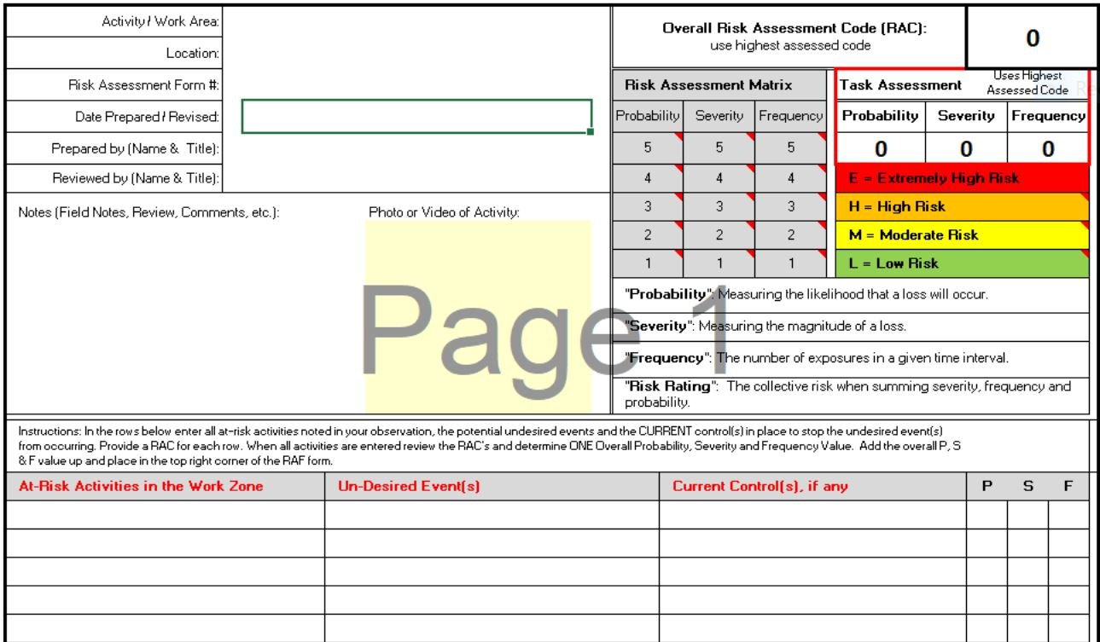
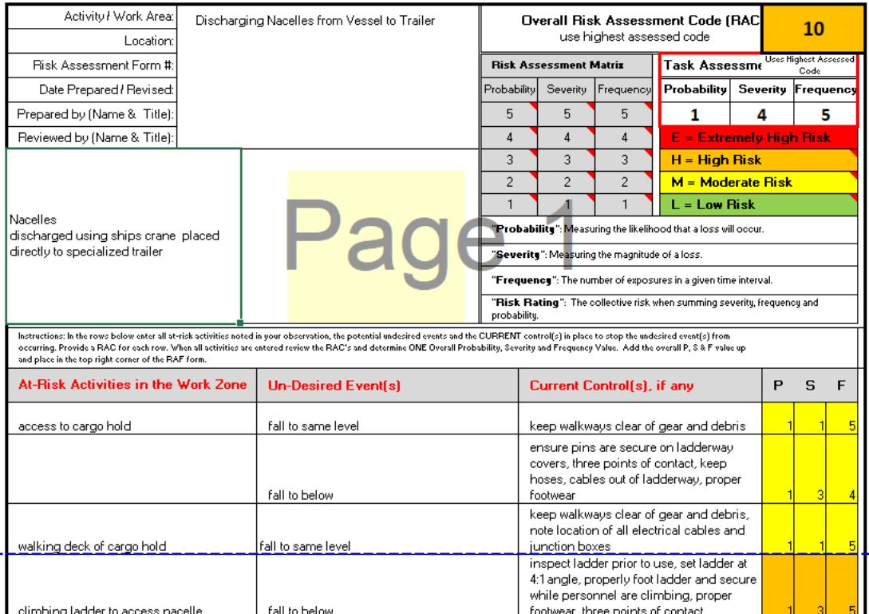
Examples: Hazards/controls = JHA

Slide 5
Purpose
There are many reasons to get involved with risk assessments
Identify and mitigate hazards within the current procedures
Bring hazard awareness to the forefront
Training tool
Drive best safety practices
Practice utilizing the hierarchy of controls

Slide 6
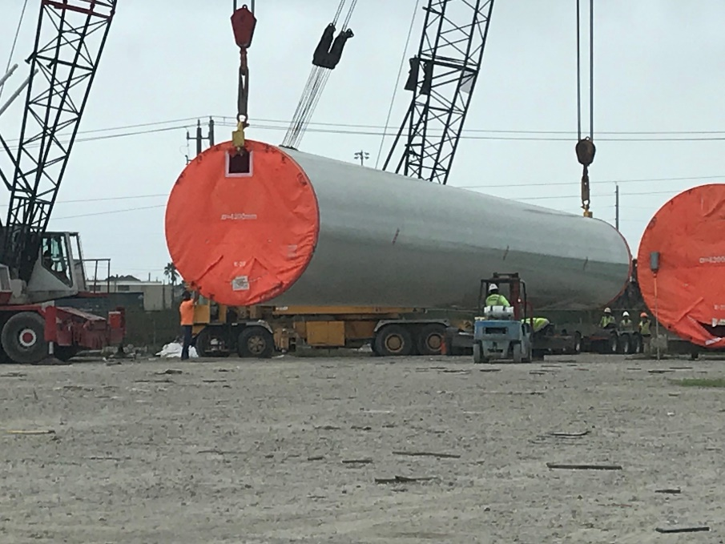
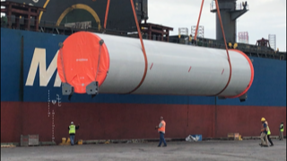
Pictures

Slide 7
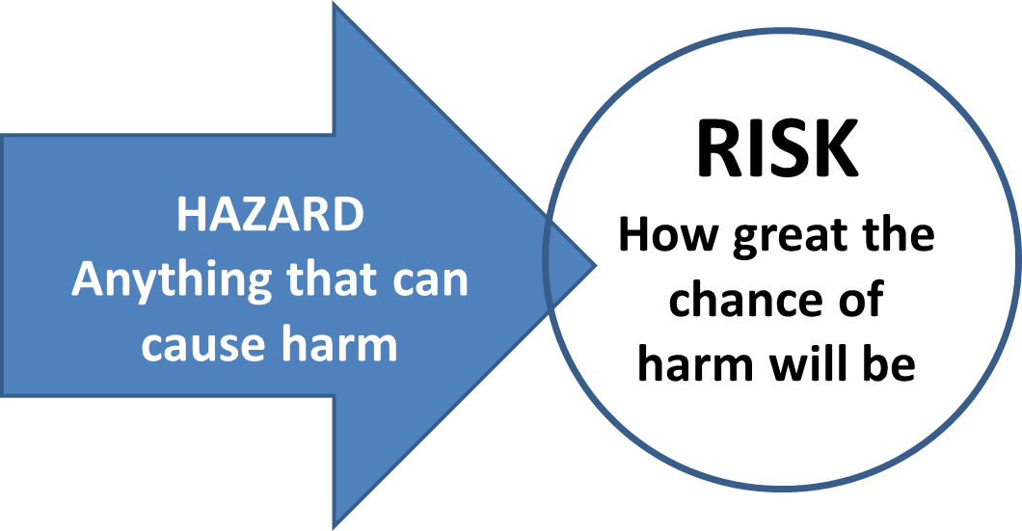
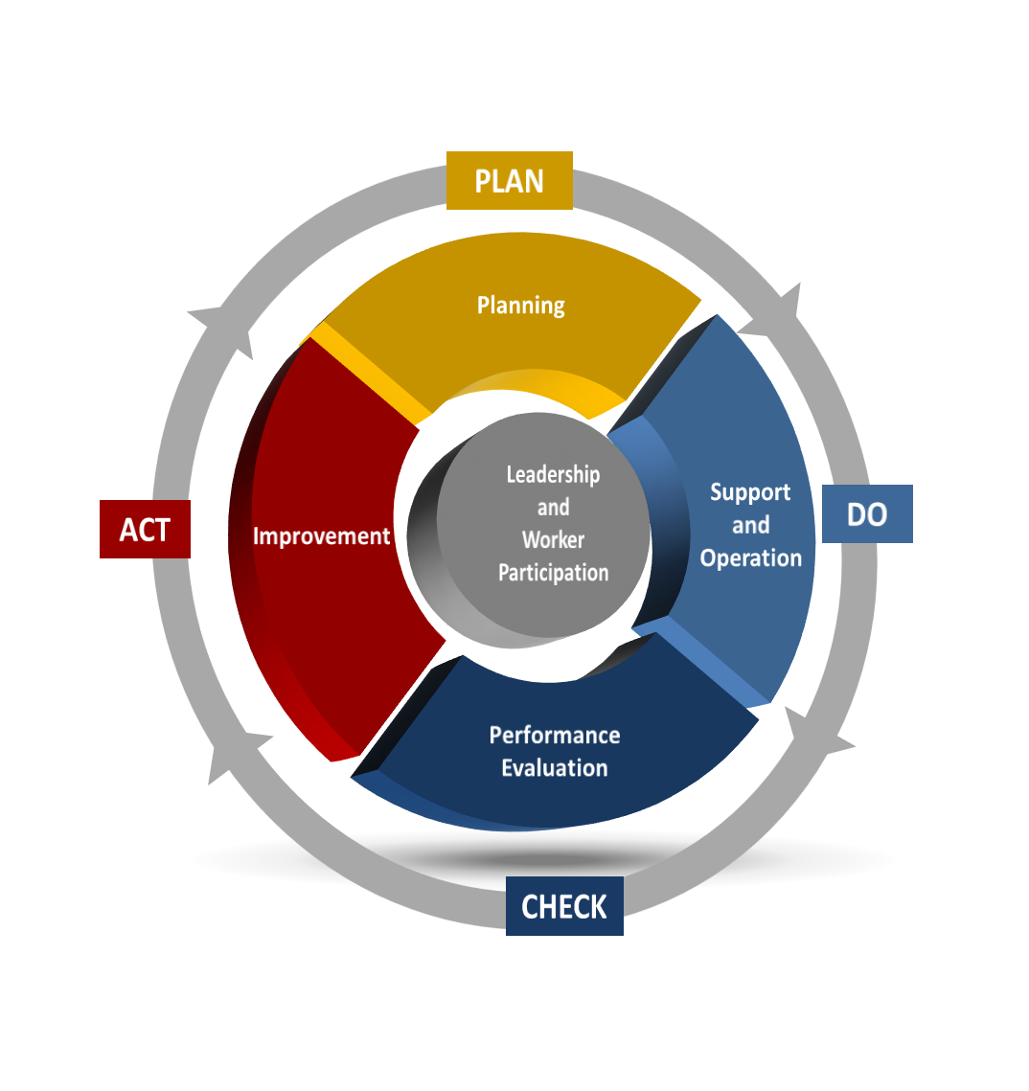
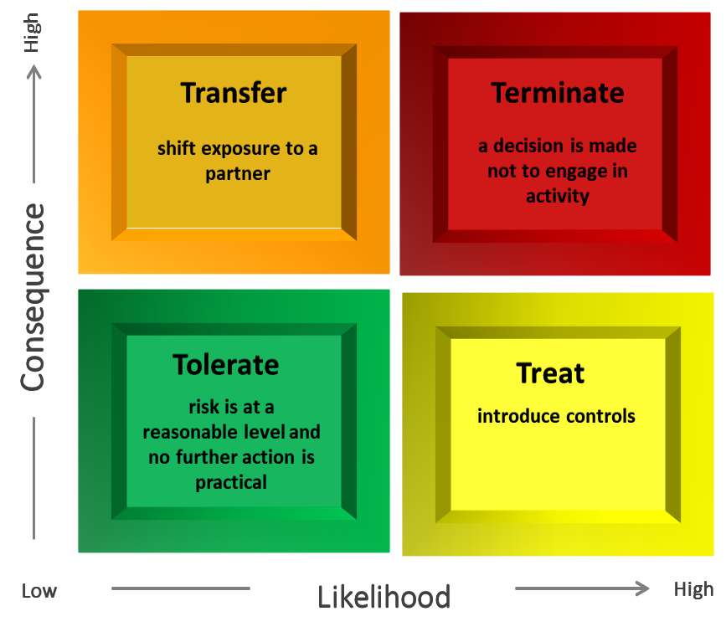
Learning all the Components of Risk Assessment
The constituent components of Risk Assessment also help with other areas of safety, such as audits and inspections.
See the risk chart

