Slide 1
Risk Assessment Overview

Slide 2
Disclaimer
The contents of this document are intended only for the informational use of the addressee. The information contained herein is not intended as, nor does it constitute, specific legal or technical advice to the reader. Any information or recommendations contained herein are provided to the addressee for usage at their own discretion. Neither Signal Mutual Indemnity Association Ltd., its Members, Managers, or Signal Management Services, LLC and/or their employees accept liability whether in tort, negligence, contract, or otherwise, to anyone for any lack of technical skill, completeness of recommendations, or analysis of issues associated with the discussion of topics set forth herein. No responsibility is assumed for the discovery or elimination of unsafe conditions. Compliance with any recommendations herein should not assume your compliance with any federal, state, or local law or regulation. Additionally, the information contained herein does not constitute and shall not be construed to reflect the adoption of any coverage position by Signal Mutual Indemnity Association Ltd., its Members, Managers, or Signal Management Services, LLC and/or their employees.
7/29/2024

Slide 3
Overview: Review of the Risk Assessment Process
Partnered with the signal safety group to create a Risk Assessment Process and Training
Worked with operations to identify the most hazardous processes for wind energy as a starting point for mitigation
Identified three to five target risks per process
Instructed Operations on the process and had them identify and correct the high-risk activities
Utilize the process to create a Job Hazard Analysis (JHA)
From the JHA, create an audit form in your Safety Management System, such as an EHS insight

Slide 4
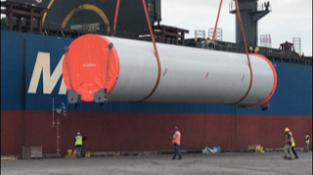
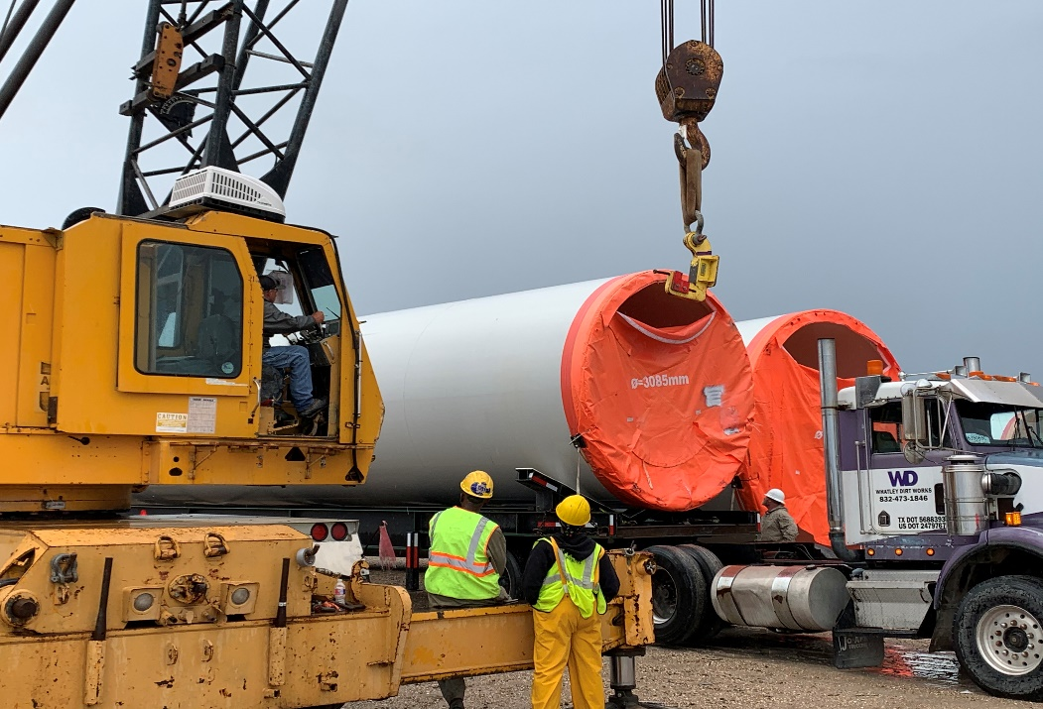
Pictures

Slide 5
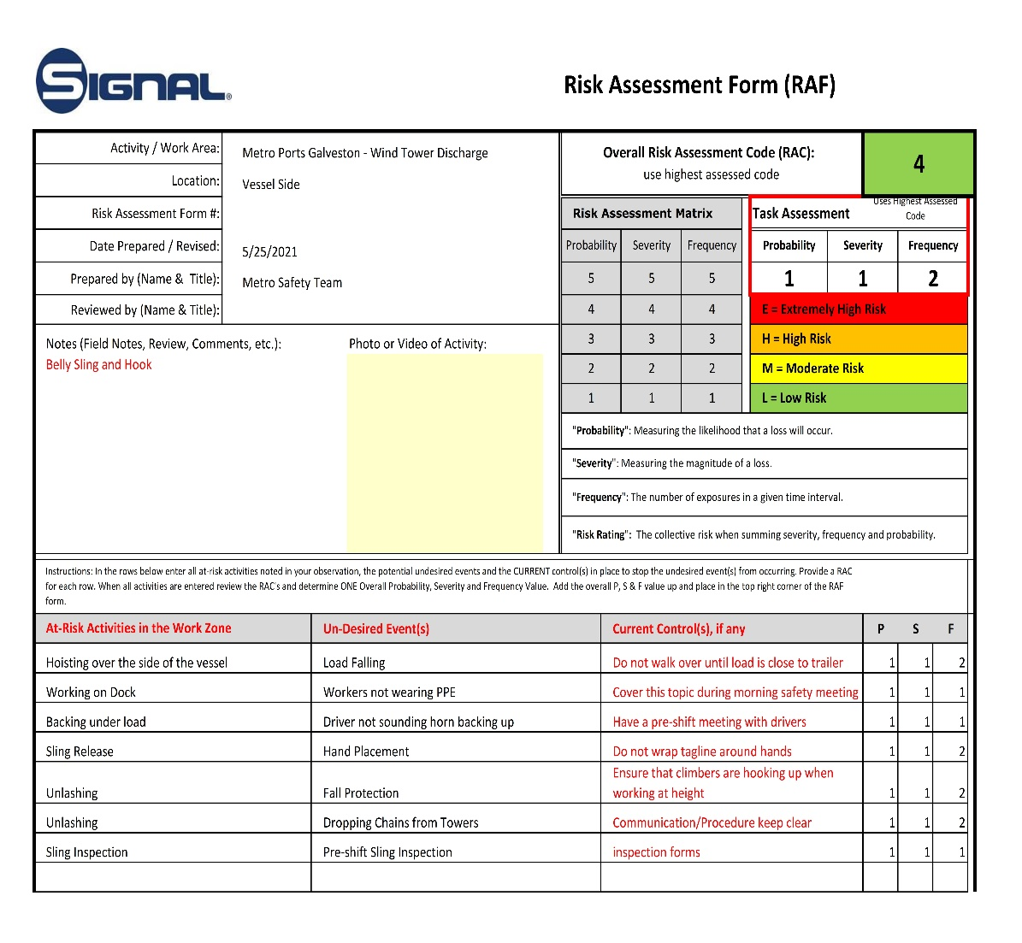
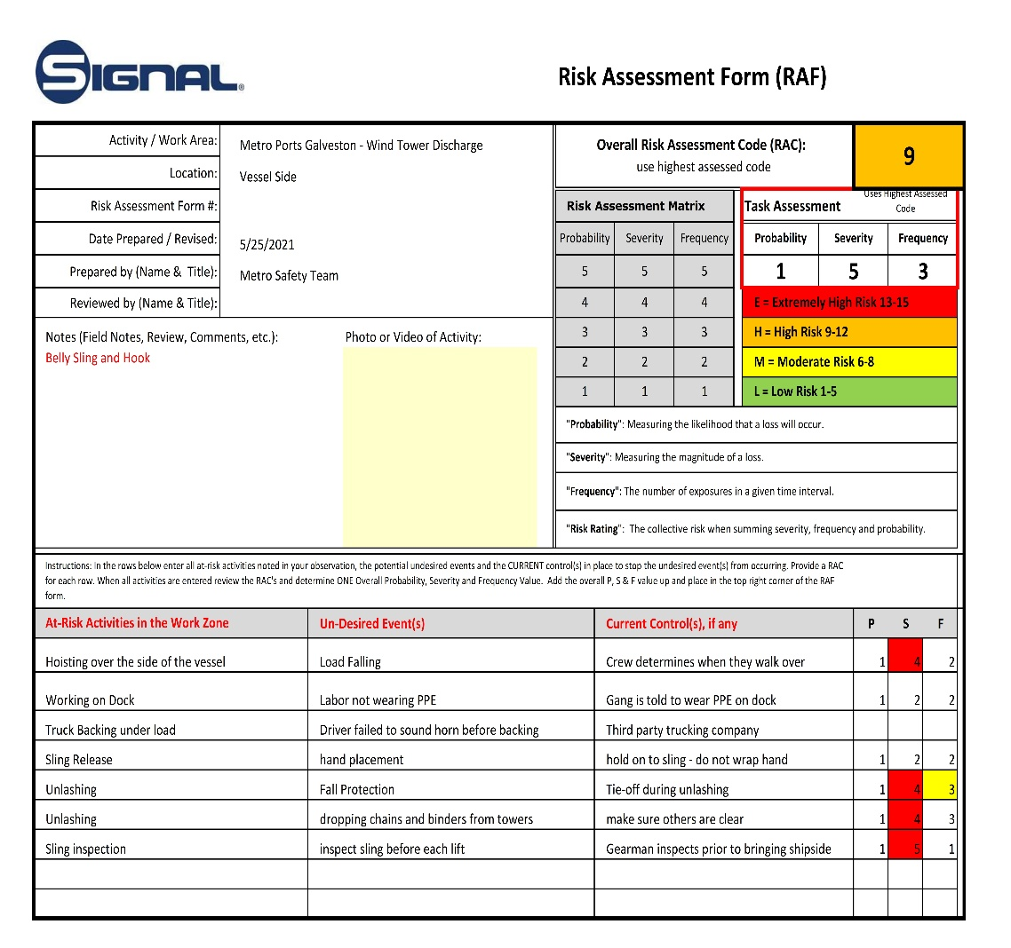
Example Risk Matrix:
Hazards/controls = JHA

Slide 6
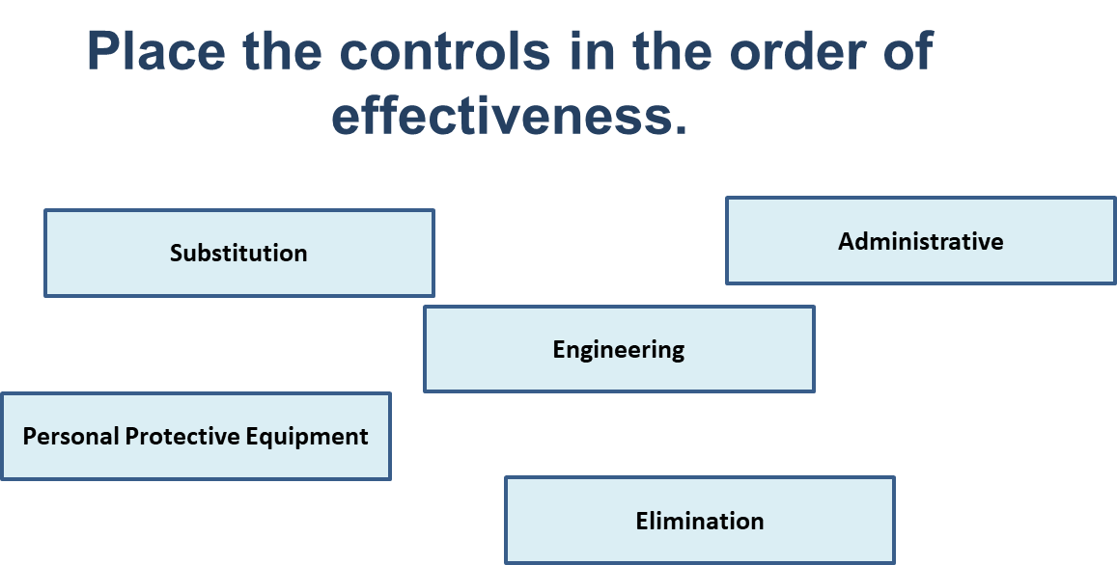
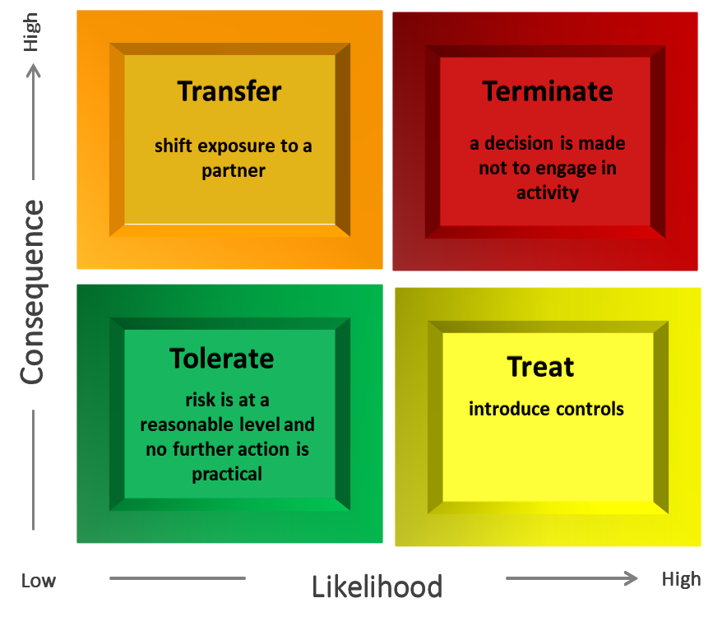
Components Risk Assessment
The constituent components of Risk Assessment offer help with other areas of safety, such as audits and inspections.

Slide 7
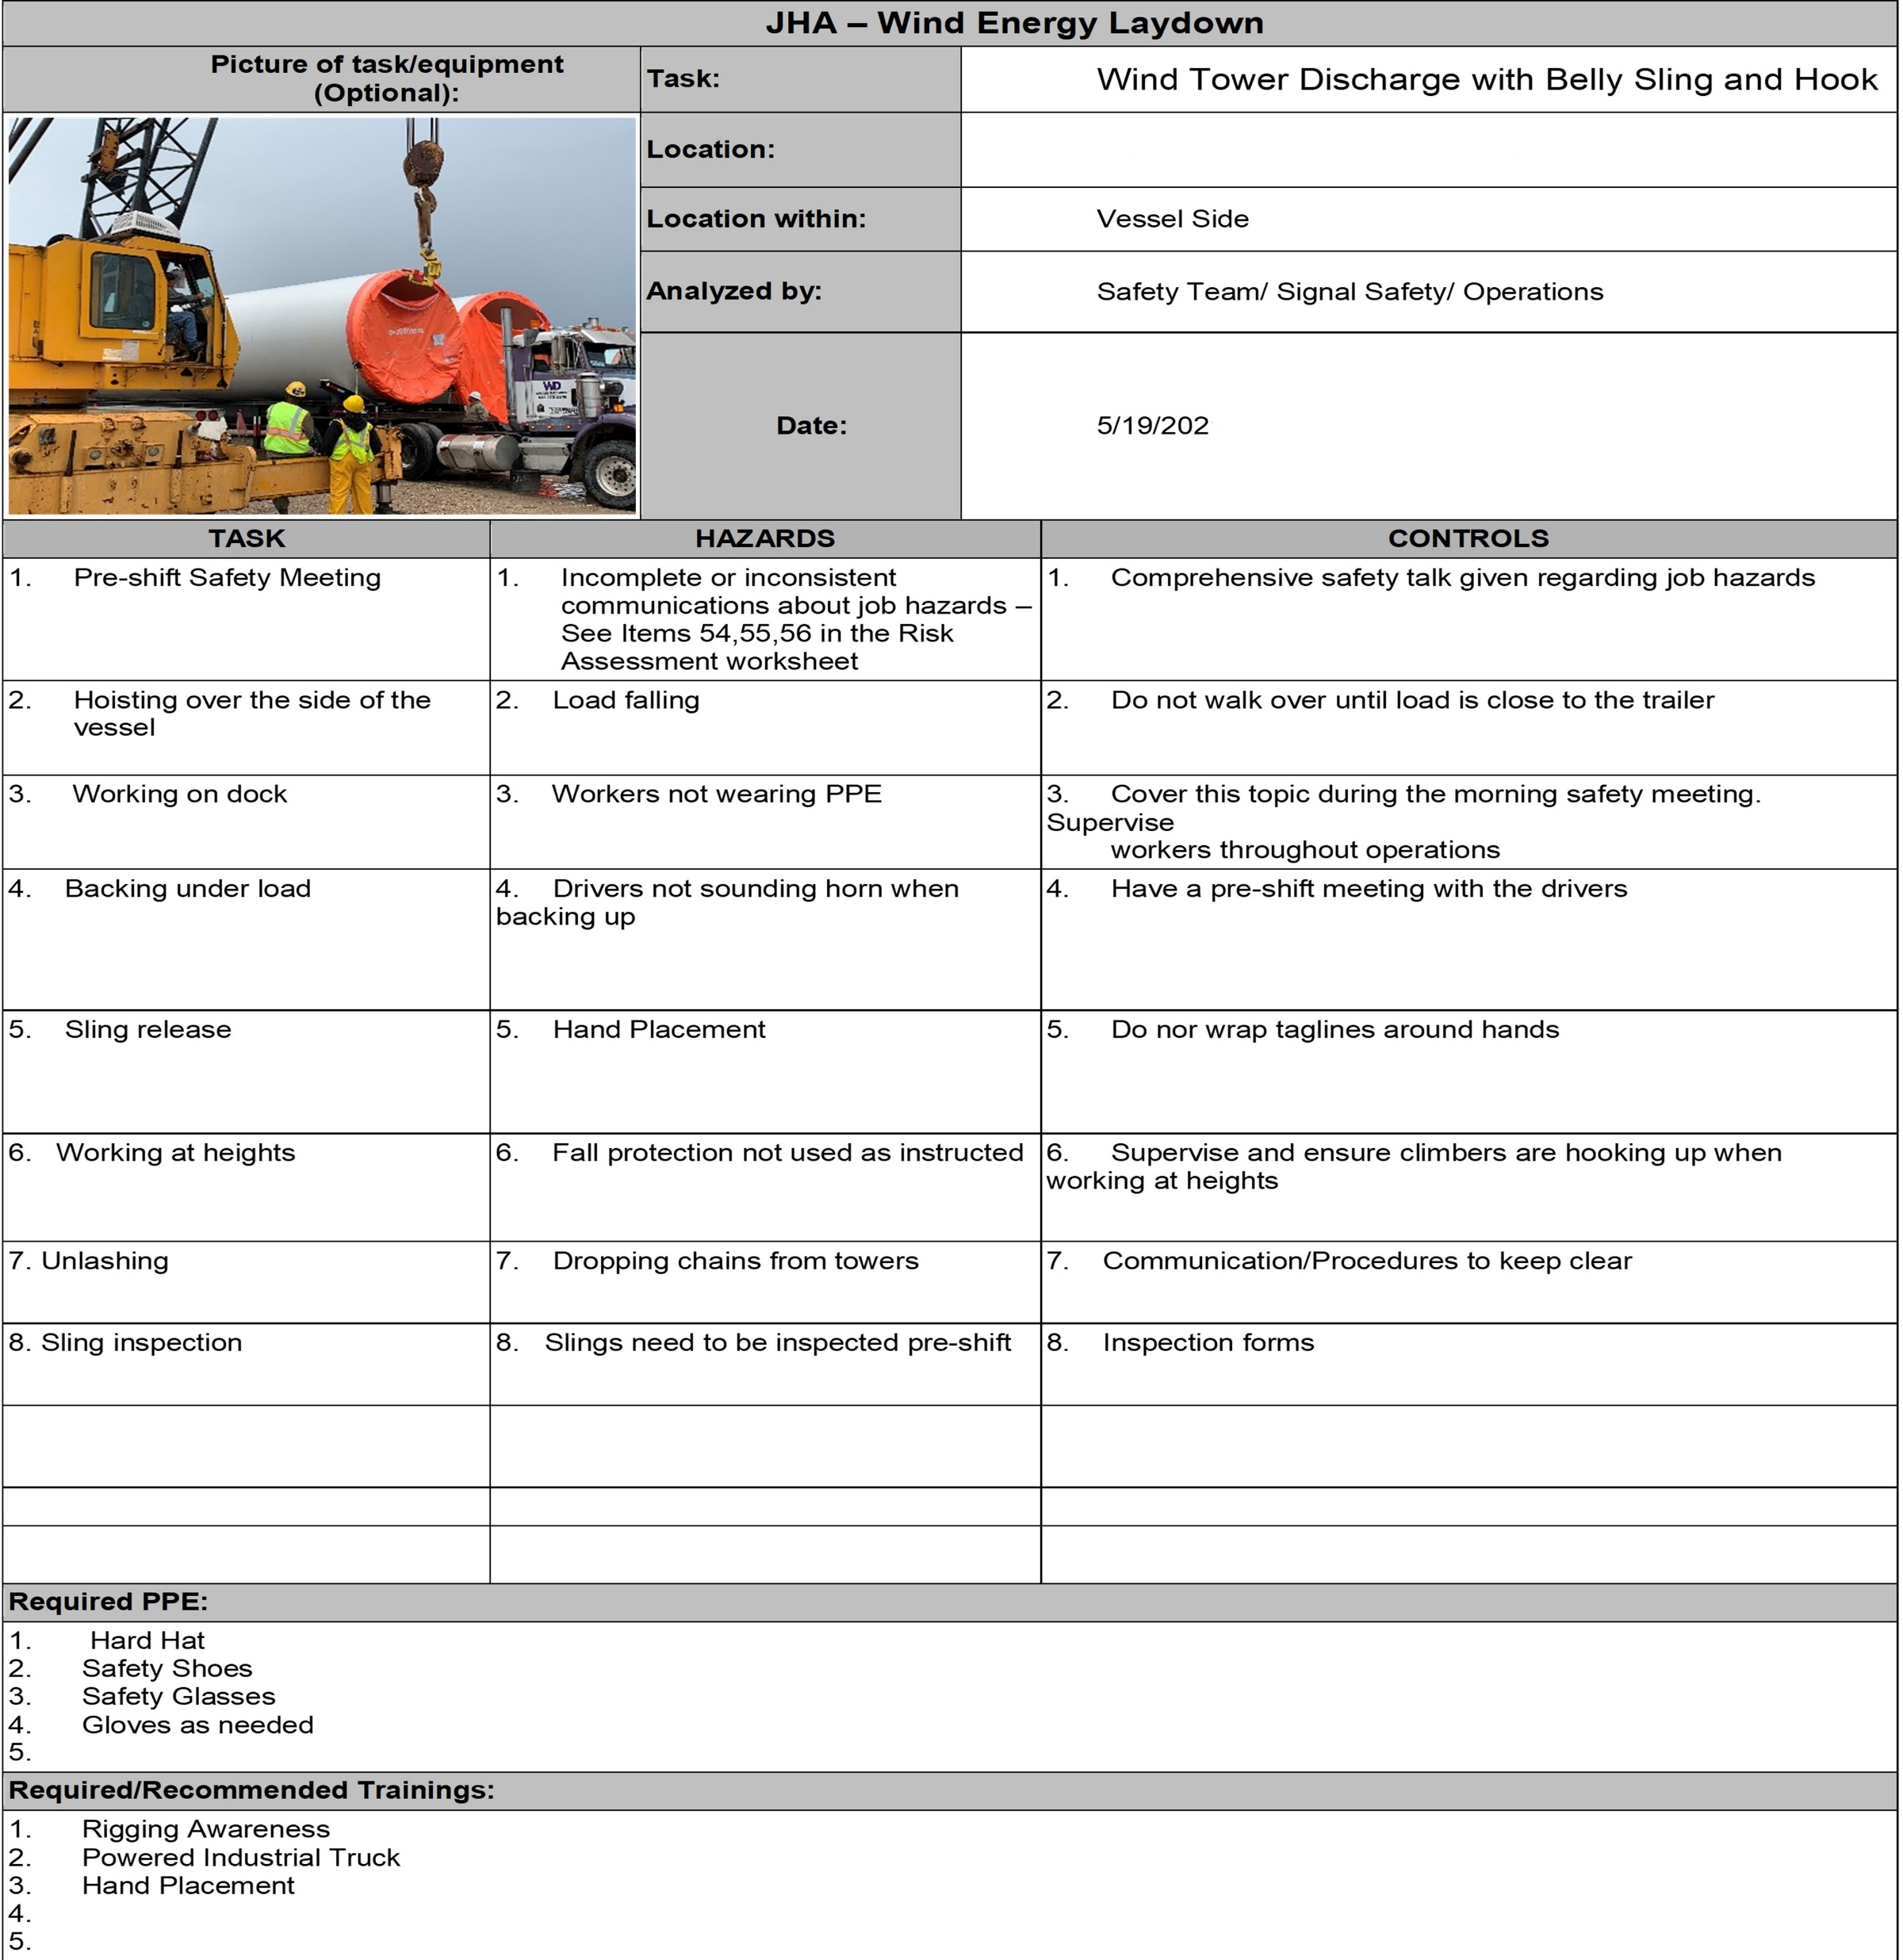
Example Job
Hazard Analysis

Slide 8
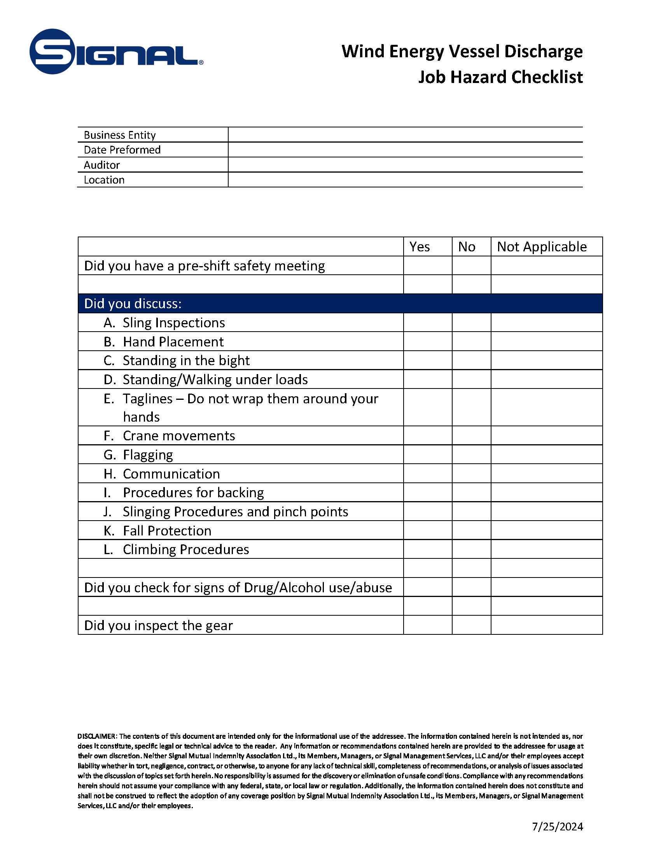
Example Audit Form

