Slide 1
Hand Safety

Slide 2
Disclaimer
The contents of this document are intended only for the informational use of the addressee. The information contained herein is not intended as, nor does it constitute, specific legal or technical advice to the reader. Any information or recommendations contained herein are provided to the addressee for usage at their own discretion. Neither Signal Mutual Indemnity Association Ltd., its Members, Managers, or Signal Management Services, LLC and/or their employees accept liability whether in tort, negligence, contract, or otherwise, to anyone for any lack of technical skill, completeness of recommendations, or analysis of issues associated with the discussion of topics set forth herein. No responsibility is assumed for the discovery or elimination of unsafe conditions. Compliance with any recommendations herein should not assume your compliance with any federal, state, or local law or regulation. Additionally, the information contained herein does not constitute and shall not be construed to reflect the adoption of any coverage position by Signal Mutual Indemnity Association Ltd., its Members, Managers, or Signal Management Services, LLC and/or their employees.

Slide 3
Introduction
Throughout the day, our hands can encounter hazards like:
machines with heavy or fast-moving parts that can pinch or grab
sharp tools that can cut or puncture
corrosive materials that can damage the skin.
Each year, thousands of people suffer unnecessary injuries to their hands, wrists, and fingers.
The initial pain caused by these injuries is often just the beginning of a long ordeal.

Slide 4
Prolonged Recovery and Lost Production Time
Treatment can be followed by a prolonged recovery period … with many hours of physical rehabilitation.
And after recovering from an accident, we often work harder to make up for production time that was lost while we were away.

Slide 5
How the Hand Works
Our hands comprise a complex system of bones, soft tissue, and skin, which gives them strength and flexibility.
Each hand has 27 bones that form the wrist, palm, and fingers.
The soft tissue – muscles, ligaments, tendons, and nerves – bind the bones together, giving the hand power, the ability to move, and sensation.
Skin provides the hand with a protective cover that holds this well-designed system together.

Slide 6
Efficient Hands
The way the human hand is constructed allows us to work very efficiently.
The hand’s nerve system is so refined that we can perform tasks by touch alone—without relying on our eyesight.

Slide 7
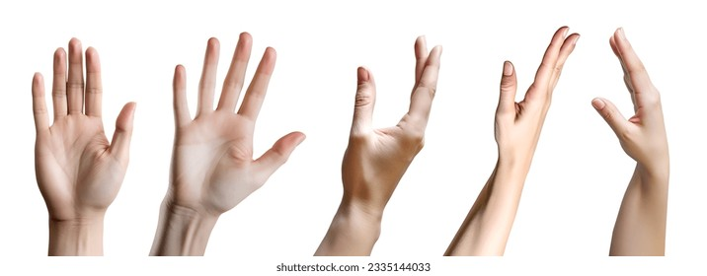
Adjustable Positions
Our hands also easily adjust to different positions so we can perform our work most effectively.

Slide 8
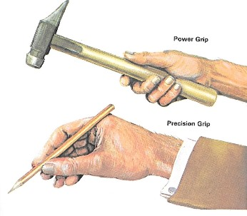
Gripping Action
The power and precision grips are just two of the various grips that we use to get our work done.
Our hands' ability to adapt to different work situations is one of the things that makes them so useful!

Slide 9
Power Grip
We can form a powerful grip by curling our fingers and thumb around an object.
Grasping an object with the entire hand distributes the object’s weight evenly over the muscles and tendons and allows the forearms to help with the load.

Slide 10
Precision Grip
For tasks that demand a delicate touch, a precision grip is needed. Here, objects are surrounded by bringing the thumb, middle, and index fingers together.
The precision grip works well for close-up tasks like centering a nail or writing with a pen.
But avoid using this grip on heavy objects. Instead, choose a good power grip. This will place less stress on your hand and wrist.

Slide 11
Safety First
You should be aware of the hazards that exist in your environment.
Become familiar with the equipment that you use.
Keep track of the work that’s going on around you.
You can take care of your hands by paying attention to the basics and preparing for the job you‘ll be doing.

Slide 12
A Few Hazards to Watch Out For
High-speed cutting tools, heavy machinery, and sharp edges are just a few of the things that we can encounter.
Because of their moving parts, many tools and machines can be dangerous. If we’re not careful, our hands can be cut, pinched, or even crushed.
Make sure that all safety shields and guards are in place before you start work.

Slide 13
Tips on Staying Safe
Not knowing how to use a machine or tool can lead to an accident too.
Take the time to become familiar with the equipment you are working with.
Follow proper procedures for operating and maintaining it.
Don’t take shortcuts.
Don’t wear loose clothing that could get caught up in moving parts and pull your hands in with it.

Slide 14
Choosing Tool Handles
When you are working with tools, be careful of handles that pinch your hand. They can lead to injuries to your nerves, tendons, and blood vessels. Avoid handles with sharp edges and finger grooves.
Protect yourself by choosing tool handles that are smooth or padded. They can also be more comfortable!
Handles should be shaped or positioned so that your wrist can be kept straight when you’re using them.
They should be long enough to extend across the palm to avoid pinching nerves within the palm itself.

Slide 15
Positioning of Trigger Switches
Trigger switches on power tools should be situated so that you use your middle finger or thumb instead of your index finger.
This allows the index finger to help balance the tool without the additional stress of pressing the trigger.

Slide 16
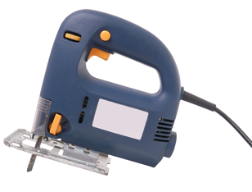
Tools that Cause Vibration
Be careful with tools that cause vibration.
Rapid movement combined with the way a tool is held can hurt circulation or pinch nerves and tendons in your hand.
Vibration-absorbing gloves can help to protect you in these situations.

Slide 17
Gloves
Gloves are the most basic piece of protective equipment for the hand.
It’s important to select gloves that provide the best protection from the hazards that you’re working with.

Slide 18
Gloves
Light, outside work can often mean scratches, blisters, and even poison ivy. You can protect yourself from these hazards with a pair of simple cloth gloves.
Work involving rough surfaces, splinters, and sparks can also lead to injuries. Heavy-duty leather gloves will shield your hands from nicks and minor burns and protect against bruising.
Operations involving sharp-edged tools such as knives can mean painful cuts and scratches. In these situations, you should wear cut-resistant gloves made of metal mesh or similar materials.

Slide 19
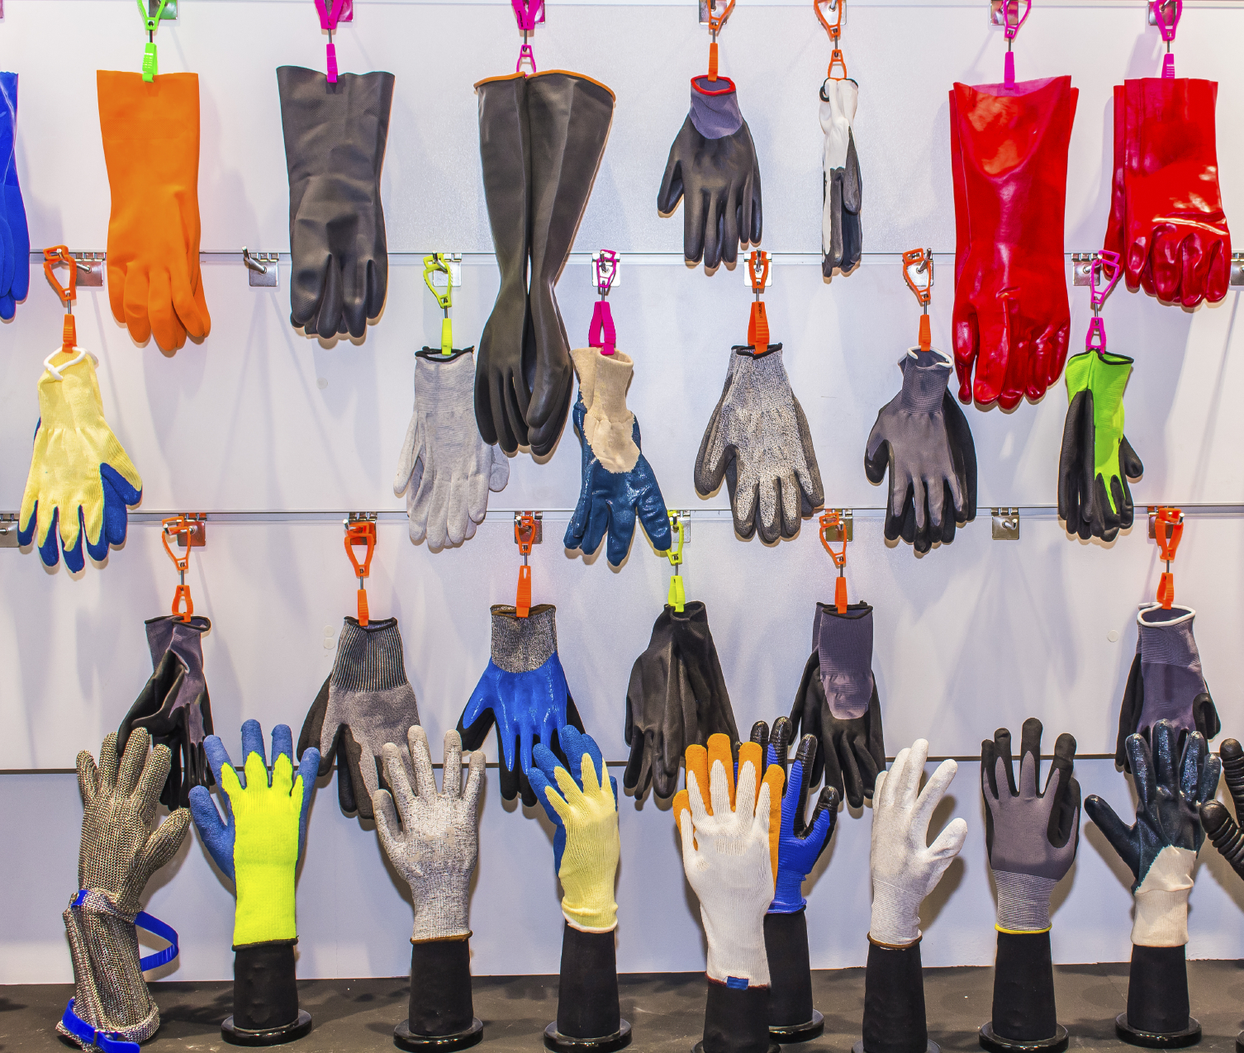
Gloves
Intense heat and flames can both burn your hands. Heat-resistant gloves made of aluminized fabric or other special materials will let you work safely near high temperatures.
And we can’t overlook problems caused by germs and bacteria. Disposable plastic gloves like those used in the food service industry will keep you and the substance you’re working with free from contamination.

Slide 20
Inspecting Gloves for Damage
Remember to inspect and test your gloves and other protective equipment before each use.
Look for rips and other defects.
Exchange or repair anything that is damaged.

Slide 21
Fits Like a Glove
Be sure to get a proper fit.
If gloves are too large for your hands, they will feel clumsy and may get caught in machinery.
If they’re too small, your hands can tire quickly.
Gloves that are too tight can also wear out prematurely, increasing the chance of an accident.

Slide 22
Caring for Your PPE
Choosing the right type of protective gear is just the start. Other factors, like the correct fit and the care of your PPE, are also important.
Make sure your gloves are long enough to keep hazards from sneaking under them.
Trapped materials can become irritating and cause cuts and scratches.
Wash your PPE regularly, especially after exposure to contaminants.
Keep it separate from your regular laundry.
It may contain chemical residue that could damage clothing.
Be sure to follow recommended storage procedures for your equipment.
Keep rubber and plastic gloves away from heat and sunlight.

Slide 23
Other PPE
Some jobs require protection that is even more specialized.
To guard against heat and splintery or abrasive materials, hand pads or guards will help to keep your hands safe.
To protect against pinching hazards, use finger guards made of fabric or metal.
Remember, no single type of PPE will protect you in every situation. Talk to your supervisor to determine what is right for you.

Slide 24
Barrier Creams
Gloves do a good job with most hazards, but in some circumstances, you’ll need extra protection from minor irritants that might sneak through.
Special barrier creams cover the skin with another invisible protective coating.
To get their full effect, barrier creams should only be applied to clean skin, and should be reapplied often.

Slide 25
Ergonomic Hazards to Hands
In addition to the external hazards caused by machinery and tools, we need to be aware of internal hazards … those ergonomic problems that can physically occur within the hand itself.
For instance, your muscles, ligaments, and tendons can all be stressed by performing repetitive motions.

Slide 26
Repetitive Jobs
Many jobs require you to do the same things repeatedly.
That means making the same stressful movements with your hands and fingers for long periods.

Slide 27
Long-Term Effects
Occasional or short-term exposure to these hazards shouldn’t cause problems.
Long-term stresses over months and years can result in significant injuries.

Slide 28
Reducing the Risk
We can reduce the risk of developing these types of problems by alternating our work, varying the motions we make, and cutting down on unnecessary movement.

Slide 29
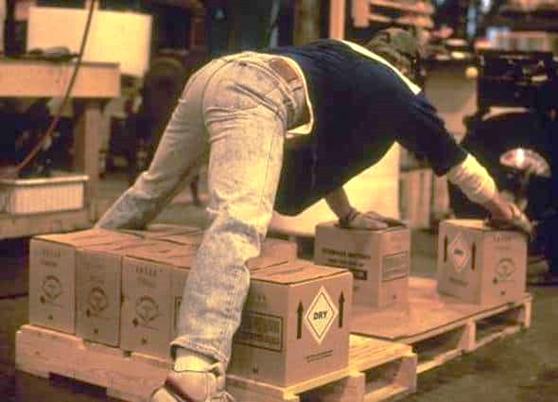
Keeping Things Within Reach
Awkward stretching, bending, and reaching can also put stress on your body.
You can help to avoid these problems by laying out tools and materials within easy reach.

Slide 30
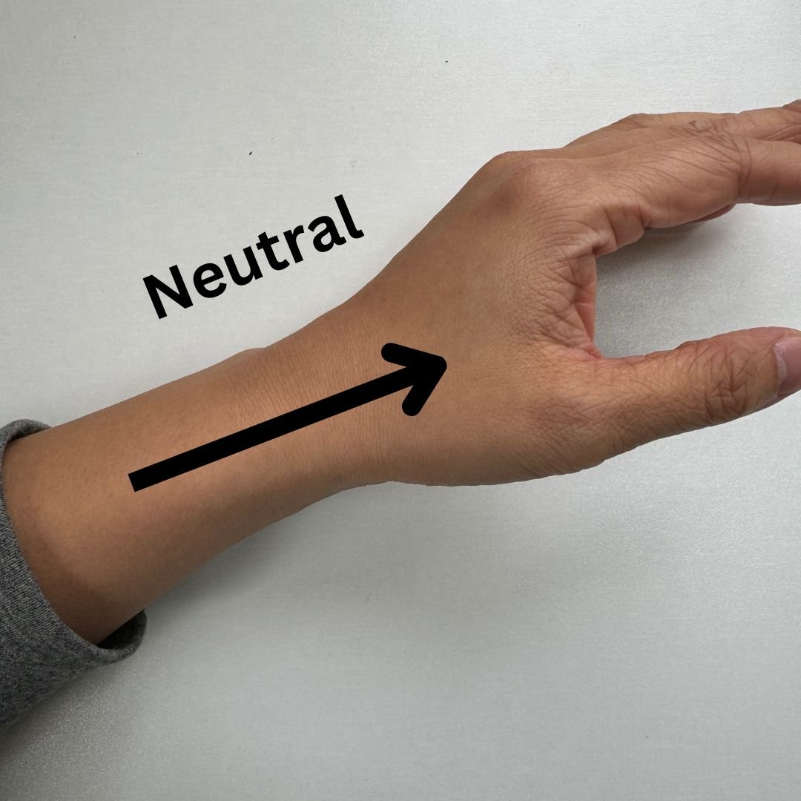
Further Reducing the Risk of Injury from Repetitive Motion
To further reduce stress on your wrist, adjust the angle of your work surface.
This will help you to keep your wrist straight, in what’s called the neutral position.

Slide 31
Review
Be aware of the hazards in your environment.
Learn how to work safely with the machines and equipment that you use.
Select tools that minimize stress and other hazards.
Use gloves and other protective equipment when needed.
Avoid repetitive motions that can lead to ergonomic problems.

Slide 32
Questions?

