Slide 1


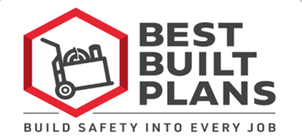
Creating a Contractor Ergonomics Program
to Reduce Soft Tissue Injuries
Among Construction Workers
Contractor Program
Ann Marie Dale PhD, OTR/L
Professor of Medicine
Washington University School of Medicine
www.bestbuiltplans.org – Click on “I’m a Trainer” -- Contractor Training Program
Notes:
This presentation will provide you with information that you can use to create your own ergonomics program to reduce soft tissue injuries among the construction workers that you employ.
This contractor program is available to download as a PowerPoint and in shorter video segments on the Best Built Plans Contractor Training Program page.
This contractor program is part of the Best Built Plans Program, which includes resources to help you plan and train for safe materials handling at each phase of your project to reduce the risk for soft tissue injuries.

Slide 2
DISCLAIMER:
The contents of this document are intended only for the informational use of the addressee. The information contained herein is not intended as, nor does it constitute, specific legal or technical advice to the reader. Any information or recommendations contained herein are provided to the addressee for usage at their own discretion. Neither Signal Mutual Indemnity Association Ltd., its Members, Managers, or Signal Management Services, LLC and/or their employees accept liability whether in tort, negligence, contract, or otherwise, to anyone for any lack of technical skill, completeness of recommendations, or analysis of issues associated with the discussion of topics set forth herein. No responsibility is assumed for the discovery or elimination of unsafe conditions. Compliance with any recommendations herein should not assume your compliance with any federal, state, or local law or regulation. Additionally, the information contained herein does not constitute and shall not be construed to reflect the adoption of any coverage position by Signal Mutual Indemnity Association Ltd., its Members, Managers, or Signal Management Services, LLC and/or their employees.

Slide 3
Questions addressed:
Why do contractors need an ergonomics program?
What do management and workers need to know about ergonomics?
How can ergonomics be integrated into a company’s safety program?
Notes:
Let’s begin.
This presentation is intended to answer three questions:
1) Why do contractors need an ergonomics program?
2) What do management and workers need to know about ergonomics?
3) And how can ergonomics be integrated into a company’s safety program?
During this presentation, we will also introduce you to the Best Built Plans Program that has resources to help you plan for and train your employees on how to prevent soft tissue injuries.

Slide 4
What is Ergonomics?
  Ergonomics is the science that reduces the risks associated with soft tissue injuries.
What are Soft Tissue Injuries?
  Sprain, strain, and overexertion injuries, also referred to as musculoskeletal disorders or MSDs.
Notes:
Before discussing why a company should develop an Ergonomics Program, it is important to understand that Ergonomics is the science that reduces the risks associated with soft tissue injuries.
And soft tissue injuries include sprain, strain, and overexertion injuries, and are also referred to as musculoskeletal disorders or MSDs.

Slide 5
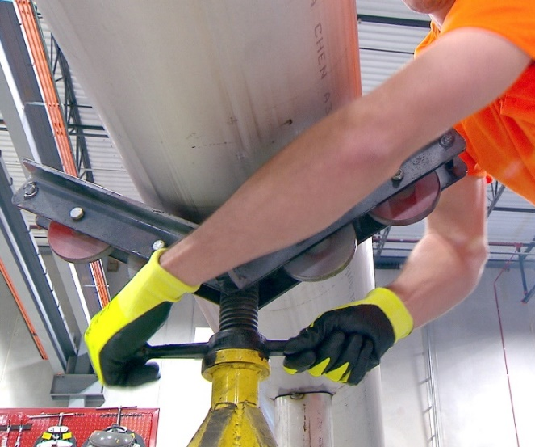
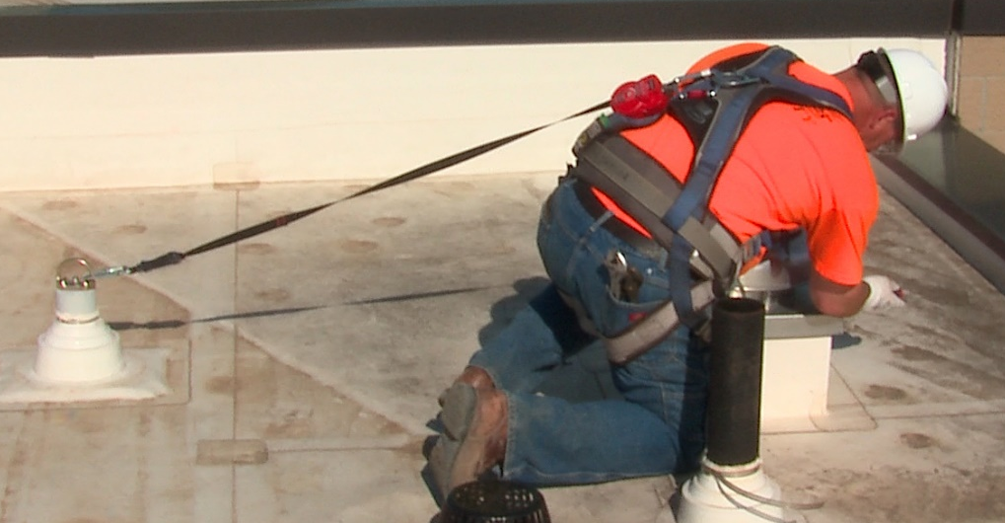
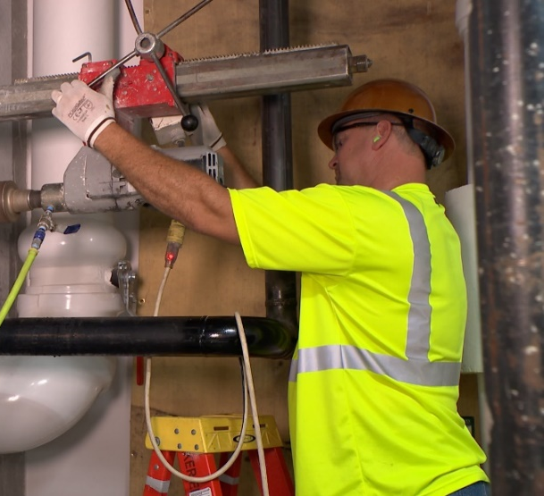
The business case for preventing soft tissue injuries
Soft tissue injuries are common and costly:
  Account for 27.3% of all nonfatal injuries in construction each year.¹
  The lifetime risk of suffering such an injury is 21% for all construction trades, although many more suffer chronic pain.²
  Cost the construction industry $2.21 billion in 2021.³
  Covering the cost of an injury claim requires significant resources. For example, the total cost of a $50,000 claim = $127,000 in direct and indirect costs.⁴
Photos courtesy of the MCAA
1) Bureau of Labor Statistics. (2016). Table R1. Number of nonfatal occupational injuries and illnesses involving days away from work by industry and selected natures of injury or illness, private industry, 2014. http://www.bls.gov/iif/oshwc/osh/case/ostb4367.pdf. 2) Dong X, Ringen K, Welch L, Dement J. (2014). Risks of a lifetime in construction, Part I: traumatic injuries. Am J of Ind Med, 57(9): 973-83. https://doi.org/10.1002/ajim.22363 3) Liberty Mutual Workplace Safety Index 2021 https://business.libertymutual.com/wp-content/uploads/2021/06/2021_WSI_1000_R2.pdf 4) National Safety Council, Substance Use Calculator : https://www.nsc.org/forms/substance-use-employer-calculator
Notes:
So why is it in a contractor’s interest to develop an ergonomics program to prevent soft tissue injuries?
The simple answer is because these types of injuries are common and costly.
They account for 27% of all nonfatal injuries in the industry;
Construction workers have a 21% lifetime risk of experiencing a soft tissue injury ;
And MANY more workers suffer chronic pain from this type of injury without having a recordable injury.
Soft tissue injuries can end careers and severely impact a worker’s productivity during work, and quality of life in retirement.
Since soft tissue injuries are relatively common, it is not surprising that they are also costly.
Soft tissue injuries have been reported to cost the U.S. construction industry billions of dollars each year. In 2021 alone, these injuries cost the industry $2.21 billion according to Liberty Mutual’s Workplace Safety Index.
If we look at one example, a single injury claim for $50,000, can actually cost an employer $127,000, and require an employer with a 5% profit margin to generate an additional $2.5 million to cover the cost of the injury. These injuries also lead to chronic pain, and this pain can affect worker productivity and lower worker morale.

Slide 6
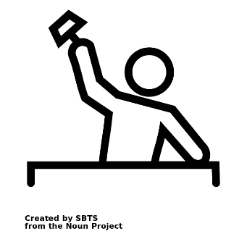
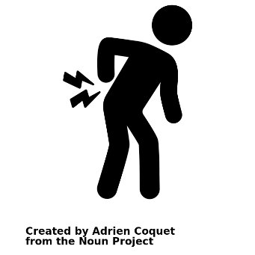
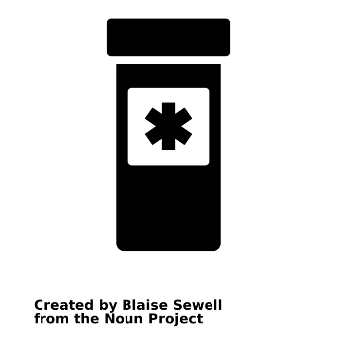

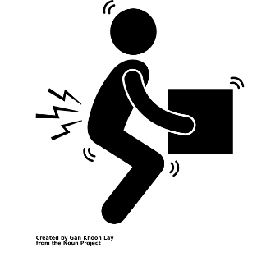
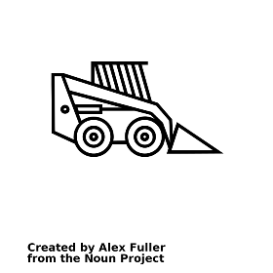
Impact of physically demanding work
Construction work is hard work
High rates of injuries
Commonly prescribed opioids
“If I don’t work I don’t get paid”
Workers work while in pain
Work while under the influence of opioids
High injury rates
Job insecurity
High levels of job stress
No sick leave for treatment
Dale AM, Evanoff B, Macomber M, O’Reilly M, Rosen J, Schneider S. Can ergonomics programs help solve the opioid crisis? Preventing Pain Is the Key. The Synergist. May 2019; https://synergist.aiha.org/the-synergist-may-2019
All icons are from the Noun Project, creators in order from left to right: SBTS, Adrien Coquet, Blaise Sewell, Kamin Ginkae, Gan Khoon Lay, Alex Fuller
Notes:
What is the impact of the physically demanding work?
We call this graphic the “pain train”.
Reading the graphic from left to right, the first picture recognizes that construction work is physically demanding.
This leads to high rates of injury and chronic pain shown in the second picture.
Many of these workers go to the doctor to seek treatment for their injuries and pain, even very young workers. Many of these workers are commonly prescribed opioids.
Many construction workers do not get paid sick leave and have poor job security
So workers continue to work even while they’re in pain and they may work while under the influence of opioids

Slide 7

The risk for soft tissue injuries increases the risk
of dependence on opioid prescriptions and illicit drugs:
  These injuries cause pain, which affects productivity, and are
  often treated with addictive opioids.
  1 out of 4 people prescribed opioids for long-term pain become addicted.¹
  Many construction workers’ painful injuries are treated with prescription opioids (e.g., codeine, morphine, hydrocodone, oxycodone)
  Substance use is costly to workers, employers, and the industry.
Estimated Annual Substance Use Cost for Employers with 100 Employees in Different Industries in Missouri ²
 | Construction | Agriculture | Transportation
TOTAL COST | $143,636 | $45,324 | $78,123
Lost time | $ 43,792 | $ 7,328 | $21,189
Job turnover & retraining | $ 63,266 | $10,208 | $30,611
Health care | $ 36,578 | $27,788 | $26,323
Centers for Disease Control and Prevention. Promoting Safer and More Effective Pain Management. https://tinyurl.com/overdosefacts
National Safety Council, Substance Use Calculator : https://www.nsc.org/forms/substance-use-employer-calculator
Notes:
The treatment of these painful injuries with prescription opioid medication is a more recent and related concern, and a growing problem.
There is new evidence that even short-term opioid use can lead to opioid dependency or addiction. According to the Centers for Disease Control and Prevention, 1 out of 4 people prescribed opioids for long-term pain become addicted.
This addiction is costly and more costly for the construction industry than other industries.
Using a substance use cost calculator, we calculated the costs a contractor with 100 employees in Missouri would pay for lost time, job turnover and retraining, and healthcare, and found it is higher than for an employer in agriculture or transportation.
These costs reduce your overall profit.

Slide 8
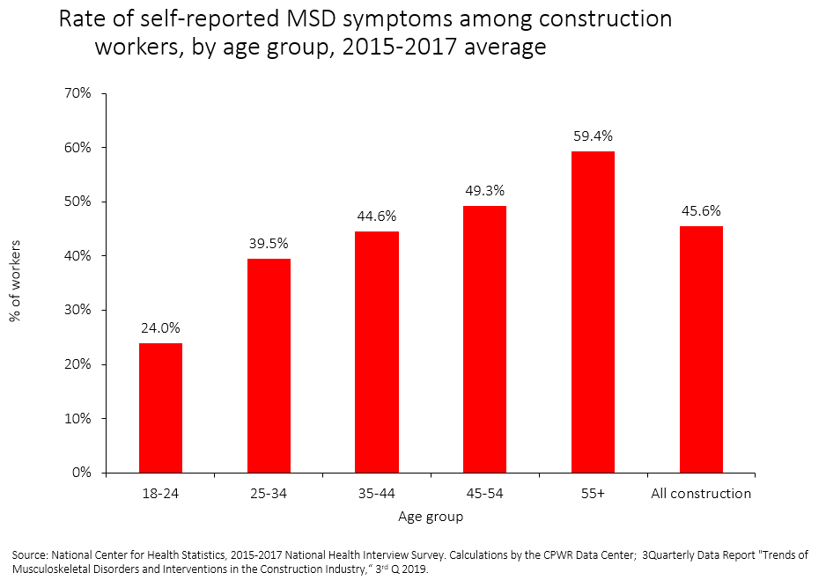
The workforce is aging
Rising workforce aged 45 to 64 years: 25% (1985) to 40% (2015).
40% of construction workers 50 years or older suffer from low back pain, and it is even higher among those with longer tenure.
Musculoskeletal disorders (MSDs) -- soft tissue injuries -- are more common among older workers, particularly those with more than 5 years working in construction.
Older workers suffer from more comorbidities compared to younger workers, including heart disease, hypertension, and diabetes, but fewer suffer from obesity.
Source: Dong XS, Wang X, Fujimoto A, et al. (2012). Chronic back pain among older construction workers in the United States: a longitudinal study. Int J Occup Environ Health, 18(2): 99–109; Construction Chart Book, 6th edition
Notes:
In addition, the construction workforce is aging.
In 1985, 25% of the workforce was between 45 and 64 years of age -- by 2015, this older group accounted for 40% of workers.
In 2012, a study by CPWR’s Data Center showed that 40% of construction workers over the age of 50 suffered from low back pain, and the pain was higher among those workers who had worked in the industry for more than 5 years.
A more recent CPWR study found that soft tissue injuries – referred to as MSDs on the chart -- are more common among older workers, as shown on the top chart. They are also more common among those with more than 5 years working in construction. As noted earlier, the pain from these injuries can reduce a worker’s productivity during work, shorten their career, and negatively impact their quality of life while working and in retirement.
Compared to younger workers, older workers also suffer from more comorbidities – in other words, other diseases or conditions that a person may have at the same time. As the second chart shows, more older workers suffer from heart disease, hypertension, and diabetes than younger workers but fewer suffer from obesity.

Slide 9
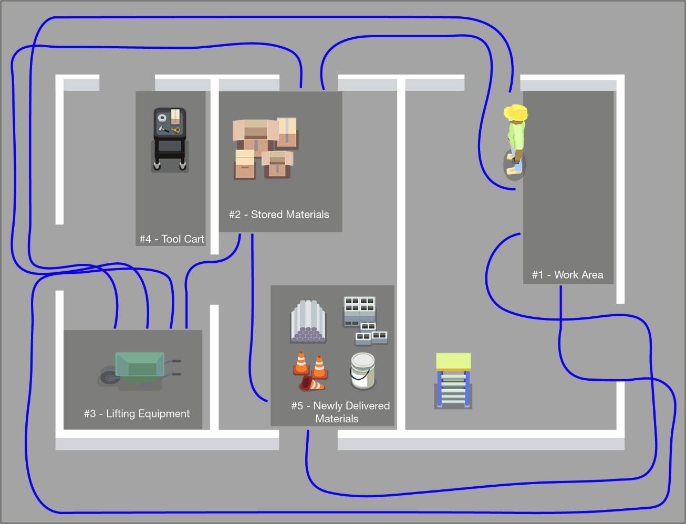
Poor work layouts are also costly
Cause physical stress and fatigue…and waste time
Spaghetti chart: visual method of showing wasted movement of your workers
Notes:
Construction workers also suffer from physical stress and fatigue, which impacts their productivity during work.
This slide shows an example of a poor work layout. The blue lines indicate the path a worker would have to travel to retrieve their materials and equipment in order to move it to the location where it will be installed. This “spaghetti chart” is a visual way to see wasted motions that likely increase fatigue and decrease productivity.
Ergonomics is focused on reducing hazards and excess physical demands on workers. One common description is to make the demands of the job fit within the workers’ abilities, because excessive demands will tear their bodies down over time.
Limiting extra motions will help reduce physical demands and allow your employees to work smarter – not harder when moving materials.
To improve your project layout, consider drawing a spaghetti chart with your project layout and asking your employees if there is a better way to locate materials closer to where they will be installed.

Slide 10
Most safety programs do not address ergonomics
Many companies have excellent safety programs ‒ but their programs do not address ergonomic hazards.
Contractors/project managers plan for, engage workers, and provide ergonomic equipment on some projects but not all ‒ it is not company wide.
Workers rely on their employer to provide appropriate equipment and training to allow the BEST ergonomic work processes.
Contractors face challenges to addressing ergonomic hazards and providing the best equipment.
Notes:
While many companies have excellent safety programs that they have spent a long time building and modifying, most do not cover ergonomics, even though ergonomics is intended to address the large number of costly soft tissue injuries that occur in the workforce.
With regard to ergonomic hazards, generally contractors or project managers determine what equipment will be available for workers to use on projects and then expect the foremen to “make it work.”
Some contractors do a great job of:
assessing ergonomic hazards, such as those associated with materials handling, as part of their job hazard analyses,
including their workers in the process,
and providing the necessary equipment for workers, but they don’t do it consistently for all of their projects.
From the worker perspective, they rely on their employer to provide the best equipment and training to prevent soft tissue injuries, but contractors can face challenges to make that happen.
So getting back to the question about why contractors need an ergonomics program, the answer is that it can help them reduce costly injuries and improve productivity.

Slide 11
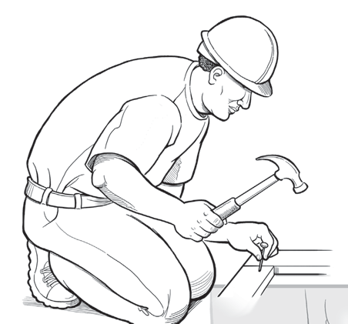
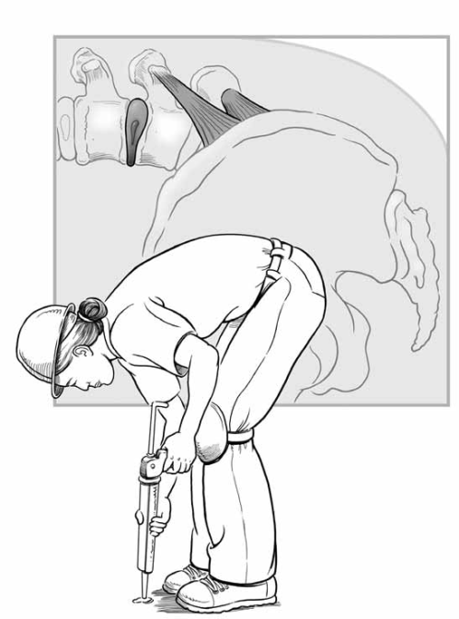
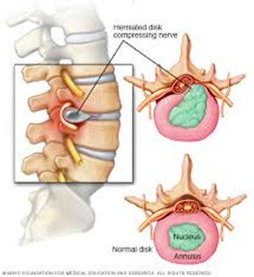
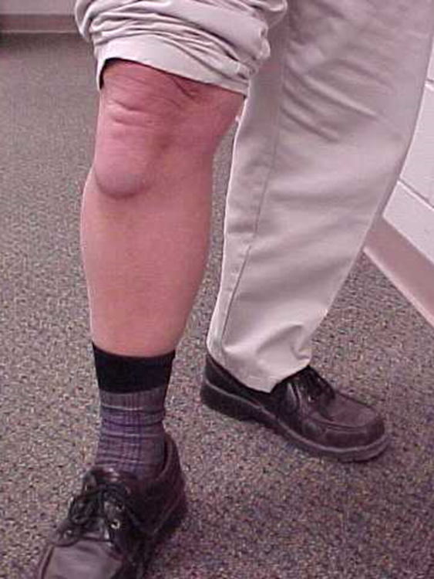

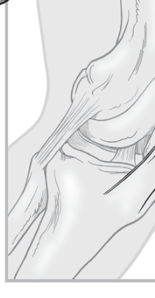
Soft tissue injuries are:
1) Damage to the musculoskeletal system – muscles, nerves, tendons, ligaments, joints, cartilage, and spinal discs.
2) Cumulative – they happen gradually, as opposed to accidents.
3) Chronic – the effects last a long time.
Photo courtesy of NIOSH
Photo courtesy of Dr. Ann Marie Dale
Photo courtesy of NIOSH
Used with permission of Mayo Foundation for Medical Education and Research, all rights reserved
Notes:
So how do soft tissue injuries, which include sprain, strain, and overexertion injuries and are also referred to as musculoskeletal disorders or MSDs, develop?
Soft tissue injuries, occur when the different soft tissues of your body – your muscles, nerves, bones, and connective tissues like tendons and ligaments – are damaged.
They develop gradually over time because the tissues are traumatized daily by heavy workloads. The damage accumulates in the tissues. Eventually, the damaged tissues fail, which may appear as a sudden event, such as an incident of low back pain. The task or activity that caused the failure may be the same activity that caused tissue trauma in the past, but not always. This is important to consider if you use past injury records to figure out how to change the way the work is done.
The damage may also become chronic or persistent, which means it lasts for a long time, possibly the rest of a worker’s life.
The photos at the bottom left side of the screen show the structure of your low back – the most common body part to be injured. The soft disc is a cushion between each bone but the center “jelly,” which is the part in green on the screen, may push on the spinal nerves, which are the orange tubes, when the body bends forward. The back is complex. Once the tissues “wear and tear,” it is very hard to get them to heal.
The bottom right photo shows a worker with knee bursitis who spent a lot of time kneeling on a hard floor without the benefit of padding against the floor. This worker‘s doctor recommended a knee joint replacement. Once you have this procedure, it is difficult to kneel. So this worker could not go back to doing the same type of work, at least the way he used to work, by kneeling.

Slide 12
Ergonomics reduces risk of soft tissue injuries
Goal: fit the tasks, tools, and environment to the physical abilities of the worker
Identify Ergonomic Hazards
High Force
Awkward Postures
Fast/Prolonged Repetition
Stress from Contact
Hand/Body Vibration
Environment (cold)
Notes:
Ergonomics is the science to reduce the risk of soft tissue injuries.
Since heavy physical demands will cause excess wear and tear on a worker’s body, the goal of ergonomics is to fit the job tasks, tools, and environment to meet the physical abilities of the worker.
There are several ergonomic hazards that should be considered in each work task because they can make the work too demanding for a worker’s body.
These hazards are high force, awkward postures, repetitive motions, stress from contact against the body, hand or body vibration, and working in a cold environment.

Slide 13
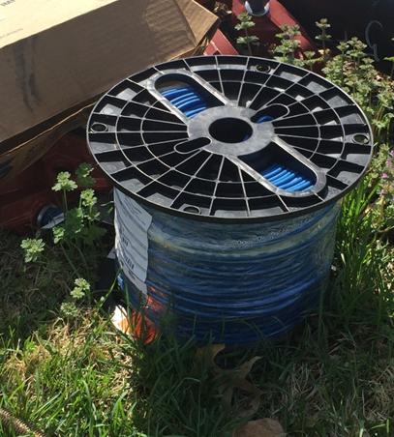
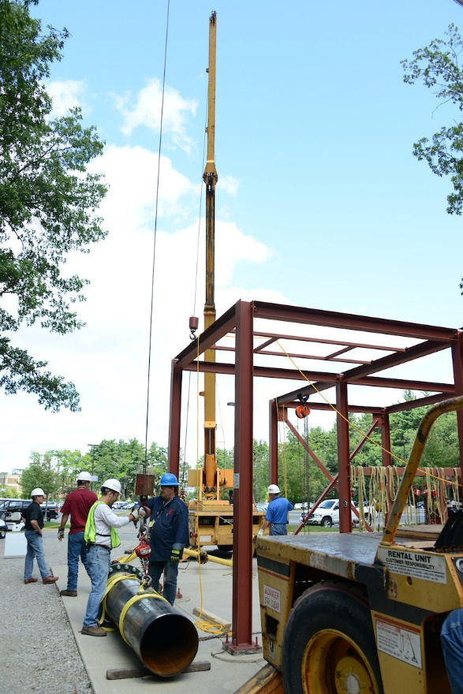
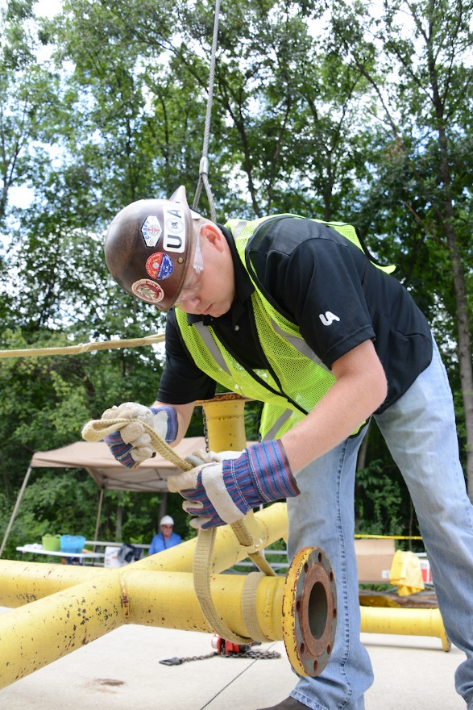
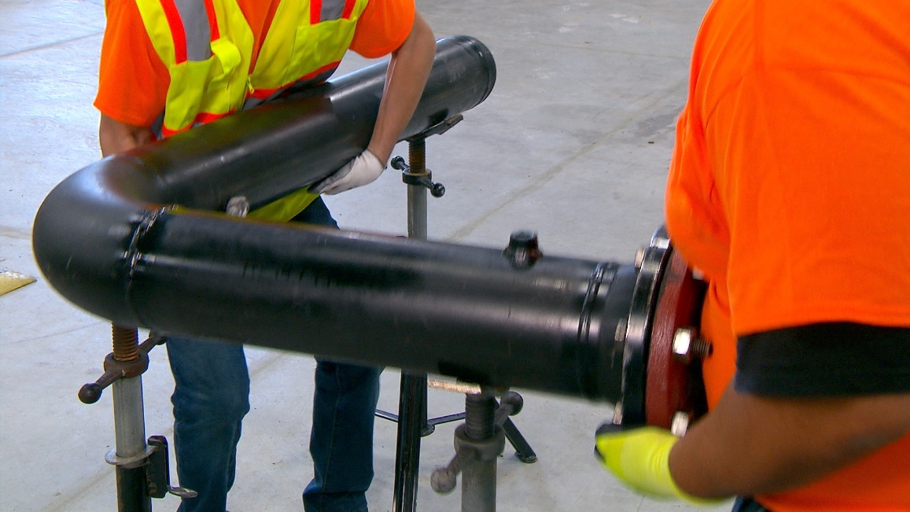
High Force: how much is too much?
Force is the physical power needed to move an object
Photo courtesy of the Healthy Work Center,
Washington University School of Medicine in St. Louis
Photo courtesy of the UA
Photo courtesy of the UA
Photo courtesy of the MCAA
Notes:
Force is the amount of physical power needed to move an object.
It’s the most important hazard that causes physical stress or wear and tear on the body. In construction, this often occurs from handling materials.
But how much is too much force?
It’s easy to decide whether something is too heavy for one person to lift if it weighs a lot, such as 200 pounds or more.
It’s more challenging to decide if one person should lift an object that weighs 100 pounds, or if they should lift an object that weighs 80 pounds and must be carried a long distance, such as to the other side of a building or job site.
The National Institute for Occupational Safety and health -- NIOSH -- recommends lifting no more than 50 pounds by one person, which is why airlines charge more if a bag weighs more than 50 pounds.
Defining how much is too much for your employees to lift will be helpful for controlling hazards from lifting.

Slide 14
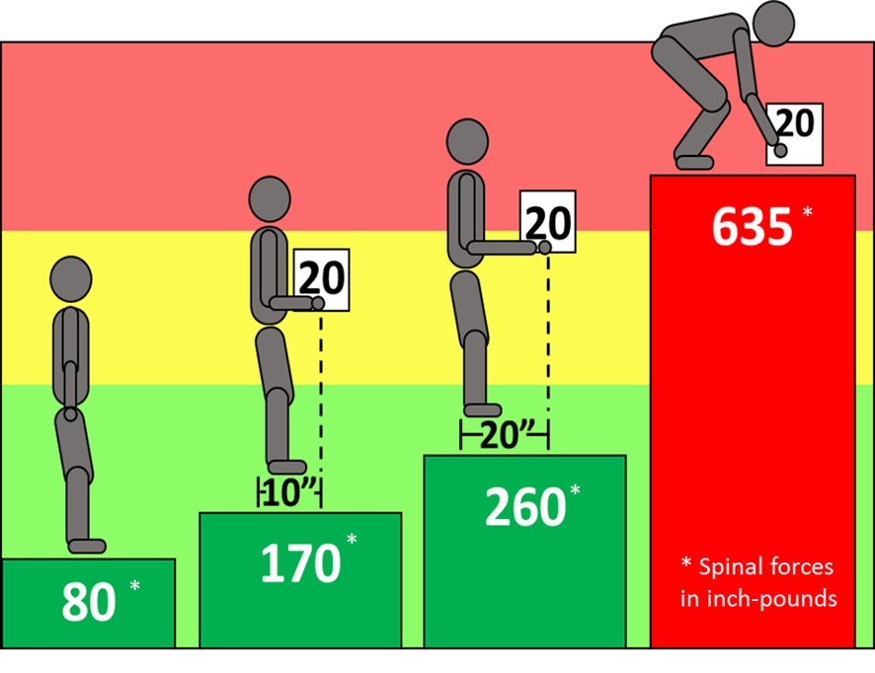
Risk of injury: Low back (spinal) forces and lifting
Effect of load and positioning on spinal forces
Reduce the physical stress
Horizontal distance -- Keep the load as close to the body as possible
Vertical location – Position materials at waist height
Weight – Get help lifting and carrying materials weighing 50 lbs. or more
*
Image courtesy of Washington University in St. Louis
*
*
* Spinal forces in inch-pounds
*
Spinal Forces
Notes:
How does the weight of the load affect your low back?
The weight can be measured through spinal forces in the joints of your low back. In this colorful diagram, the figure to the left is standing upright with no load. The spinal forces from gravity on the low back is 80 inch-pounds.
The second figure is holding a 20-pound load close to the body ‒ 10 inches from the hands to the low back ‒ this is an IDEAL posture to carry a load. The spinal forces goes up to 170 inch-pounds.
If the load is moved away from the body to a distance of 20 inches, the spinal forces increase significantly to 260 inch-pounds, as shown in the third figure. This shows that how close you hold an object in front of your body makes a BIG difference to your low back forces.
The fourth figure shows the large increase in spinal forces from lifting an object from the floor. The distance to the box is larger and the body is not upright. The spinal forces have more than tripled from the IDEAL figure ‒ changing from 170 inch-pounds to 635 inch-pounds.
To reduce physical stress, it’s important to keep the load close to the body, consider the vertical location of the materials – whenever possible position them at waist height, and limit the weight of what one person can lift and carry without help. Equipment or teams should be used to lift and move materials weighing 50 pounds or more.
Your insurance company may have resources available to help you determine the risk for tasks your workers perform. For example, Liberty Mutual has an app that can help gauge the risk and recommend movement modifications to prevent injuries.

Slide 15
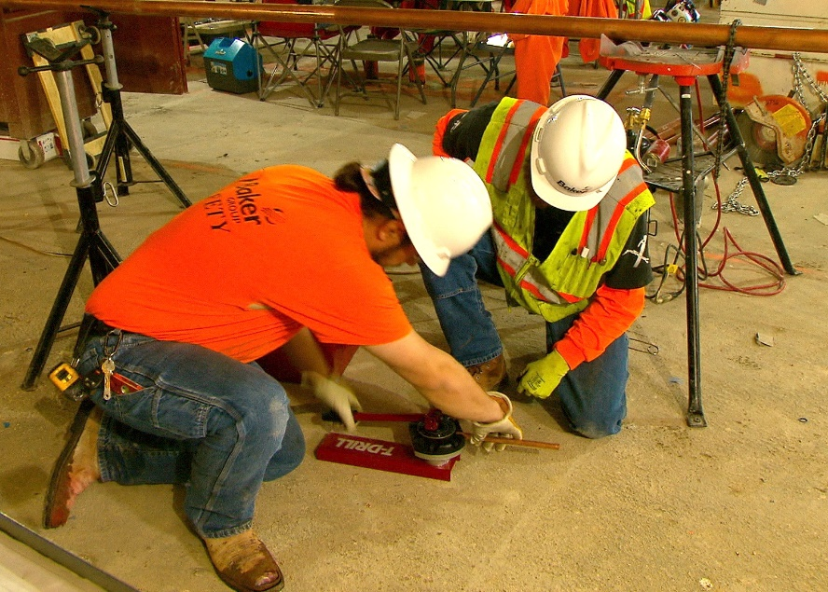
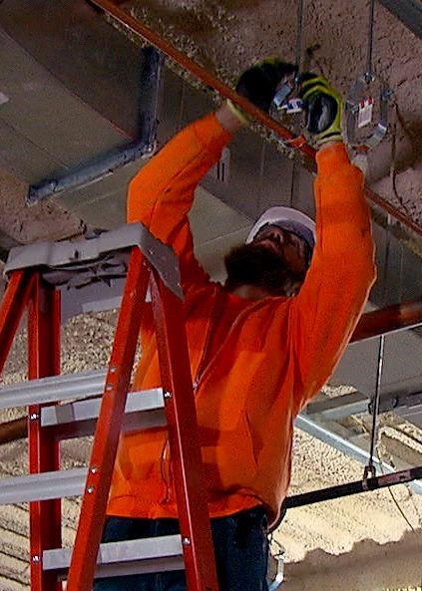
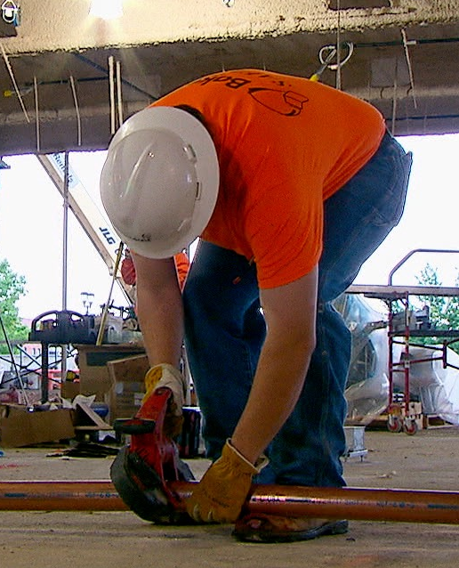
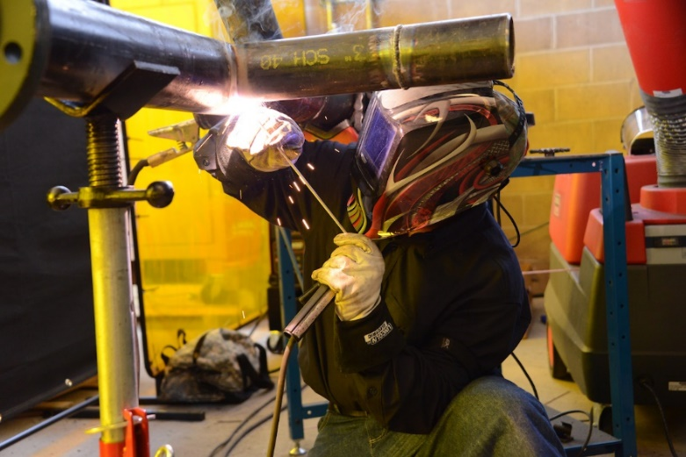
Awkward Postures: near floor or overhead
Photo courtesy of the MCAA
Photo courtesy of the MCAA
Photo courtesy of the UA
Photo courtesy of the MCAA
Notes:
Awkward posture is another common hazard in construction work.
The far left picture on the screen, which shows a person working at floor level using a forward bent posture, is an awkward posture that causes increased spinal force.
The second photo from the left shows a person kneeling, which causes a contact stress between the hard ground surface and the knee.
The other two photos show individuals working overhead and above the shoulder level. Doing overhead work places the body in another poor or awkward posture. Working in this posture decreases a worker’s available strength to perform the task and will cause fatigue more quickly.
Any time a worker’s hand is positioned above their head height, there is high stress on their shoulders, increasing the risk of having a shoulder injury.

Slide 16
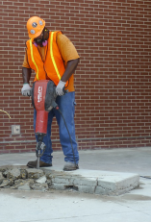
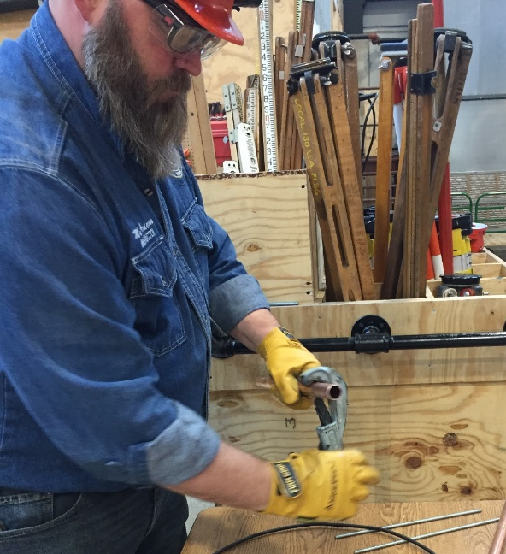
Other Hazards
Repetition
Contact stress
Vibration
Environment (cold)
Photo courtesy of the UA
Photo courtesy of the International Masonry Institute & OSHA
Disclaimer: CPWR does not endorse any specific equipment or product.
Notes:
Other hazards that contribute to risk for soft tissue injuries, but may not involve handling materials, are highly repetitive tasks, such as repeatedly tightening objects using a wrench, contact stress, hand and body vibration, such as that caused by jackhammering, and working in a cold environment.

Slide 17
Build an ergonomics program to create an ergonomics culture
Must include:
  Management Commitment to address ergonomic risks and willingness to participate in developing the program.
  Worker Involvement to create the program and to attend ongoing meetings to support the program over time.
  A Plan to decide on the company goal for ergonomics and define the steps for achieving the goal.
  Communication and ongoing activities to work on to develop and implement the ergonomics program.
Building an ergonomics program and creating the culture will take time.
Notes:
To address ergonomic hazards and reduce the risk of soft tissue injuries, you need to build an ergonomics program. Your program will help you create a culture focused on ergonomics.
The most important ingredients needed to build your program are listed on your screen.
First, you must have management commitment. This is not just a commitment to having the company address ergonomics, but a commitment to having management actively participate in developing and implementing the program over time. I want to emphasize, a culture cannot change without management showing true commitment, and the effort must be consistent over time. Conducting a one-time toolbox talk or telling workers informally to lift properly is not enough to cause a change.
Second, workers must be included in creating and implementing the program. You need their involvement to get buy-in, to help you identify hazards and related solutions, and to help them understand what you want them to do. They should also help review the progress of the program over time.
Third, you must have a plan for creating your program. This should include a company goal for ergonomics, and some clear steps to take to achieve your goal.
Finally, you should communicate your plan and program to everyone in your company. You should also include several activities from your ergonomics plan that are delivered over time.
Building a company ergonomics program and creating an ergonomics culture takes time. You can start by assembling a small team, including representatives from all employee levels, and have a meeting to layout an approach, establish your goal, and develop a schedule and next steps.

Slide 18
What should an ergonomics program include?
Ergonomic goals: Common ergonomic hazards in your company.
Five key elements:
  A plan to mitigate hazards
  Defined work processes to reduce ergonomic hazards
  Steps to obtain proper equipment and make it available
  Employee training for ergonomic knowledge and awareness
  Ongoing review of ergonomic hazards and injuries
Every company should create an ergonomics program that systematically addresses ergonomic hazards on all projects.
Notes:
What should an ergonomics program include?
First, your ergonomics goals – the ergonomic hazards you want to address. To establish your goals, you need to consider the common ergonomic hazards in your company.
Once you’ve set your goals, then you need to develop the 5 key elements of your program:
The first element is planning to mitigate the hazards in work tasks.
The next 3 elements focus on the methods to mitigate the hazards. They include:
Defining the work processes or steps for how the work can be done to control the hazards.
Making sure the proper ergonomic equipment is available.
Training employees to ensure they have knowledge and awareness of ergonomic work processes and proper use of the equipment.
And the last element is engaging in an ongoing review to check to see if the ergonomics program is working as planned. One part of this final element is conducting a final review – a look back -- at the end of a project to understand what worked well and what did not work as planned so that lessons learned can be applied to improve future projects.
These elements should be systematically applied to every construction project.

Slide 19
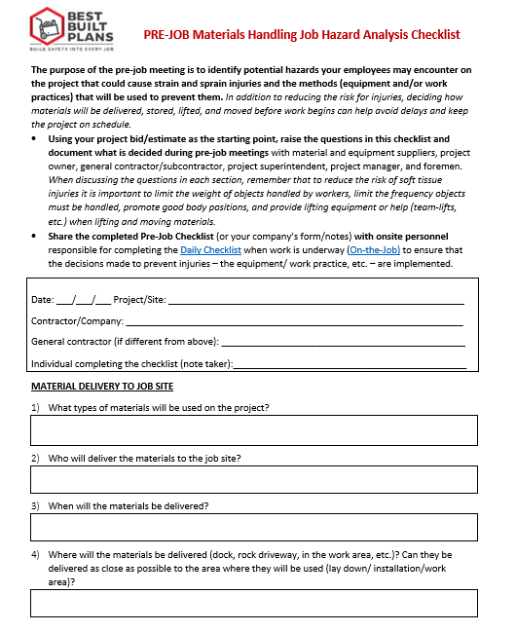
A. Ergonomic goals: hazard identification processes
Review types of injuries on your OSHA log to identify cause of sprains/strains
  ‒ more useful for large companies
Conduct ergonomic hazard assessment of common work tasks
  ‒ use simple checklist of ergonomic hazards
Start by addressing manual materials handling risks
  ‒ the most common ergonomic hazard in the construction industry
Notes:
The hazard identification process will serve as the foundation of the program you develop and should highlight what is of greatest concern or risk in your company.
You may identify the ergonomic hazards you want to address in one of the following three ways:
One approach is to review your OSHA log or injury records to see which tasks or events caused soft tissue injuries. This may not be the best approach for all companies because most companies are too small to have enough injuries to actually see a pattern of cause.
Another approach is to conduct an ergonomic hazard assessment of common work tasks. An ergonomic hazards checklist can help. Simple checklists ask you to list the common work tasks, identify ergonomic hazards in each task, and then prioritize the list of hazards to address the highest risk tasks first. This method is feasible for many companies but not all.
Finally, you may want to consider starting by addressing the task of manual materials handling since this is the most common ergonomic hazard in the construction industry, often associated with 40% of nonfatal injuries. The pre-job checklist, shown on this slide, is an example of a checklist that can be used to identify manual materials handling ergonomic hazards and solutions.
Regardless of the approach, you should reach out to your employees to get their input.

Slide 20
B. Five key elements:
BASIC
ADVANCED
COMPREHENSIVE
Project & Task Planning
Work Practices
Project-level activities
Company-level program
Equipment
Key Elements
Knowledge & Awareness
Review
Notes:
Once you’ve identified your goals – the ergonomic hazards -- you will be ready to develop the five key elements of your ergonomics program touched on earlier in this presentation and shown on this slide.
Most companies will start to build a basic program and include a simple activity or process for each of the key elements listed on the left side of this slide – project and task planning, work practices, equipment, knowledge and awareness, and review.
The basic program is applied to project-level activities. These may be done on one or more projects to get started. Over time, you should apply the same activities or processes to all of your projects.
As the ergonomics program begins to grow within your company, the program will become more “advanced” and then “comprehensive.” These levels are achieved when a company has created a company-level program, and systematically applies the same activities and processes throughout the company and on all projects.

Slide 21
BASIC
ADVANCED
COMPREHENSIVE
Key Elements
Project and Task Planning
Planning for each task when bidding a job/ daily plan includes ergonomic information
Work Practices
Proper lifting and teamwork
Equipment
Basic ergo PPE (knee pads)
Knowledge & Awareness
Toolbox Talks
Review
OSHA log/EMR – review of records
Notes:
This chart shows an example of activities across all elements of a basic ergonomics program.
Project planning tools may include worksheets to help identify ergonomic hazards and solutions to address in a project bid, or for pre-job and daily planning of best ergonomic methods and work tasks.
Workers are trained on simple ergonomic techniques such as proper lifting and teamwork.
Workers are provided with ergonomic PPE, such as knee pads or floor movers.
And Toolbox Talks on ergonomic topics are used to increase worker awareness and knowledge.
The review element at this stage primarily relies on the OSHA log, which is a crude measure of a program’s progress at best.

Slide 22
BASIC
ADVANCED
COMPREHENSIVE
Key Elements
Project and Task Planning
Planning for each task when bidding a job/ daily plan includes ergonomic information
Best ergonomic processes in tasks for bid, pre-job, and on the job on all projects
Work Practices
Proper lifting and teamwork
Policy on lift limits
Equipment
Basic ergo PPE (knee pads)
Process for good supply of ergonomic equipment
Knowledge & Awareness
New employee orientation
OSHA 30 Ergo Module
Toolbox Talks
Review
OSHA log/EMR – review of records
Integrate ergonomics into audits
Formal review of leading ergonomic indicators
Notes:
As the company’s ergonomics program develops and advances, a contractor will monitor planning from what was bid on the job for ergonomic equipment to what was actually used during the project.
The program may expand to include:
Policies such as lifting limits, and requirements for how to lift loads of different weights manually or by mechanical means;
Steps to ensure there is an adequate supply of ergonomic equipment, a way to monitor whether or not workers had the ergonomic equipment when needed, and may include an annual budget to purchase a supply of ergonomic equipment;
Ergonomics training in the new employee orientation;
And use of project written audits that record the use of equipment and work processes to review ergonomic methods.

Slide 23
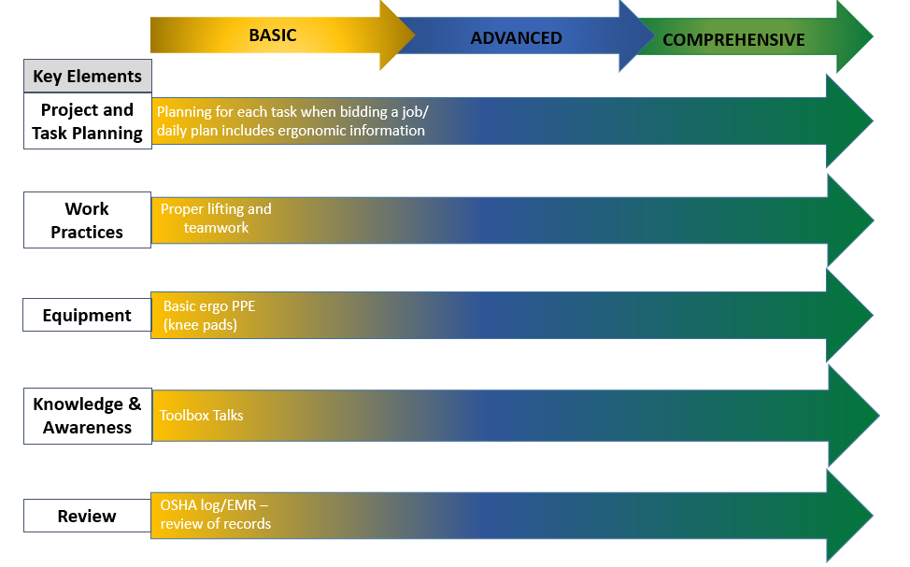
Planning, Practices, and Equipment
(elements #1-3)
Prevent injuries through effective controls:
  Create a plan or steps to consider ergonomics in addition to safety during project planning
  Define ergonomic work practices that reduce the hazards
  Find ergonomic tools/equipment to rent or purchase
Notes:
Now let’s focus on developing the specific elements of your ergonomics program starting with elements 1-3, which include project planning, work practices, and proper equipment to address the ergonomic hazards.
Your plan should define the best ergonomic work practices that will be followed and include finding the best ergonomic tools and equipment. It is important to remember that renting instead of purchasing the tools and equipment may be an option, as well as coming up with solutions of your own.
Contractors and workers have developed some excellent work practices for one project that the workers in the same crew continued to use on future projects. Sadly, these ideas are not always picked up by other crews in the same company or adopted by the contractor for use company-wide.
Having an ergonomics program can help you capture these work practices so the company as a whole will benefit.

Slide 24
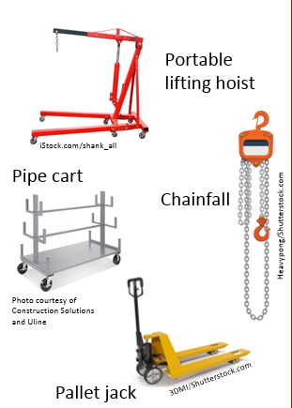

Reduce Force: Move Materials With Lifting Equipment
Equipment Examples
PLAN YOUR WORK
USE ENGINEERING CONTROLS*
  Lift assist to lift large-sized, long, or heavy materials.
  Lifting equipment to transport loads, make fewer trips, and avoid carrying materials on your shoulder.
KEEP FLOORS CLEAR
*Find more examples in the Best Built Plans Contractor Planning Tool:
Notes:
Planning for lifting and moving materials to reduce force and prevent injuries is an essential part of any construction ergonomics program.
A first step is to think through how you are going to do the work and what equipment will be needed – the engineering controls.
You should consider different aspects of the work, including:
The weight of the load;
The size of the load, such as long pipe versus large boxed material or loose fittings;
The distance to move the load; and
The surface to move the load.
Although this information may seem like basic knowledge, many workers don’t have the proper equipment needed when the material needs to be lifted and moved. That’s why involving your construction workers in planning the work is critical.
Your plan should include how you will provide your employees with the lifting equipment for the heavier loads and train them on how to use the equipment. This slide shows several examples of lifting equipment. Additional examples can be found in the Best Built Plans Program Contractor Planning Tool. You can scan the QR code to retrieve these resources.
Since many of these tools are on wheels, it is important to also including steps for keeping the work area clear of obstacles and debris – in other words, engaging in good housekeeping practices.

Slide 25
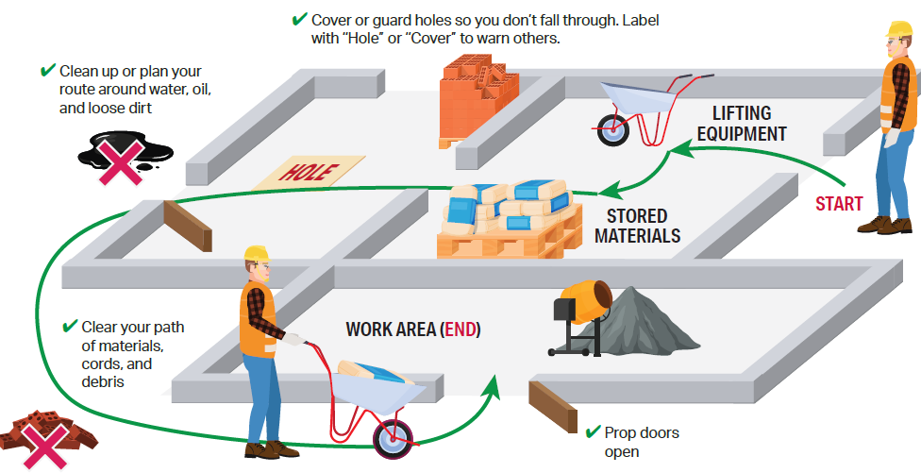
Planned work layouts save time, reduce injury risk, and improve productivity
Save time – less time is spent retrieving and moving materials
Reduce physical stress and fatigue
Spaghetti chart: visual method of showing efficient movement of your workers and materials
Notes:
It is also important to consider the job site layout when planning for how materials will be lifted and moved, where the lifting equipment will be located and, as mentioned in the previous slide, the steps that will be taken to ensure clear paths. Doing so can save time, reduce the risk for injuries, and improve productivity.
This slide shows an example of a GOOD work layout. The green line indicates the path a worker would travel to retrieve the equipment and materials, and move the materials to the location where they will be installed.
This “spaghetti chart” is a visual way to see how best to move materials and avoid wasted motions and obstacles that likely increase fatigue and risk for injury, and reduce productivity.

Slide 26
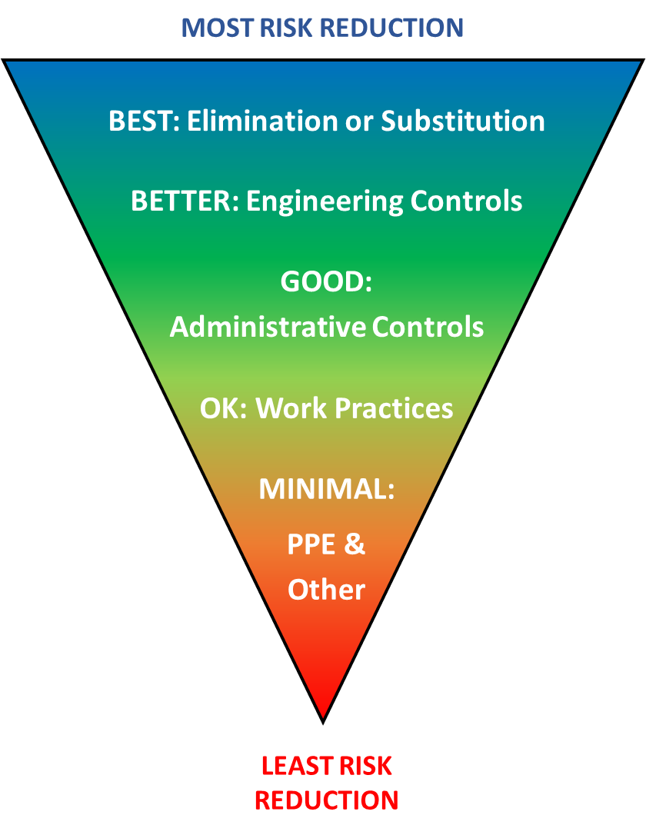
Hierarchy of Controls for Manual Materials Handling
Elimination: Physically remove the hazard (e.g., deliver and store material near work to avoid lifting and carrying)
Substitution: Replace the hazard (e.g., use smaller or lighter-weight materials)
Engineering Controls: Isolate people from the hazard (e.g., provide/use lifting equipment for materials ≥ 50 lbs.)
Administrative Controls: Change the way work is assigned [management] (e.g., assign more workers or rotate tasks)
Work Practices: Change the way work is done [individual workers] (e.g., use proper lifting techniques, two-person lift teams, keep walking paths clear)
PPE & Other Protective Measures: Protect the workers without changing the hazard (e.g., impact resistant gloves, stretch & flex programs)
Notes:
There are a number of solutions or controls that reduce the risk of ergonomic hazards.
Some controls reduce the risk better than others.
This figure shows the hierarchy of ergonomic controls. The types of controls at the top of the triangle are the “BEST” while the controls at the bottom are the least effective.
Eliminating the hazard or substitution that reduces the hazard in the task are the best controls.
Engineering controls generally use equipment to reduce the risk. An earlier slide, showed examples of types of equipment used to lift and move heavy objects.
Scheduling, or what is more commonly called administrative controls, shares the work between workers.
Work practice controls use the best methods to perform the task. Examples include using safe lifting techniques or team lifts.
PPE and other protective measures is the lowest control that offers the smallest benefit. Examples include knee pads or stretching exercises. If you have no other option, stretching exercises may be helpful.

Slide 27
Hierarchy of Ergonomic Controls
HOC level | Ergonomic Hazards
 | Manual materials handling | Work below knee | Arms overhead
Elimination or Substitution | Deliver material near work | User lighter-weight material | Use lighter-weight material
Engineering Controls | Use mechanical assist | Preassemble at shop/in field | Use mechanical assist: scissor lift, hoist
Administrative Controls | Assign more workers | Rotate workers | Rotate workers
Work Practices | Position material close | Raise height of work | Assemble at waist level
PPE & Other | Stretch before and after task | Knee pads, stretch before and after task | Stretch before and after task
BEST
BETTER
GOOD
OK
Minimal
Reduction of risk
Notes:
It‘s helpful to lay out your plan to address ergonomic hazards based on the hierarchy of controls and to identify controls at each level because sometimes workers are unable to use the best control and must resort to one that is only “good enough.”
Here is a simple matrix of solutions that could be used for three different hazards: manual materials handling, work below knee, and arms overhead.
If we look at the ergonomic hazard of manual materials handling, an engineering control would be to use a mechanical assist, an administrative or scheduling control would be to assign more workers to the task, a work practice control would be to position the material as close as possible to where it will be installed, and another control would be to stretch before and after the task.
Remember to implement engineering controls over other methods if possible at all times.

Slide 28
Ergonomic topics on safety forms and checklists
Example of a site-specific safety plan
Deliveries and material storage |  |  |  | Job Hazard Assessment
Trade | Who | How unloaded | Where stored | Task | Hazard | Injury Risk | Prevention
Electrical | Materials will be delivered by truck driver and brought onsite by crew members | Materials will be unloaded by hand; heavier items will be unloaded by boom truck | All materials will be brought on jobsite daily, offloaded by crew, and pushed by cart to install area | Moving materials (wire, conduit, anchors) to install | Improper body mechanics | Strains and sprains | Use the proper lifting techniques covered in training, no lifting over 50 lbs. without help, move materials by cart from delivery location to install area
Mechanical | Delivery company | Delivery company responsibility | Safe locations will be provided by General Contractor | Install duct overhead | Lifting, falls, overhead work | Strains and sprains, falls, struck-by | Proper use of fall protection equipment/plan, contain work area, and utilize proper equipment for safe handling, team lifting or mechanical moving equipment
Find worksheets to help you create your site-specific safety plan at www.bestbuiltplans.org
Notes:
Next, create a simple form or checklist to list how tasks will be done. This information may be listed in your safety program or on a site-specific safety plan and will need to be communicated to your workforce.
This slide shows one example. The Best Built Plans Program includes a workbook, individual worksheets, and checklists that you can use and tailor to create your site-specific safety plan.

Slide 29
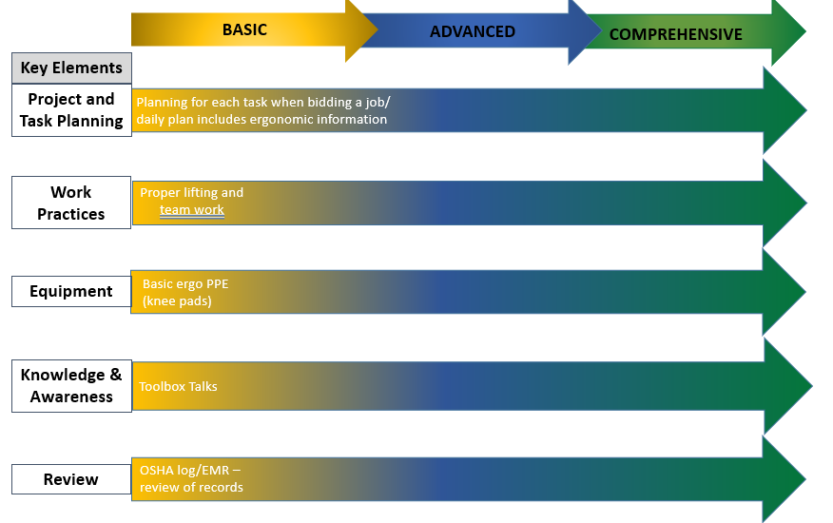

Knowledge & Awareness
(element #4)
What do workers and management need to know about ergonomics?
  The physical risks (aspects of tasks that cause undue stress on body)
  Job-specific hazards (recognize risks of tasks)
  Prevention (controls and work practices)
Worker ergonomic training program that includes in-class lecture and hands-on & computer/ app-based interactive training components
Notes:
The fourth element of a good ergonomics program is making sure that workers and management have the knowledge and awareness to understand the body’s physical abilities and limitations, recognize job-specific ergonomic hazards in work tasks, and identify appropriate controls and work practices to prevent injuries.
We have developed a free worker training program for apprentices and other workers that is available for use with your employees. This training program covers basic ergonomic information and lift training techniques, and includes a hands-on module, computer and app-based training components, and a refresher module for workers who have received the basic training.
It is important that all employees be able to recognize ergonomic hazards so they can help plan for solutions. The worker program should be provided not only to workers and foremen, but also to project managers, estimators, and other staff so all are aware of the hazards and solutions.
You can scan the QR code to retrieve this program.

Slide 30
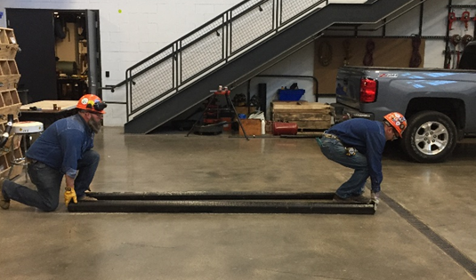
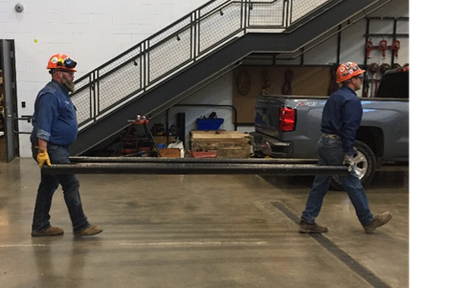
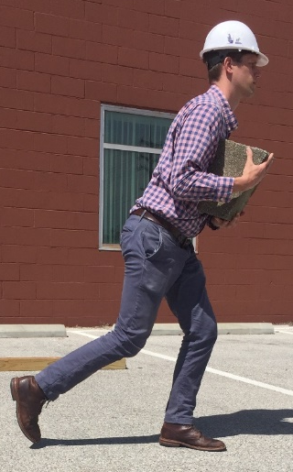
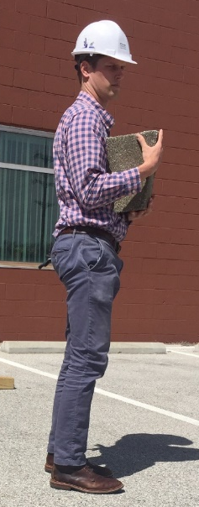
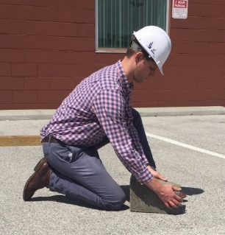
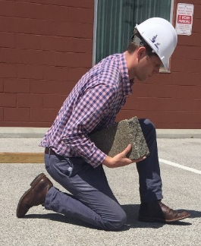
High Force: Make sure workers are properly trained
1 person ideally lifting no more than 50 pounds
Carrying heavy objects no more than 100 feet
Keep work involving objects weighing more than 25 pounds at waist height
One-person lift: small heavy object
Photo courtesy of the UA
Two-person lift: 2-10’ long poles
Photo courtesy of the UA
Photos courtesy of the Healthy Work Center, Washington University School of Medicine in St. Louis
Notes:
To prevent injuries, it is critical to train workers who manually handle materials on proper body mechanics and best practices including lifting no more than 50 pounds without lifting equipment or help from a co-worker, carrying heavy objects no more than 100 feet, and keeping objects weighing more than 25 pounds at waist height.
The photos on this slide show good lifting practices. These are photos from the worker training program I just mentioned, and the lifting practices are included in both the presentation and the hands-on portions of the program.
The left photo is a two-person lift of two 10-foot pipes, although team lifts can be done with any large, bulky, or heavy material.
The right photo series shows the steps for lifting a small heavy object by rolling it up to the waist before standing up.
Through proper lift training you can reduce injuries, as long as the weight of the object is reasonable for a worker to lift.
The human body has limits and it will break down over time.
If too much is expected from the individual’s body, the damage and cost of the injury will be worse.

Slide 31


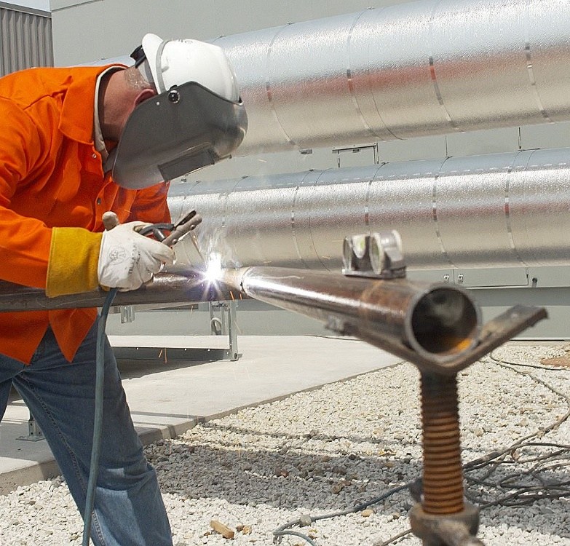
Awkward Posture:
Ground-Level WORK – “RAISE IT UP”
When possible, bring material to waist height using a stand or a cart.*
Adjust its position to get close to the task.
*Find more examples in the Best Built Plans Contractor Planning Tool:
Photos courtesy of the MCAA
Notes:
Awkward postures are another hazard.
It’s important to teach your employees about the risks and provide them with equipment, such as a cart or stand to assemble materials, that they can use to raise the work up and avoid working from the floor or on the ground.
On this slide under “Yes”, for example, a jig or pipe stand on a tripod is being used so the worker can work at waist level. Other trades would need to consider other equipment options suitable for their tasks.
More examples of equipment to raise materials up to waist level can be found in the Best Built Plans Contractor Planning Tool resources.
You can scan the QR code to retrieve these resources.

Slide 32
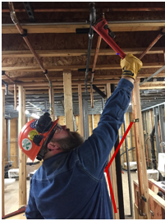
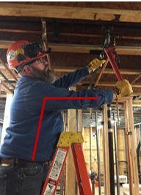
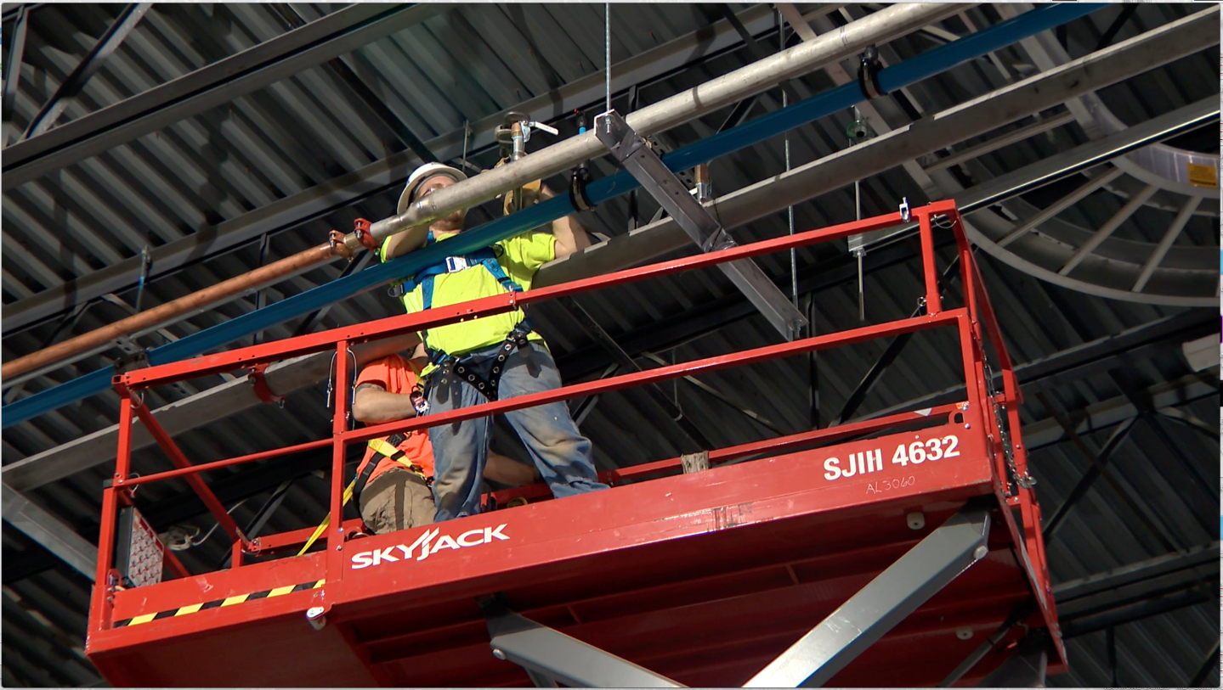
Awkward Posture: Overhead Work – “Get Close”
Get as close to the task as possible.
Move the lift closer or move up on the ladder.
Use extended handled tools or tool extensions.
Photos courtesy of the UA
Photo courtesy of the MCAA
Notes:
Another awkward posture is reaching up overhead to perform a task. This posture puts extra strain on a worker’s shoulders and low back.
If your employees are required to perform work overhead, they should be provided with a device such as a lift or ladder to raise them up, and the equipment should be positioned so the work is at or near the worker’s head height.
The NO photo shows a worker reaching overhead. The shoulder angle is greater than 90 degrees.
The photos next to YES shows a worker using a taller ladder and a worker using a scissor lift to get closer to the work.
Tools with longer handles or extensions can also reduce overhead reaching.

Slide 33
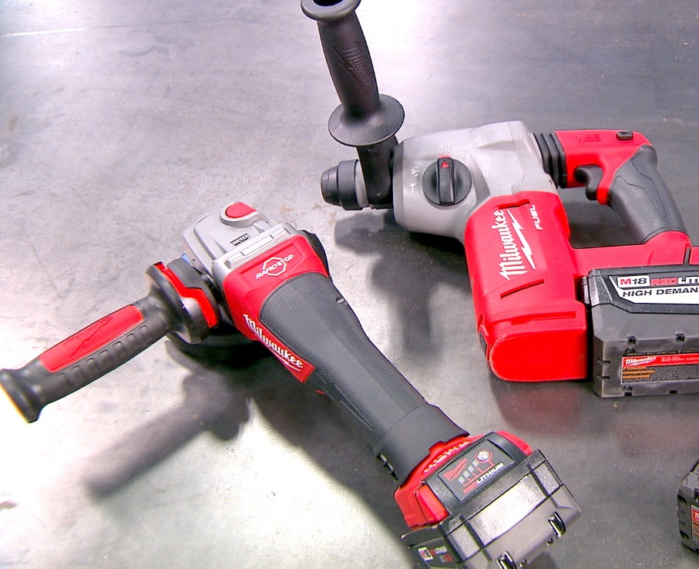
Other ergonomic hazards & solutions
Contact Stress
Cushioned handles help relieve this pressure
Vibration
• Use tools with internal dampers
• Alternate tasks
• Wear anti-vibration gloves
Budgeting for these tools and equipment when preparing a bid can improve your ergonomics program
Find additional examples of solutions for these ergonomic risks at www.bestbuiltplans.org and www.choosehandsafety.org
Photo courtesy of Milwaukee Tool
Disclaimer: CPWR does not endorse any specific equipment or product.
Notes:
Other ergonomic hazards include contact stress and vibration.
There are new ergonomically designed tools with light weight batteries, cushioned handles or additional handles for better leverage, and internal damping for vibration that can reduce exposures.
Budgeting at the bid stage for these tools will improve your ergonomics program.
The Best Built Plans Program, discussed in Section 6, as well as the Choose Hand Safety website include more examples of tools and equipment that can be used to reduce the ergonomic risks associated with these hazards.

Slide 34
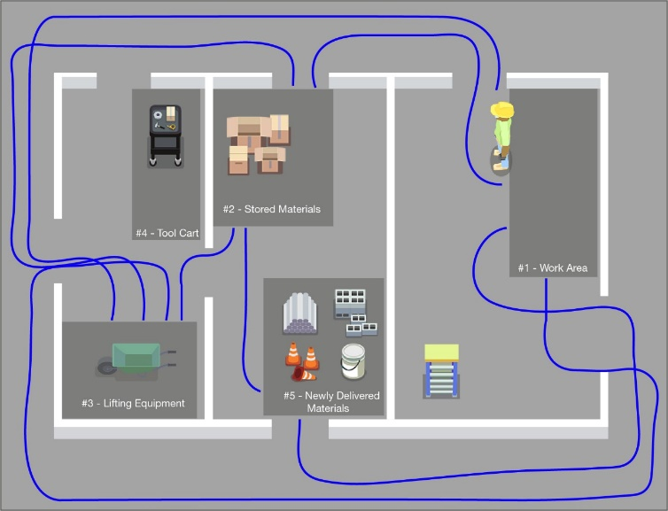
Wasted Effort Moving Materials: “Plan the Route”
Clear pathway
Remove or cover obstacles
Use the most direct path.
Work smarter – not harder
Notes:
Construction workers also suffer from physical stress and fatigue, which impacts their productivity during work.
This slide shows two spaghetti chart examples. The first, uses a blue line to show a poorly planned work layout. This one requires additional effort, putting the worker at an increased risk for injury.
The second one, under “Yes”, is an example of a good work layout. As shown by the green line, this layout reduces the need for wasted motion and pathways are clear, thereby reducing the risk for injury.
Ergonomics is focused on reducing hazards and excess physical demands on workers. One common description is to make the demands of the job fit within the workers’ abilities, because excessive demands will tear their bodies down over time.
Limiting extra motions will help reduce physical demands. The goal should be to work smarter – not harder to get the job done.

Slide 35
Review
(element #5)
Collect one or more leading indicators to monitor program delivery and to review program
  Review training and planning documentation for compliance
  Conduct discrete observations and audits
Get worker feedback
Review OSHA log, EMR, injury records (lagging indicators)
Notes:
The final element in a good ergonomics program is Review.
This step allows you to gauge how well your program is working, helps you understand whether modifications are needed while the project is underway and, at the end of the project, provides you with the information you’ll need to “Look Back” at the project to identify what worked well, what did not work as planned, and what needs to be changed on future projects based on lessons learned.
Most contractors rely solely on their OSHA log, injury records, or Experience Modification Rates – their EMR – to assess their program’s effectiveness. Although these are commonly collected for business requirements, these lagging indicators are not sensitive to early program improvements or failures.
It’s best to collect one or more “leading indicators.” Examples may include tracking of training records, reviewing planning documentation for compliance, or collecting and reviewing discrete worker observations or job site audits.
In addition, ask your employees, including the ones performing the work, if the program is working. Engaging your employees will be a sign of management commitment to making improvements and encourage honest and constructive input.
Finally, review other materials including your OSHA log and EMR.

Slide 36
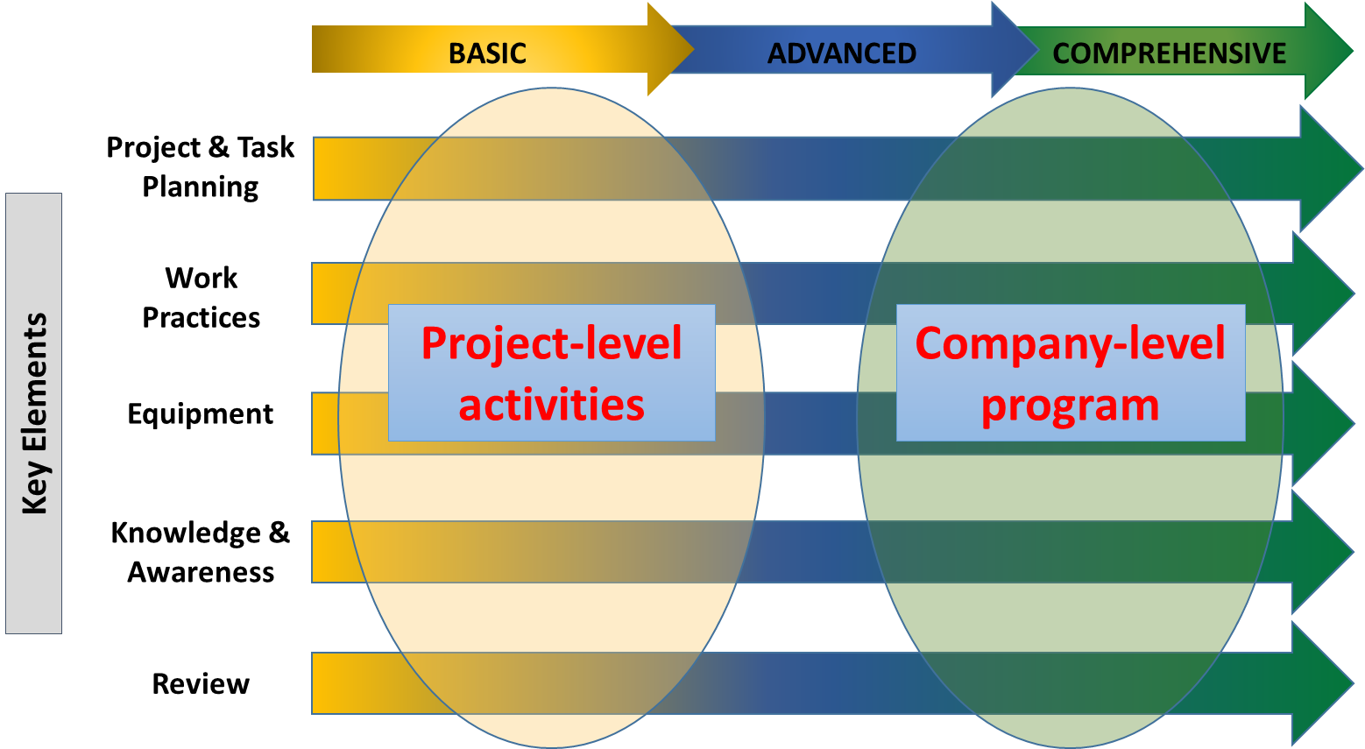
Process Improvement Method
Use a process improvement method to transition from project-level planning to a company-level ergonomics program
Plan-Do-Check-Act (PDCA) is a common model to create a systematic company-level program
Notes:
Whether you start working at the project level or across your entire company, your program must follow a process improvement method so it can achieve the results you desire – namely, to reduce soft tissue injuries and increase worker productivity.
Many companies use the plan-do-check-act model as a means to continuously improve their process and to create their company-level program.

Slide 37
Company-level ergonomics program
STARTING POINT:
Review injuries
Conduct hazard assessment
Select an ergonomic hazard
Plan
Do
  Include ergonomics in planning
  Develop best work practices and write them down (JHA)
  Provide equipment
  Train workers
  Company safety program & policies
  Set goals and objectives
Act
Check
  Discuss
  Modify plans
  Re-train
  Conduct audits
  Worker feedback
  Review OSHA log, EMR, injuries
Notes:
The Plan-Do-Check-Act model, shown here, is a continuous process improvement method.
Your company-level ergonomics program should start with developing a “plan” to address ergonomic hazards to prevent related soft tissue injuries as part of your company’s overall safety program. It should include your ergonomic policies, goals, and objectives.
Then “do” your plan. Train workers to identify ergonomic hazards, provide ergonomic equipment, and develop best ergonomic processes.
Then “check” periodically. Review your program to assess its effectiveness by conducting worksite audits, asking for worker feedback, and reviewing injuries and other indicators.
Based on the results from “check,” you should then “act” by taking steps to modify the program, re-train workers, and create new activities. By conducting ongoing and final reviews of your projects – a look back – you will be better positioned to identify lessons learned that can be applied to improve future projects.
The process improvement method will repeat itself in order to achieve your advanced or comprehensive company-level ergonomics program to reduce the risk for injuries.

Slide 38

Hierarchy of Controls for Manual Materials Handling
Elimination/Substitution
Stage: Bidding, Pre-Job
Who’s Involved: estimator, project manager, supervisors, suppliers
Engineering Controls
Stage: Bidding, Pre-Job, On-the-Job
Who’s Involved: estimator, project manager, supervisors, suppliers
Administrative Controls
Stage: Pre-Job, On-the-Job
Who’s Involved: project manager, supervisor, workers
Work Practices
Stage: On-the-Job
Who’s Involved: project manager, trainer, supervisor, workers
PPE & Other Protective Measures
Stage: On-the-Job
Who’s Involved: project manager, supervisor, workers
Notes:
An important part of this process is understanding and applying the Hierarch of Controls for Manual Materials Handling. Earlier we described how each level shows the most effective way to reduce risk. This graphic shows how these controls are addressed at different stages of the construction process and examples of the types of people in the organization to involve.
The highest levels of control, elimination and substitution and engineering, must be determined early during the Bidding and Pre-job stage, and involve the estimators, project managers, supervisors, and suppliers. While engineering controls can be revisited once work is underway., it’s important to plan and budget for them at the bidding stage.
As you move down the hierarchy to administrative, these controls are determined during the Pre-job and On-the-Job stages and involve the project manager, supervisor, and workers.
Work practices are determined On-the-Job and involve the project manager, trainer, supervisor and workers.
The lowest level of the hierarchy, PPE and other protective measures, is also determined during the On-the-job stage of construction and involves project managers, supervisors and workers.
As you move down the hierarchy, the effectiveness of the controls declines, so only controlling manual material handling risks during the “on-the-job” stage of construction is least effective.

Slide 39
How does a company get started?
PLAN
  Pick a specific hazard in your work
  Define one or more controls for the hazard & create a plan
DO
  Communicate plan, provide equipment, train workers
  Document compliance (checklist for equipment and training on each project)
CHECK: Review to verify that controls are consistently used
ACT:
Revise plan or expand controls to make robust over time
  Review and apply lessons learned to future projects
Bid Phase
Pre-job Phase
On-the-Job Phase
Review/
Look Back
Workers trained on use of equipment and team lifting
Audits --
check worker compliance with use of lifting equipment & team lift
ID Risk – lifting heavy load (low back pain)
Include Solution – use lifting equipment & team lift
Lifting equipmentdelivered to all projects
Checklist for equipment/ training returned to office
Quarterly monitoring – review checklist for compliance; end of project review
Notes:
How can contractors – including smaller companies -- who are new to planning around ergonomics get started using the Plan-Do-Check-Act model and applying the hierarchy of controls to each project stage listed on this slide? The process works the same for large and small size contractors but will likely start at the project level before working into a more advanced plan. The Best Built Plans Program that I mentioned earlier, and will touch on more later, has resources contractors of all sizes can use to develop their plan.
Here is a generic example. For your own plan, you would want to specify the material and the lifting equipment and/or work practices to be used.
At the bid stage, lifting a heavy load to install is identified so the bid included funds for the solution -- to use lifting equipment and team lifts for the material.
During The pre-job stage, the plan is reviewed and updated as needed to ensure steps are in place to ensure the lifting equipment will be delivered to the project when needed and all workers are trained on using the equipment and team lifting. The team lift could be the focus of a toolbox talk or a hands-on demonstration exercise from the Best Built Plans Worker Training Program.
During the on-the-job phase, the work is monitored on a regularly scheduled basis to check that the equipment is available onsite and accessible, workers are using the lifting equipment and proper team lifting, and all workers are trained. Daily or weekly checklist used and any documentation on training should be returned to your office.
The last stage is the review or look back. The plan, checklists, and other documentation are reviewed to assess how well the plan was implemented. The results are discussed with employees and input is solicited to help find solutions for areas where there was low compliance so the lessons learned can be used on future projects.

Slide 40

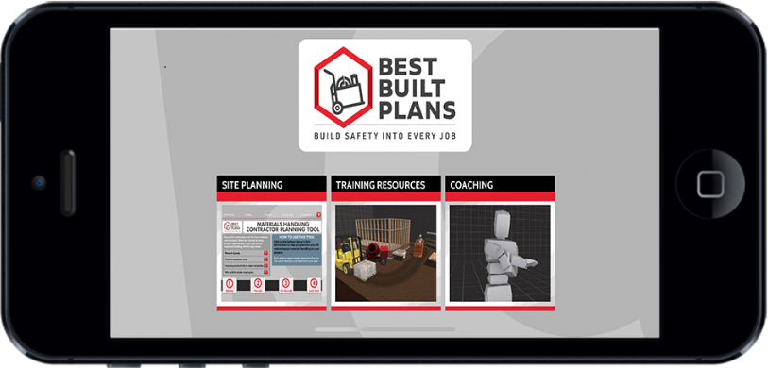
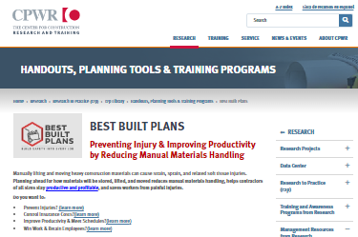
  Best Built Plans Resources www.bestbuiltplans.org
Addresses barriers by providing:
Planning questions, spreadsheets, & checklists
Training & Coaching Resources
Related materials (infographics, video, games, toolbox talks, hazard alerts, etc.)
Full Program available to download to your PC or as an App
Planning resources and additional training materials available directly online in English and Spanish
Notes:
The Best Built Plans program has resources contractors of all sizes can use to plan for safe materials handling at each project stage to reduce the risk for soft tissue injuries.
The full program, which includes interactive training and coaching resources, is available for download to your PC or as an app for Apple and Android devices.
The planning resources plus additional training and educational materials to use with your employees are also available directly online in English and Spanish.

Slide 41
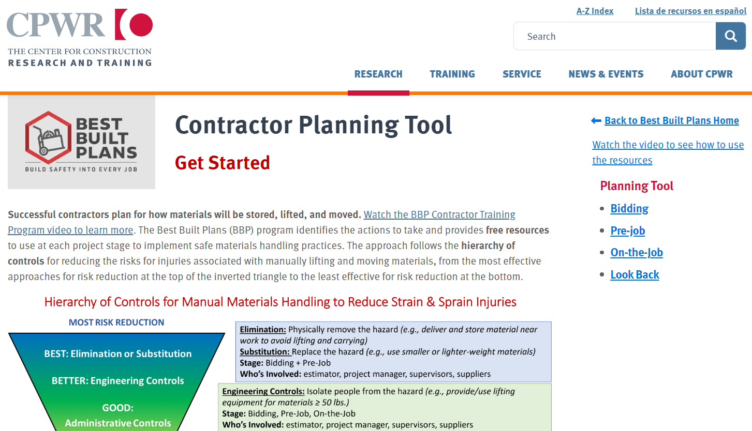
Help contractors…
A Planning Tool
Planning questions, spreadsheets, and checklists
Weights of materials
Storage options
Lifting options
Training resources
Video demos why, how, and when to use this resource
https://www.youtube.com/watch?v=kigonAjj2gU&t=1s
Notes:
The Best Built Plans Planning Tool includes resources and ways to involve everyone in your company – including your employees and trainers -- in reducing risks for soft tissue injuries.
Some of the materials and resources were specifically designed to help you develop your project-level plan and others were designed to help you implement it.
In addition to information on the benefits of reducing manual materials handling, the planning tool includes questions to consider and steps to take at each project stage, weights of common building materials, and examples of storage options and equipment to reduce the risks when lifting and moving materials.
In addition, there are spreadsheets and checklists to help you develop your bid and track what will be needed once work is awarded and underway. And finally, there are training materials that can be used on the job, in a class, and by workers on their own.
There is also a video in English and Spanish that walks you through how to create and implement a project-level plan.

Slide 42
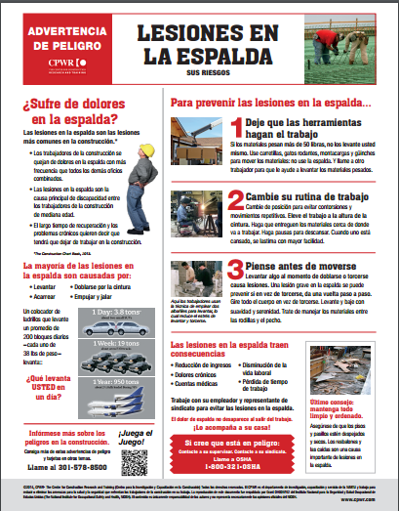







Notes:
This slide shows some of the resources to use with your employees. The images on the left show a hazard alert card, toolbox talk, and examples of infographics that can be used as reminders or posters on the job. The toolbox talk includes a QR code that links to the two free smartphone games, Lift Coach Plan Your Lift and Lift Coach Plan Your Route, shown on the right-hand side.
Both games were designed to reinforce safe practices. They can be used in a class or employers can encourage employees to play them after conducting the toolbox talk on safe lifting practices. The games may not appeal to all workers. The idea is to tap into the generations of workers who grew up playing video games and learning online.
All of these and other Best Built Plans resources are free and available in English and Spanish.
Other organizations have also developed planning resources that can be purchased, such as the ANSI.A10.1 standard.

Slide 43
Risk of opioid dependence from opioid prescriptions and illicit drugs
1 out of 4 people prescribed opioids for long-term pain become addicted.¹
Construction work can result in painful injuries; many are treated with prescription opioids (e.g., codeine, morphine, hydrocodone, oxycodone).
Estimated Annual Substance Use Cost for Employers with 100 Employees in Different Industries in Missouri²
 | Construction | Agriculture | Transportation
TOTAL COST | $143,636 | $45,324 | $78,123
Lost time | $ 43,792 | $ 7,328 | $21,189
Job turnover & retraining | $ 63,266 | $10,208 | $30,611
Health care | $ 36,578 | $27,788 | $26,323
Centers for Disease Control and Prevention. Promoting Safer and More Effective Pain Management. https://tinyurl.com/overdosefacts
National Safety Council, Substance Use Calculator : https://www.nsc.org/forms/substance-use-employer-calculator
Notes:
In addition to the benefits of developing and ergonomics program already discussed, another benefit of preventing injuries and pain up front is that your employees will not need pain medication.
Opioid dependence has become a serious issue for construction employers and their employees because construction workers are at risk for painful work-related injuries and opioids are commonly prescribed for pain relief.
According to the Centers for Disease Control and Prevention, 1 out of 4 people prescribed opioids for long-term pain become addicted.
As shown in the example in the table, a contractor with 100 employees in Missouri would spend over $143,000 annually to cover the costs related to managing those workers with substance use disorders. This would include higher costs from lost time, job turnover and retraining for terminated employees, and costs for healthcare.

Slide 44
How to protect your employees
Share resources with workers to ensure they understand that:
Opioids are strong, addictive medications that should only be used if they are prescribed by a doctor and determined to be the best option to manage the pain.
Misuse of opioid prescriptions, including taking more than the dose prescribed, taking someone else’s prescription, taking multiple opioid medications, or taking high doses for long periods of time can all lead to opioid dependency and addiction.
Before taking prescription opioids, they should FIRST ask their doctor for information on ALL available treatments for pain. There may be non-addictive medications or treatments available.
Notes:
You can help address this issue by providing your employees with information on what they can do to protect themselves when they seek treatment for painful conditions.
If your employees do get injured, there are resources that you can share with them to ensure they understand that:
Opioids are strong, addictive medications that should only be used if they are prescribed by a doctor and determined to be the best option to manage the pain.
Misuse of opioid prescriptions, including taking more than the dose prescribed, taking someone else’s prescription, taking multiple opioid medications, or taking high doses for long periods of time can all lead to opioid dependency and addiction.
Before taking prescription opioids, they should FIRST ask their doctor for information on ALL available treatments for pain. There may be non-addictive medications or treatments available.

Slide 45






Resources to help prevent opioid deaths in construction
www.cpwr.com
Notes:
Here are a few of the free resources available through the CPWR website in a section under “Mental Health and Addiction” that you can use or share with your employees.
The upper three images show a toolbox talk and hazard alert about opioid deaths in construction and prevention, and the cover of one of the materials in the opioid awareness training program developed for the industry with support from North America’s Building Trades Unions.
The bottom left is an infographic that presents the staggering statistics on the effects of the opioid crisis, and the last document is a physicians’ alert to provide clinicians with advice when treating construction workers for pain. Workers are encouraged to share this document with their doctors.
You can scan the QR code to retrieve these and other resources.

Slide 46
Summary: Reasons to develop an ergonomics program
Soft tissue injuries:
  Are common in the construction industry
  Cost the construction industry billions each year
  Are costly to individual employers
  Cause pain, which affects productivity, quality of life AND if treated with addictive opioids – can lead to addiction
An ergonomics program can:
  Prevent painful soft tissue injuries and risk for addiction
  Improve productivity
  Control insurance and other costs
  Preventing injuries upfront avoids the need for pain medications & risks for addiction later!
Notes:
To recap, a company should develop an ergonomics program because soft tissue injuries, which include strain, sprain and other overexertion injuries and are also referred to as musculoskeletal disorders - MSDs, are very common in the construction industry, cost the industry billions each year, and are very costly for employers in terms of, for example, lost productivity and higher insurance costs.
These injuries also lead to chronic pain, and this pain can affect productivity during work, lower worker morale, and negatively impact a worker’s quality of life in retirement. They also contribute to another more recent concern -- namely, the growing problem caused by the treatment of soft tissue injuries with prescription opioid medication.
There is new evidence that even short-term opioid use can lead to opioid dependency or addiction. This addiction is costly for workers, employers, and the industry. The annual substance use cost for a contractor with 100 employees in Missouri, for example, is more than $143,000.
Developing an ergonomics program at the company level or starting with a specific project can help your company prevent these painful injuries, reduce the need for pain treatments and risk for addiction, improve productivity, and control insurance and other costs.

Slide 47
Recommendations for building a successful ergonomics program:
Find a starting point:
  a) Review injuries
  b) Conduct an ergonomic hazard assessment of common work tasks
  c) Address manual materials handling risks
Select one or more of the five key elements to address the change:
  Create a plan or steps to consider ergonomics in addition to safety during project planning
  Define ergonomic work practices that reduce the hazards
  Find ergonomic tools/equipment to rent or purchase
  Educate/train to increase awareness
  Collect one or more leading indicators to monitor the program delivery and review progress
Notes:
To build an ergonomics program, find a starting point by identifying the ergonomic hazards on your jobs that you want to address using one or a combination of the following three methods:
Review injury data collected from past projects
Conduct a hazard assessment of common work tasks performed by your employees
Or start with manual materials handling risks.
Then use one or more of the five key elements to begin developing your ergonomics program to address the ergonomic hazards. The first three involve planning to identify the hazards and find interventions -- work practices and tools or equipment – to reduce the risk. These are good to use together since any plan should include solutions. It is also important to involve your employees in this process because they can provide valuable insights into the causes of the hazards and ideas for mitigating the risks.
It is also important to make sure through training and education that your employees are aware of the hazards and understand how to use the work practices and equipment in your plan to reduce the risks for injuries.
And finally, it is important to monitor your plan to ensure it is implemented as intended. In other words – to make sure the tools and equipment are available when your employees need them and, along with work practices, are properly used. As part of this step, it’s important to “Look Back” at the end of the project to understand what worked well or needs to be changed so that you can apply lessons learned on future projects.

Slide 48

Continuous Process Improvement
Follow the Plan-Do-Check-Act Model:
Notes:
Following the continuous process improvement - Plan-Do-Check-Act model shown on this slide will help you develop your program and continuously learn from and improve it – in other words, help you prevent ergonomics injuries on your projects.
Again, it is important to involve your employees throughout this process because they can provide important insights into what is working or not working and ways to improve the process and prevent injuries.

Slide 49

Take advantage of FREE resources
Best Built Plans – planning and training resources to help you reduce injuries associated with materials handling www.bestbuiltplans.org :
  Worksheets, weights of common materials, equipment options, checklists
  Training programs for use in a classroom setting and on-the-job
  Frequently updated with new resources identified by contractors and researchers including new types of equipment to prevent injuries
  A gateway to other ergonomics and safety resources
Be Patient. Know that change will happen gradually
but won’t happen without sustainable effort!
Notes:
CPWR’s Best Built Plans program provides free resources that can help you develop your project-level plans and build your company-wide ergonomics program.
These resources are available at www.BestBuiltPlans.org
Finally, be patient, developing a program and building a culture for your ergonomics program will take time.

Slide 50
Thank you!
CPWR and the Washington University Research Team
www.cpwr.com
www.bestbuiltplans.org
©2023, CPWR-The Center for Construction Research and Training. All rights reserved. CPWR is the research and training arm of NABTU. Production of this document was supported by cooperative agreement OH 009762 from the National Institute for Occupational Safety and Health (NIOSH). The contents are solely the responsibility of the authors and do not necessarily represent the official views of NIOSH.
Notes:
Please see CPWR’s websites for these and other materials.
Thank you. for your time and thank you from CPWR and the Washington University Research team for your efforts to prevent soft tissue injuries and improve the safety and health of the construction workforce.
DISCLAIMER: The contents of this document are intended only for the informational use of the addressee. The information contained herein is not intended as, nor does it constitute, specific legal or technical advice to the reader. Any information or recommendations contained herein are provided to the addressee for usage at their own discretion. Neither Signal Mutual Indemnity Association Ltd., its Members, Managers, or Signal Management Services, LLC and/or their employees accept liability whether in tort, negligence, contract, or otherwise, to anyone for any lack of technical skill, completeness of recommendations, or analysis of issues associated with the discussion of topics set forth herein. No responsibility is assumed for the discovery or elimination of unsafe conditions. Compliance with any recommendations herein should not assume your compliance with any federal, state, or local law or regulation. Additionally, the information contained herein does not constitute and shall not be construed to reflect the adoption of any coverage position by Signal Mutual Indemnity Association Ltd., its Members, Managers, or Signal Management Services, LLC and/or their employees.

