Slide 1
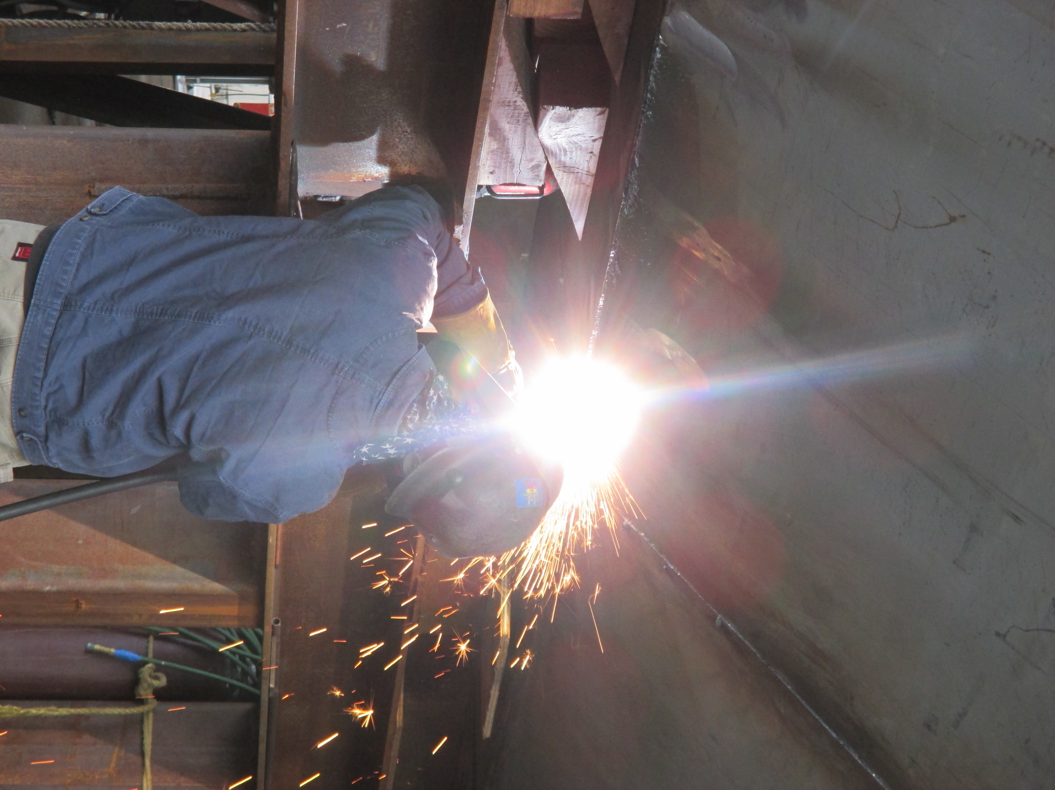

Fire Watch Training

Slide 2
Disclaimer:
The contents of this document are intended only for the informational use of the addressee. The information contained herein is not intended as, nor does it constitute, specific legal or technical advice to the reader. Any information or recommendations contained herein are provided to the addressee for usage at their own discretion. Neither Signal Mutual Indemnity Association Ltd., its Members, Managers or Signal Management Services, LLC and/or their employees accept liability whether in tort, negligence, contract, or otherwise, to anyone for any lack of technical skill, completeness of recommendations, or analysis of issues associated with the discussion of topics set forth herein. No responsibility is assumed for the discovery or elimination of unsafe conditions. Compliance with any recommendations herein should not assume your compliance with any federal, state, or local law or regulation. Additionally, the information contained herein does not constitute and shall not be construed to reflect the adoption of any coverage position by Signal Mutual Indemnity Association Ltd., its Members, Managers or Signal Management Services, LLC and/or their employees.

Slide 3


Slide 4
What is a Fire Watch?
OSHA mandates the presence fire watch personnel in the Code of Federal Regulations. Fire watch personnel provide surveillance of areas where “hot work”, such as welding or cutting with torches, is occurring. Fire watch workers may be part of a welding team that make sure that no smoldering fires result from cutting or welding metal. They are a vital part of construction and industrial maintenance safety programs.
The main job for fire watch personnel is to sound the alarm if there is an emergency so that firefighters can be brought in. They may attempt to control the fire, but their primary role is not to fight the flames, but to simply alert professionals so that they can come in and take care of it. A fire watch position is not permitted to perform any other duties.

Slide 5
Fire Watch Training Elements
Definitions and Terms for Clear Understanding of job duties.
Duties and Responsibilities.
Relationship between a Fire Watch and the Hot Work Operator.
Principles, Selection and Hazards of fire extinguisher use.
Activities to reduce fire hazards.
Incipient stage firefighting and the hazards involved.
Company Fire Safety Plan.
Proper fire reporting and alarm procedures.
Hands-on session - Extinguishing a live-fire.

Slide 6
Fire Watch and Hot Work Definitions
Adjacent Space: Spaces bordering a subject space in all directions, including all points of contact, corners, diagonals, decks, tank tops, and bulkheads.
Confined Space: A space that has adequate size and configuration for an entry, and has limited means of access, not designed for continuous occupancy.
Enclosed Space: Any space other than a Confined Space, which is enclosed by bulkheads and overhead, it includes cargo holds, quarters, machinery, and boiler spaces.
Fire Triangle: The triangle portion of a fire tetrahedron which represents three of the four components of fire: Fuel, heat and Oxygen.

Slide 7
Fire Watch and Hot Work Definitions, cont’d
Fire Watch: The activity of observing and responding to the fire hazards associated with hot work in shipyard employment and the employees designated to do so. Employees designated as Fire Watch are sometimes referred to as Fire Preventers and all personnel have a role as a fire preventer throughout the course of ship repair activities.
Fuel: Something that will produce heat by burning.
Hot Work : Work involving burning, welding, or a similar operation that is capable of initiating fires or explosions.
Incipient stage fire: A fire in the initial or beginning stage, which can be controlled or extinguished by portable fire extinguishers, Class II standpipe or a small hose system without the need for protective clothing or breathing apparatus.

Slide 8
Fire Watch and Hot Work Definitions, cont’d
Marine Chemist: An individual who possesses a current Marine Chemist Certification issued by the National Fire Protection Association.
Permit Authorizing Individual (PAI) The individual’s designated by management to authorize Hot Work. The PAI is permitted to be the supervisor, foreman, and owner. Can not be the hot work operator. (optional)
Shipyard-Competent Person (SCP) A person who is capable of recognizing and evaluating employee exposure to hazardous material or to other unsafe conditions and is also capable of specifying the necessary protection and precautions to take to be taken to ensure the safety of the employee as required by the applicable regulations. Is Designated in writing and maintained by the company.

Slide 9
Duties & Responsibilities
The hot work operator and the fire watch can at anytime necessary stop the hot work operation.
Fire watches shall not perform any other duties while hot work operations are being done.
Have visual, clear and immediate access to all areas associated with the hot work operation.
Visually inspect the hot work area.
  Ensure that all fire hazards within 35ft have been removed (trash, oily rags, flammable liquids, paper, etc.)
Protect customer property/equipment by barriers, that can not be removed from the work area. (fire cloth, welding blanket or other protective materials)
Ensure adequate communication is established between the fire watch and the hot work operator to indicate start and stop of hot work.

Slide 10
Duties & Responsibilities, cont’d
Fire Watch must remain hot work area for at least 30 minutes after completion of the hot work.
Attempt to extinguish any incipient stage fires.
Be familiar that most fire extinguishers will function for less than 40 seconds.
Fire extinguisher shall be within arms length, and you must remain standing where permissible, during hot work operations.
Be alert of changing conditions that may require the stopping of hot work.
Fire watches have the authority to alert and direct the hot work operator and other workers to stop work and leave the work site when if a fire breaks out.
Fire watches will be required to have in his or her possession a current Fire Watch training card.

Slide 11
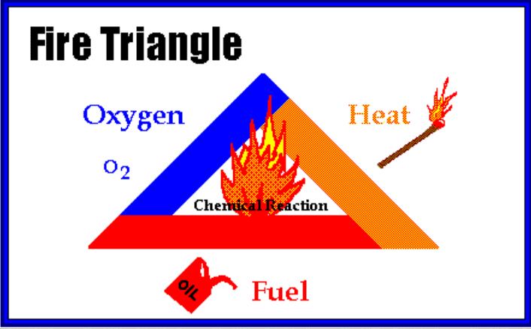
Fire Science
Basic components of a Fire:
Fuel
Source or ignition
Oxygen
Process of combustion
Commonly referred to as the Fire Tetrahedron, it adds the Chemical Chain Reaction to the three elements already present in the fire triangle.
Once a fire has started, the resulting exothermic chain reaction sustains the fire and allows it to continue until or unless at least one of the 3 elements is blocked.

Slide 12
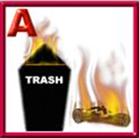

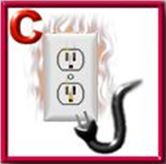
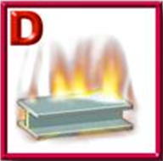
4 Classes of Fires
Class A
Ordinary combustibles or fibrous material, such as wood, paper, cloth, rubber, and some plastics.
Class B
Flammable or combustible liquids such as gasoline, kerosene, paint, paint thinners and propane.
Class C
Energized electrical equipment, such as appliances, switches, panel boxes and power tools.
Class D
Certain combustible metals, such as magnesium, titanium, potassium, and sodium.

Slide 13
The Operator & Fire Watch carry equal
Supervisor
Fire Watch Coordinator
Hot Work Operator
Fire Watch
weight in preventing unsafe Hot Work

Slide 14
Personal Protective Equipment
Fire Watches will wear all PPE required as standard in the yard, to include hard hat, safety toed footwear, safety glasses, and readily available hearing protection.
Additional PPE may be required. Training will be provided when equipment is issued, such as:
  #5 shaded goggles,
  face shields, and
  Respiratory protection.

Slide 15
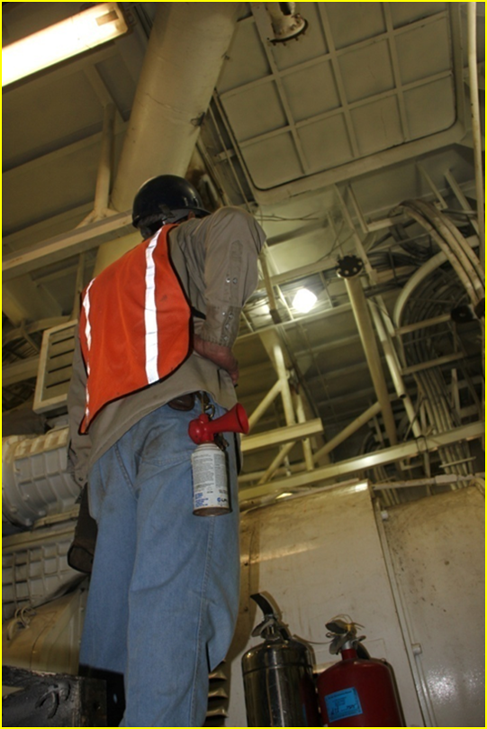
Posting of Fire Watch
A Fire Watch shall be posted prior to the commencement of hot work.
A Certified Marine Chemist or a shipyard Competent Person, as defined in OSHA 29 CFR 1915, Subpart B, requires that a fire watch be posted.
Fire watches shall be posted in all areas affected by the hot work operation to include all adjacent spaces affected by the hot work.

Slide 16
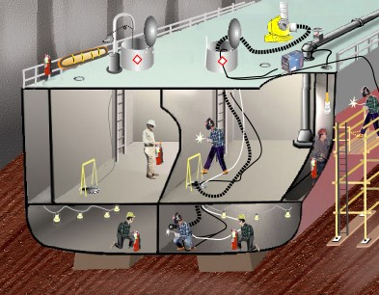
Identifying Adjacent Spaces
Adjacent Space: Spaces bordering a subject space in all directions, including all points of contact, corners, diagonals, decks, tank tops, and bulkheads.
Adjacent

Slide 17
Visual Inspection
Look for evidence prior to the start of hot work! Remember four things must be present to start a fire.
Oxygen: Must be present to support life.
A Heat source: The hot work operation – welding, grinding, etc.
Fuel: Trash, combustibles, and flammables.
Chemical Chain Reaction: The right ingredients at the right time.

Slide 18
Visual Inspection, cont’d
    Designated hot work areas shall be kept clear of all fire hazards. If hot work has to be performed within 35 feet of any combustible material, they shall be removed, or fire-resistant guards or curtains shall be utilized.
    Ensure that adequate LIGHTING, VENTILATION and ACCESSES are available.

Slide 19
Visual Inspection, cont’d
    Check to make sure that the temporary services such as ventilation, airlines, welding leads are not blocking egress route.
    Ensure adequate installed to remove excess smoke and/or fumes.
    Make sure that ships equipment that has been moved due to the hot work operation is not blocking the fire watches view of the hot work or the egress route.
    Ensure all required documentation (SCP Log, and Hot Work Notice) are posted and have been reviewed FOR ACCURACY.

Slide 20
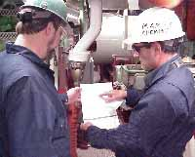
Communication
Hot work operators need to ensure that fire watches are posted correctly up to and including all adjacent spaces affected by the hot work.
Means of communication shall be established between the hot work operator and the fire watch(es).
Communicate the type of hot work to be performed and the hazards associated.

Slide 21
Fire Extinguishing Equipment Types
Class “A” water type extinguishers
CO2 Fire Extinguishers
Dry Chemical Extinguishers
CO2 Fire or Dry Chemical extinguishers are checked out through the Tool Issue Room
Automated/fixed/manual Fire Extinguishing Systems onboard ships

Slide 22
Selection & Application of Fire Extinguishers
Class “A” type water extinguishers are utilized for confined and enclosed spaces such as tanks, voids, inner bottoms, and cofferdams.
Class “A” type water extinguishers shall not be utilized in electrical rooms or during other conditions where electrical shock hazards exist.

Slide 23
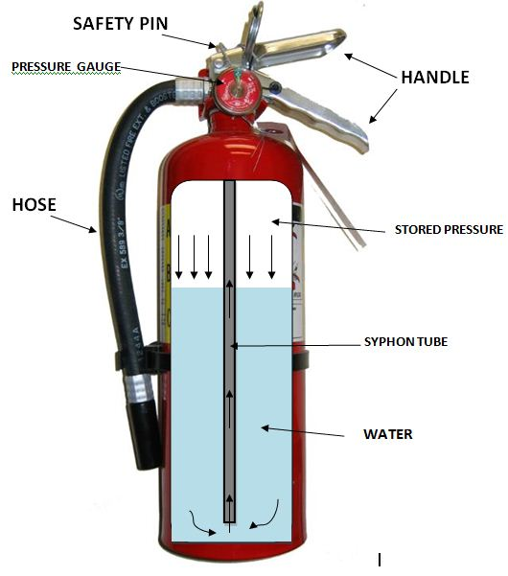
Water Fire Extinguisher
2 ½ Gallons of water.
Stored pressure.
Not used for Flammable liquids.
Not used for Flammable metals.
The pressurized release of this product will cause injury to the eyes.
The pressurized release of this product will cause injury to the skin.

Slide 24
Selection & Application of Fire Extinguishers
CO2 and Dry Chemical extinguishers are only authorized for work associated with electrical rooms or during other conditions where electrical shock hazards exist.
CO2 and Dry Chemical extinguishers shall not be utilized in confined spaces.

Slide 25
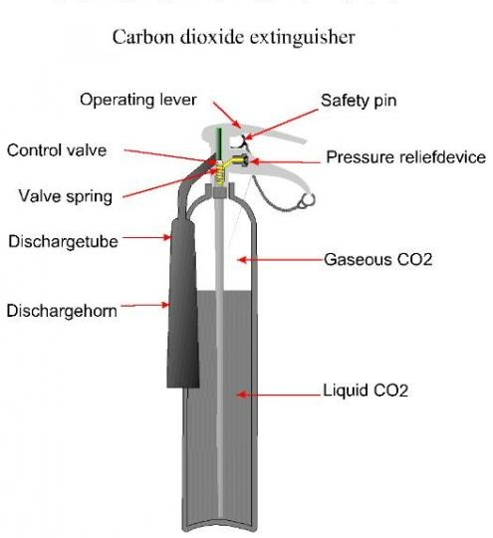
Co2 Fire Extinguisher
For use on Electrical, Flammable liquids.
Not for wood, paper and textile.
Not for use in confined space.
Contains gas under pressure; may explode if heated.
May cause frostbite.
May displace oxygen and cause rapid suffocation.
May increase respiration and heart rate.

Slide 26
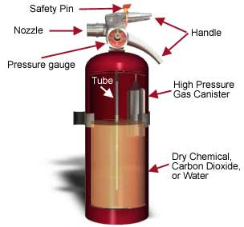
Dry Chemical Fire Extinguisher
For Chemical fires
For Paint fires
For Electrical fires
For trash, rags and paper

Slide 27
Hazards of Dry Chemical Fire Extinguisher
INHALATION: Inhalation of this product should be avoided, but if it occurs, may cause mild irritation of the nose, throat, and other tissues of the respiratory system.
CONTACT WITH SKIN OR EYES: Contact of dust from this product with the eyes may cause moderate irritation, reddening of the affected eye, and discomfort.
INGESTION: Ingestion of this product may cause gastric distress.

Slide 28
Fire Extinguisher Maintenance
Class “A” type water extinguishers shall be inspected daily prior to use for the following:
  That extinguisher is not damaged, and the nozzle is unobstructed.
  That the extinguisher is fully charged weighing between 27 and 28 pounds.
  Ensure that the safety pin and seal is intact.
  That the pressure gage is in operable range (Green).
  Complete check out log to identify inspection has been conducted with fire watch coordinator.

Slide 29
Fire Extinguisher Maintenance (cont.)
CO2 and Dry Chemical extinguishers must be inspected daily for damage and have a safety pin and seal intact.
Any extinguisher used or damaged must be removed from the job site immediately and returned for refilling and or repairs.
Any extinguisher discharged no matter the reason shall be immediately reported to management.

Slide 30
BEFORE You Consider Extinguishing a Fire . . .
Confirm that the fire is small enough and is not spreading.
Confirm you have a safe path to an exit not threatened by the fire.
You know what kind of extinguisher is required and the correct extinguisher is immediately at hand.

Slide 31
NEVER Attempt to Extinguish a Fire if..
The fire is spreading beyond the immediate area in which it started or if it is a large fire.
The fire could block your escape route.
You are unsure of the proper operation of the fire extinguisher.
You doubt that the fire extinguisher you are holding is designed for the type of fire at hand or is large enough to fight the fire.

Slide 32
Tips on How and When to Use a Fire Extinguisher
Most fires start small. Except for explosions, fires can usually be brought under control if they are attacked correctly with the right type and size of extinguisher within the first 2 minutes!
A fire extinguisher should be "listed and labeled" by an independent testing laboratory. The higher the rating number on an A or B extinguisher, the more fire it can put out. Be careful, high-rated units are often heavier models. Make sure you can hold and operate the model you are using.
Before attempting to fight a small fire, be sure everyone is out of the area. Ensure someone has called or gone to the quarter deck. If the fire starts to spread or threatens your escape path, get out immediately!
The operator must know how to use the extinguisher quickly without taking time to read directions during an emergency. Remember that the extinguishers need care and must be recharged after every use.
Before attempting to fight a small fire, be sure everyone is out of the area. Ensure someone has called or gone to the quarter deck. If the fire starts to spread or threatens your escape path, get out immediately!
The operator must know how to use the extinguisher quickly without taking time to read directions during an emergency. Remember that the extinguishers need care and must be recharged after every use.
Notes:
Replace flintstones

Slide 33
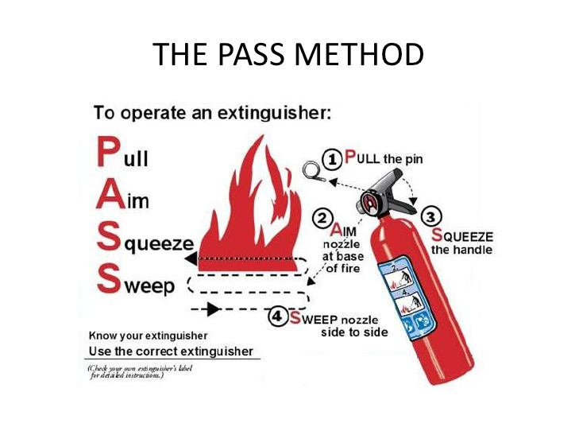
IF YOU FIGHT A FIRE: REMEMBER THE WORD P. A. S .S.
PULL . . . AIM . . . SQUEEZE . . . SWEEP
PULL... the pin. Some extinguishers require releasing a lock latch, pressing a puncture lever or other motion.
AIM... low, pointing the extinguisher nozzle (or it's horn or hose) at the base of the fire.
SQUEEZE... the handle. This releases the extinguishing agent.
SWEEP... from side to side at the base of the fire until it appears to be out. Watch the fire area in case fire breaks out again and repeat use of extinguisher if necessary.
Read and follow the directions on your extinguisher. If you have the slightest doubt about whether or not to fight a fire – DON’T!

Slide 34
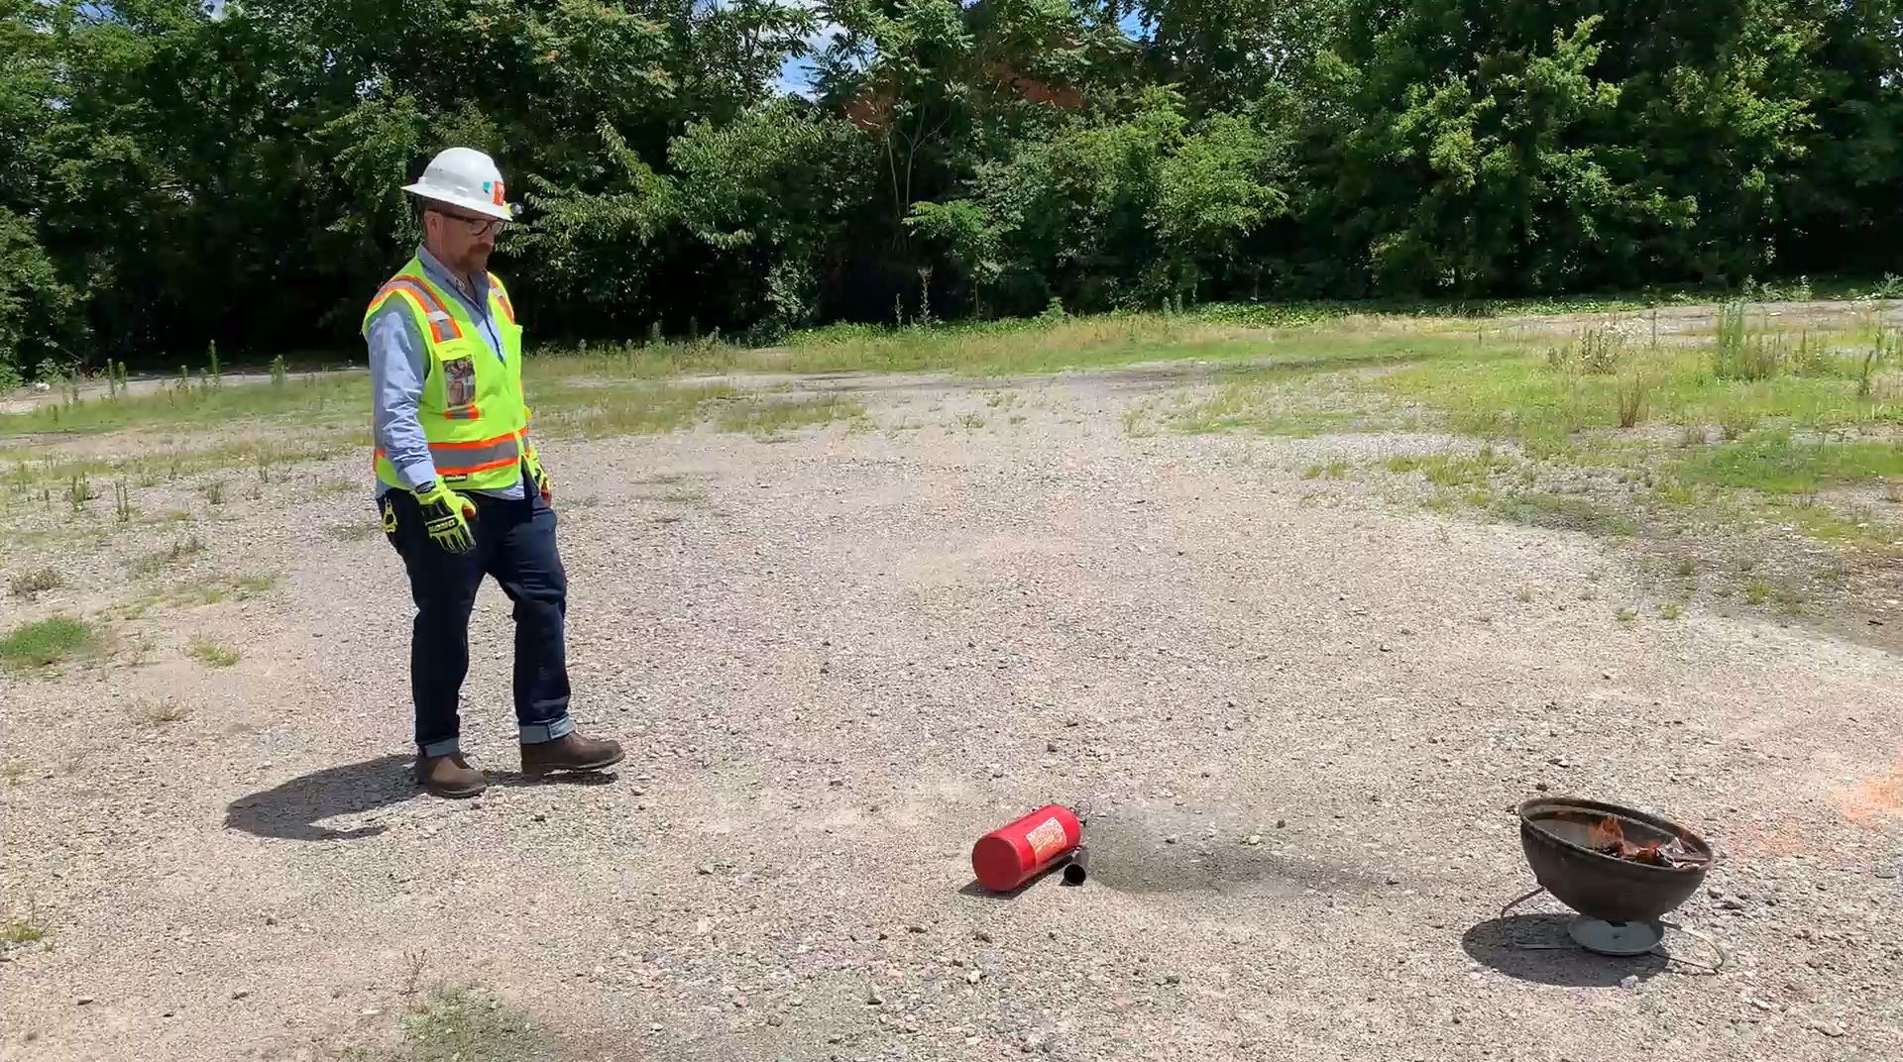

Slide 35
Procedures for Evacuation
Evacuations
  There are several reason that vessel or facility would have to be evacuated.
    Once an alarm has sounded over the company’s or vessel’s communications system, employees must immediately exit the area or vessel. All employees will meet at a pre-designated muster area and stay there until released by a supervisor.
    The muster identified on the pier by a sign. It is critical for each evacuated employee to be accounted for and reported to the customer. This confirms that you are safe and out of danger.
Notes:
and some of these are Security concerns, flooding, and fire

Slide 36
Familiarization with Adverse Health Affects Caused by Fires
Smoke Inhalation
Cough, Shortness of breath, hoariness or noisy breathing;
Eyes may be red and irritated by the smoke, and there may be burns to the corneas in the eyes;
Skin color may range from pale to bluish to cherry red;
Can cause headaches and change in mental status.
Think about what on the ship which might be burning!
Petroleum-based lubricants, paints, permeated cloth, etc.

Slide 37
Summary and Important Reminders: Procedures
Ensure that all compartments have been check by a Marine Chemist and/or Shipyard Competent Person and that conditions are “safe for hot work” (Company Hot Work Procedures).
Have a valid hot work notice posted in accordance with company policy. It must be verified, the checklist must be in order and up to date, signed by the Hot work Operator, Fire Watch, Hot work Supervisor and PAI (Permit Authorizing Individual).
Ensure that engineering controls are followed (OSHA 29 CFR 1915).

Slide 38
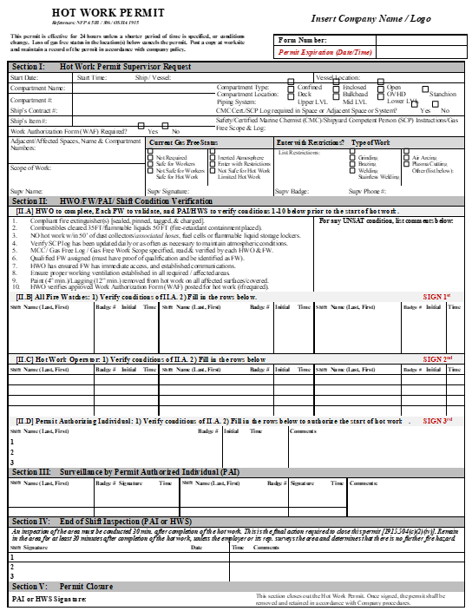
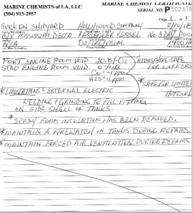
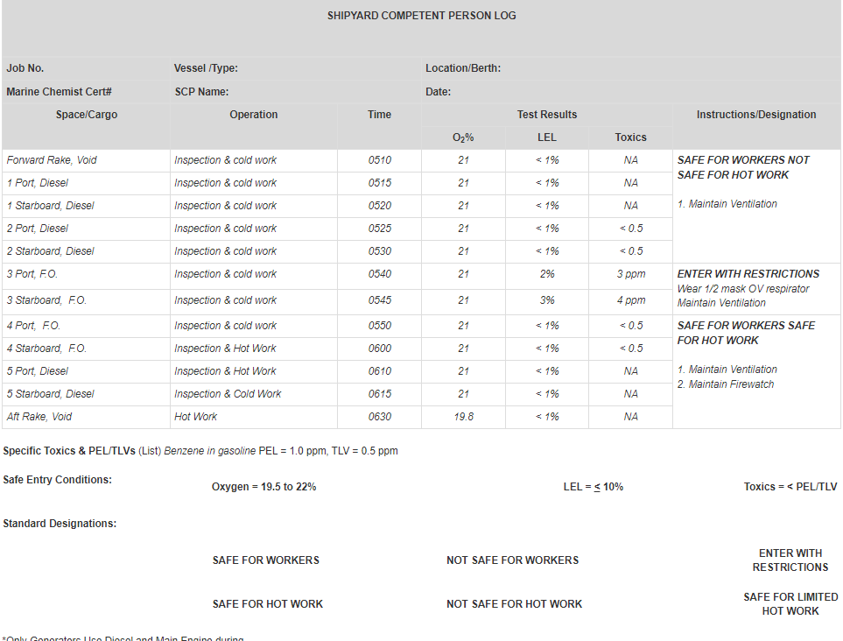
Hot Work Permit
Example Documents
Marine Chemist Certificate
SCP Ticket

Slide 39
Summary and Important Reminders: Prevention
Taking action and being responsible prior to performing hot work
  Follow procedures;
  Identify adjacent spaces affected by the hot work operation;
  Visual inspection (identifying and removing hazards;
  Establishing Communication between the hot work operator and the Fire Watch.

Slide 40
Summary and Important Reminders: Prevention (cont.)
  Continually looking for any environmental or physical change in the work area that could cause a hazard, and all work shall be stopped and space reevaluated.
    Thoroughly inspect all work areas affected by the hot work for smoldering or hot spots. Fire watch shall remain at the job site for 30 minutes from the time the hot work is completed unless the Hot Work Supervisor surveys the affected work area and determines that there is no further fire hazard.

Slide 41
OSHA Regulatory References
29 CFR 1915.14 Hot Work
29 CFR 1915.35 Painting
29 CFR 1915.36 Flammable Liquids
29 CFR 1915.503 Precautions for Hot Work
29 CFR 1915.504 Fire Watches
29 CFR 1915.505 Fire Response
29 CFR 1915.506 Hazards of Fixed Systems
29 CFR 1915.508 Training Requirements
NFPA 51B Standard for Fire Prevention During Welding
NFPA 306 Standard for the Control of Gas Hazards on Vessels

Slide 42
Fire Preventer Training

Slide 43
QUESTIONS?
SAFETY FIRST
QUALITY ALWAYS

Slide 44
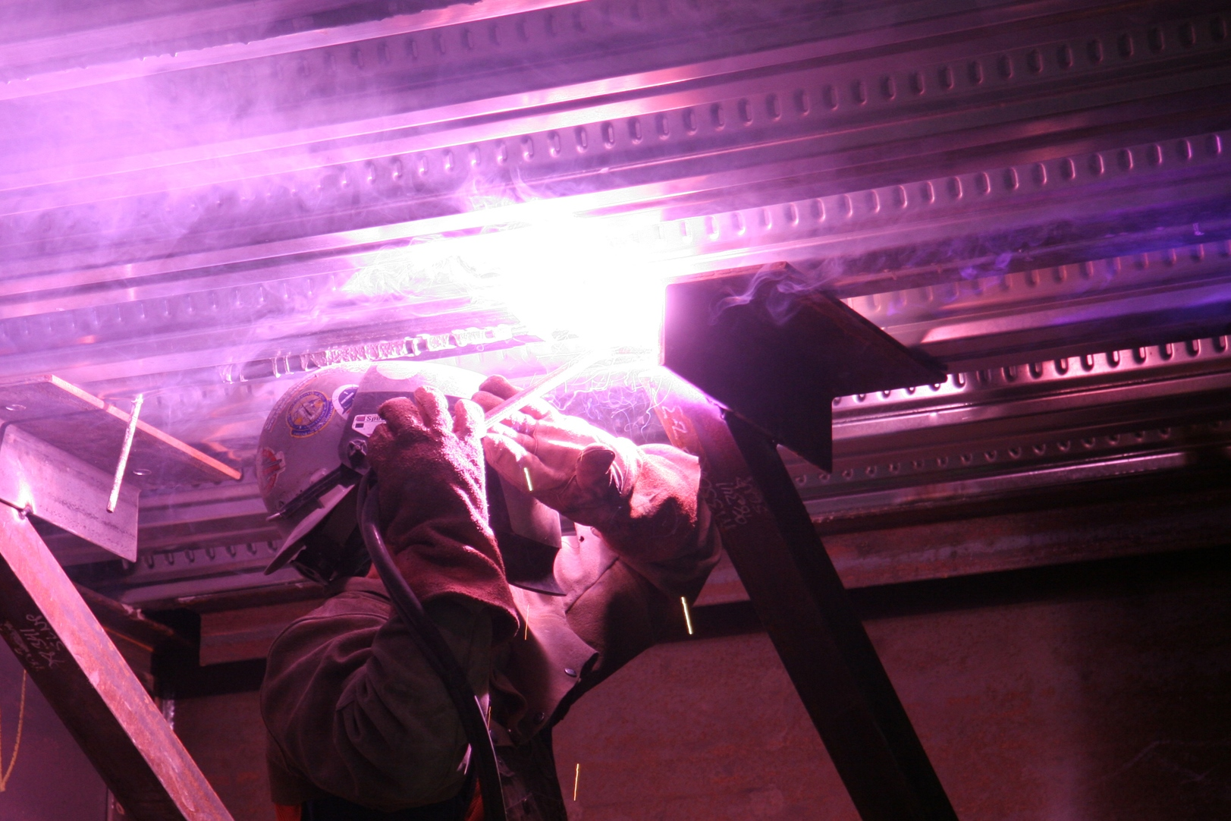
Photo for use as needed

Slide 45
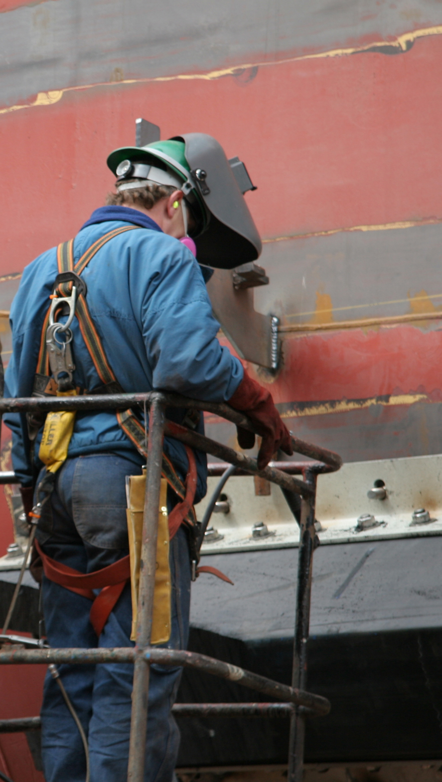
Photo for use as needed

Slide 46
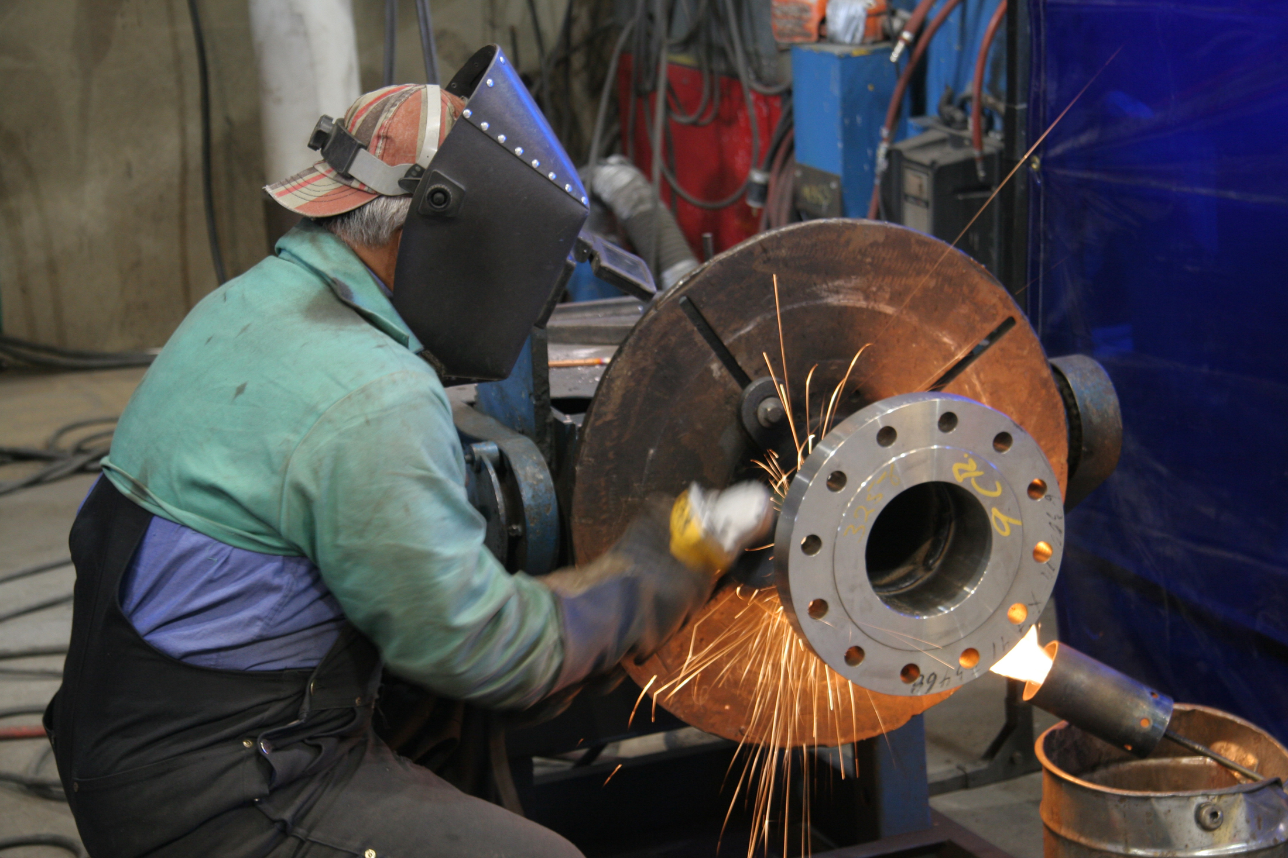
Photo for use as needed

Slide 47
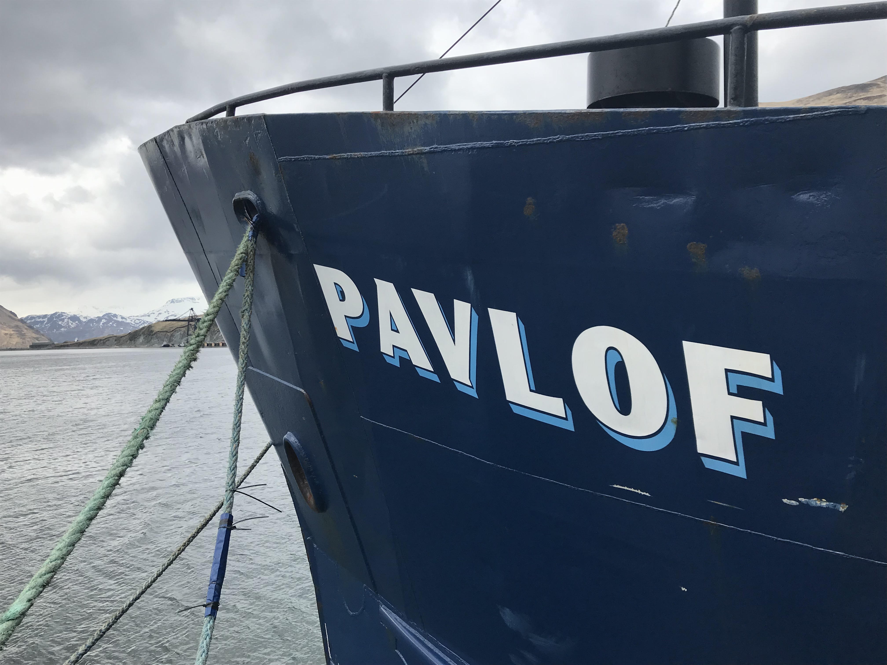
Photo for use as needed

Slide 48
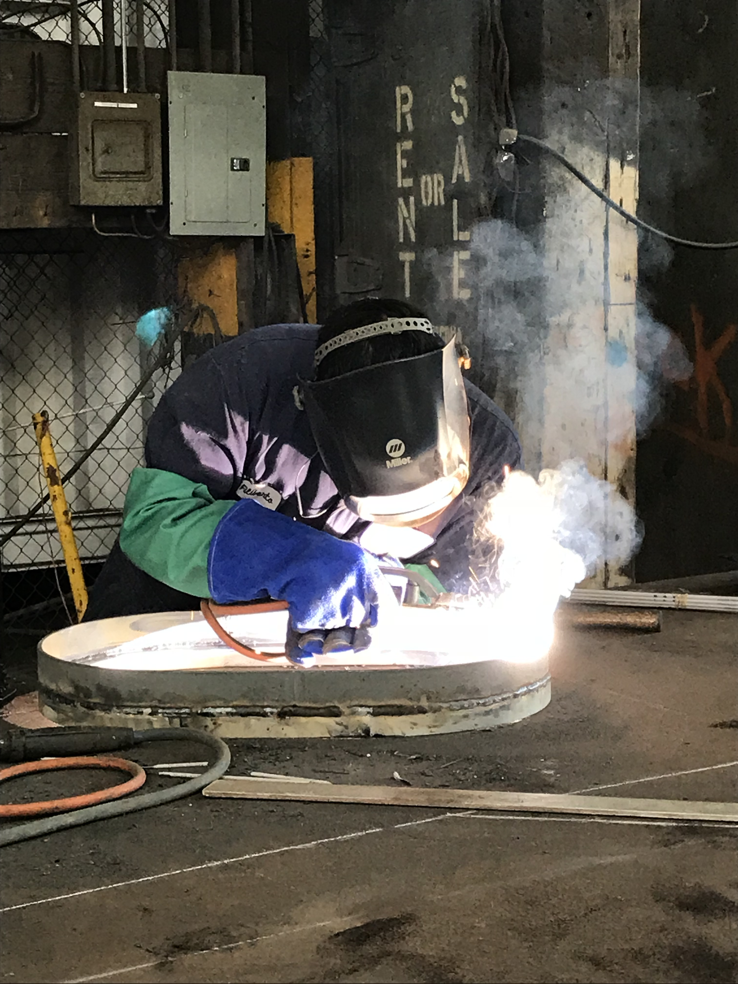
Photo for use as needed

Slide 49
Training Outline
Fire Watch Training Requirements
Fire Watch Duties and Responsibilities
Personal Protective Equipment (PPE)
Important Definitions
The Fire Tetrahedron
Components, classes and health considerations of fires
Fire Extinguishers (Fixed/Portable): Types, Selection, Tips, Application, Hazards, Maintenance, and Use Considerations
Posting of the Fire Watch and Identifying Spaces
Visual Inspections and Communication
Alarms, Reporting Emergencies and Evacuation Procedures
Fire Prevention

Slide 50
Fire Watch Training Elements
Understanding of the duties and responsibilities of Fire Watch, and the
equipment provided for use.
Knowledge and understanding in the selection, use and maintenance of
required Personal Protective Equipment (PPE)
Proper selection and general principles of using fire extinguishers; including the
hazards associated with fire extinguishers during discharge;
Proper procedures used to reduce fire hazards;
Hazards involved with incipient firefighting;
Proper fire reporting and alarm procedures;
Company Fire Safety Plan

Slide 51
Fire Watch Policy
The Fire Watch Policy is a stand-alone document which details critical Fire Watch duties, expectations and responsibilities.
Key elements include:
  All Fire Watch personnel must receive effective training (in accordance with 29 CFR 1915-504). To include: the selection of PPE, company expectations and limitations of fire-fighting, reporting of emergencies, visual inspections responsibilities.
  The Fire Watch Coordinator is responsible for onsite (specific) training to all Fire Watch personnel.
All Fire Watch will be personnel visibly identified, by an orange hard hat. They must also carry their Fire Watch card at all times;

Slide 52
Fire Watch Policy (cont.)
Fire Watch personnel only being authorized to extinguish fires in the incipient stage;
Fire Watch personnel levels of knowledge and understanding of their duties (or the concern of inability) and potential removal from Fire Watch duty until retrained;
Fire Watch personnel yearly refresher training requirements.

Slide 53
Duties & Responsibilities (cont.)
Fire extinguisher shall be within arms length and you must remain standing where permissible, during hot work operations;
Be alert of changing conditions that may require the stopping of hot work;
Fire watches have the authority to alert and direct the hot work operator and other workers to stop work and leave the work site when if a fire breaks out.
Fire watches will be required to have in his or her possession a current Fire Watch training card.

Slide 54
Familiarization with Adverse Health Affects caused by fires (cont.)
Burns
Blisters
Pain, the degree of the pain is not related to the severity of the burn, the most serious burns can be painless;
Peeling skin;
Shock, symptoms of shock may include pale and clammy skin, weakness, bluish lips and finger nails, swelling and white or chaired skin.

Slide 55
Automated / fixed / manual Fire Extinguishing Systems onboard ships
  Before any work is accomplished in spaces with fixed extinguishing systems that have the potential to create a dangerous atmosphere when activated; the systems must be physically isolated or by other positive means to prevent accidental discharging into the space.
  Supervisors are required to train / inform workers of the hazards and recognition of the systems. Associated piping, linkage, detection, activation and alarm devices awareness shall be discussed.

Slide 56
Automated/fixed/manual Fire Extinguishing Systems onboard ships (cont.)
  The following fire extinguishing systems are commonly found onboard vessels.
Fixed Carbon Dioxide (C02)
Fixed AFFF – bilge sprinkling
Halon – automated
Sodium Bromide – Galley
Portable – PKP
Portable – Carbon Dioxide (C02)
Fire Fighting Stations

Slide 57
Automated/fixed/manual Fire Extinguishing Systems onboard ships (cont.)
Fixed systems onboard are only activated and / or used by ship personnel. Contractor / sub-contractor personnel are not, under any circumstances, to operate any shipboard fixed fire extinguishing systems.
Shipboard fixed extinguishing systems: Halon, C02 are to be isolated or secured only by direction of the ship’s Captain or the designated representative. Employees will be trained prior to entering/working in spaces with active shipboard fixed extinguishing systems.

Slide 58
Halon Fixed System Alarms
Halon systems are both audible, (horn or siren) and visual, (flashing red lights) are located both manned and unmanned spaces and are manually activated by ships crew.
Manned Spaces such as the Main Engine, Auxiliary spaces the alarms have a 60 second delay for emergency egress.
Unmanned Spaces such as paint locker, Flammable storage spaces have a 30 second delay.

Slide 59
Shipboard Alarms and how to report fires to the ship:
  Should a fire start on board ship, contact the quarter deck immediately. State the compartment i.e. 6-215-0-L and the nature of the emergency (Fire, Medical, etc.)
  The quarter deck will rapidly ring bells and make an announcement of FIRE, FIRE, FIRE over the ship’s communications system with details regarding the location and type of the fire.

