Slide 1
Risk Assessment Awareness Training
7/26/2024

Slide 2
Disclaimer
The contents of this document are intended only for the informational use of the addressee. The information contained herein is not intended as, nor does it constitute, specific legal or technical advice to the reader. Any information or recommendations contained herein are provided to the addressee for usage at their own discretion. Neither Signal Mutual Indemnity Association Ltd., its Members, Managers, or Signal Management Services, LLC and/or their employees accept liability whether in tort, negligence, contract, or otherwise, to anyone for any lack of technical skill, completeness of recommendations, or analysis of issues associated with the discussion of topics set forth herein. No responsibility is assumed for the discovery or elimination of unsafe conditions. Compliance with any recommendations herein should not assume your compliance with any federal, state, or local law or regulation. Additionally, the information contained herein does not constitute and shall not be construed to reflect the adoption of any coverage position by Signal Mutual Indemnity Association Ltd., its Members, Managers, or Signal Management Services, LLC and/or their employees.

Slide 3
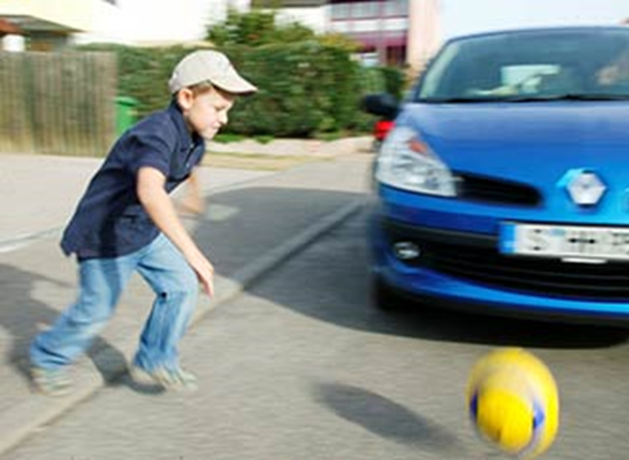

Slide 4
How is YOUR Perception of Risk Acquired?
FORMAL INSTRUCTION
Professional training, organizations, and schools
EXPERIENCES
Parents, coaches, and OJT
The sense of risk we are born with
INNATE

Slide 5
What is Your Current Level
of Risk Assessment?

Slide 6
Hazard vs Risk
Notes:
What is a hazard? What is Risk?

Slide 7
“HAZARD” DEFINITION
WHAT IS A HAZARD?
an unwanted condition or practice that could cause an injury or illness

Slide 8
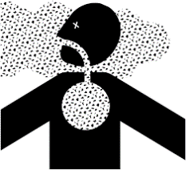
Types of Hazards

Slide 9
WHAT IS RISK?
combination of the likelihood of occurrence of a hazardous event or exposure and the severity of injury or ill health that can be caused by the event(s)
Notes:
In defined circumstances, such as:
human injury
ill health
damage to property
damage to the workplace
damage to the environment

Slide 10
HAZARD vs RISK
RISK
How great the chance of harm will be
HAZARD
Anything that can cause harm

Slide 11
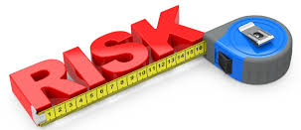
RISK ASSESSMENT
The process of estimating the magnitude of risk and deciding if the risk is tolerable.

Slide 12
Benefits of Risk Assessment
Worker participation
Identifies Weaknesses in System
Evaluate adequacy of current controls
Establishes action items and priorities

Slide 13
PLAN
Planning
Leadership
and
Worker
Participation
Support
and
Operation
ACT
DO
Improvement
Performance
Evaluation
CHECK
Notes:
JRB

Slide 14
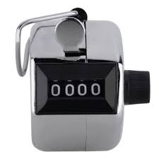
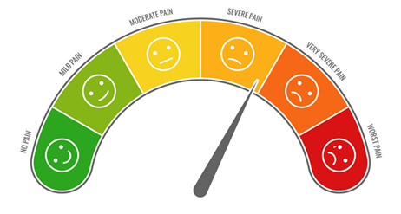
Probability
Severity
Frequency
The likelihood that a loss will occur
The magnitude of a loss
The number of exposures in a given time interval

Slide 15
Assessment or Investigation?

Slide 16
What are the top
5 risks at your jobsites?

Slide 17
Risk Controls
Measures that reduce or control risks. They are opportunities to prevent or minimize losses.
UNDERSTANDING RISK

Slide 18
Hierarchy of Controls
Place the controls in the order of effectiveness.
Substitution
Administrative
Engineering
Personal Protective Equipment
Elimination

Slide 19
Managing Risk
High
Transfer
Terminate
shift exposure to a partner
a decision is made not to engage in activity
Consequence
Tolerate
Treat
risk is at a reasonable level and no further action is practical
introduce controls
Low
Likelihood
High

Slide 20
Acceptable Risk
The level of risk deemed tolerable to an organization given its policies, obligations, and purpose
Unacceptable Risk
Anything identified by a risk assessment that must be terminated, transferred, or treated
ALARP
As low as reasonably practicable

